Slide 1

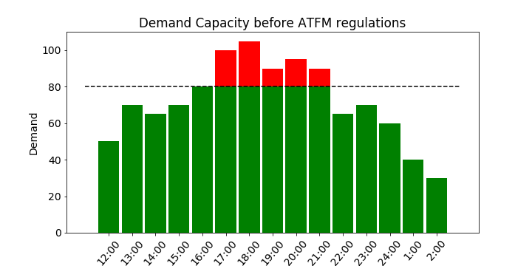
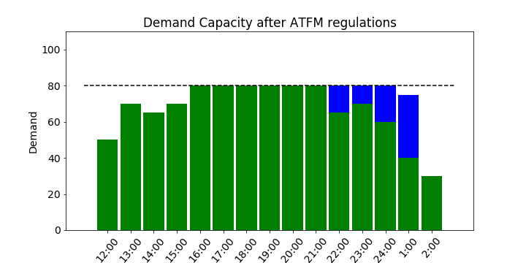









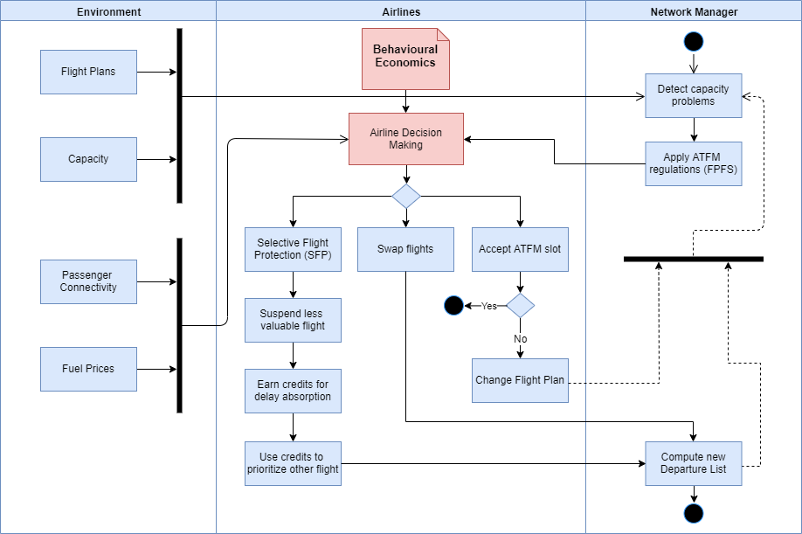
Evaluating UDPP Concepts through Computational Behavioural Economics
Flight prioritization under demand-capacity imbalances
ATFM
Which flight prioritization mechanism provides the best performance?
Evaluation of flight prioritization mechanisms through CBE
Scenarios
Agent Based Model
Performance Framework
Network
Airports
Sectorization
Capacity
Agents
Network Manager
Airlines
Behaviour
Behavioural Economics:
Prospect Theory
Bounded Rationality
Hyperbolic Discounting
KPAs
Capacity
Predictability Punctuality
Cost Efficiency
Flexibility
Access and Equity
Environment
Robustness
Demand
Passenger Connectivity
Flight Schedules
Mechanisms
SESAR UDPP: Step1 & Step 2
Monetary: Auctions
Non-Monetary: Flexible Credits
Simulation experiments
Example: SESAR UDPP Selective Flight Protection (SFP) Workflow
This project has received funding from the SESAR ENGAGE Network under the European Union’s Horizon 2020 research and innovation programme under grant agreement No 783287. The opinions expressed herein reflect the authors’ view only. Under no circumstances shall the SESAR Joint Undertaking be responsible for any use that may be made of the information contained herein.
David Mocholí González (Nommon)
david.mocholi@nommon.es

