Slide 1
INFORMATION DAY
SESAR 3 Digital European Sky
Second Exploratory research Call for Proposals
HORIZON-SESAR-2023-DES-ER-02
7 July 2023

Slide 2
Before starting the meeting…
- The meeting will be recorded – please let us know if you do not agree
- Participants will be muted during the speakers’ presentations – please use the chat to ask your questions
- The presentation and the recording will be available on SESAR 3 JU website

Slide 3



AGENDA
INFORMATION DAY
SESAR 3 Digital European Sky
Call for Proposals
EXPLORATORY RESEARCH 02
Virtual event
07 July 2023
10:00 | Digital European Sky (DES) programme overview Alfredo Gomez
10:10 | DES Exploratory Research – second call Alfredo Gomez
10:30 | Programme management and Communication, Dissemination & Exploitation Olivier Mongenie & Triona Keaveney
10:50 | Horizon Europe Call evaluation and procedures Manuela Alfé
11:10 | Legal and financial aspects of grants – key messages Manuela Alfé
11:20 | Tips and tricks for proposal submission Manuela Alfé
11:30 | Questions and answers
12:00 | ENDS

Slide 4
SESAR 3 DIGITAL EUROPEAN SKY
OVERVIEW
Alfredo Gomez de Segura

Slide 5
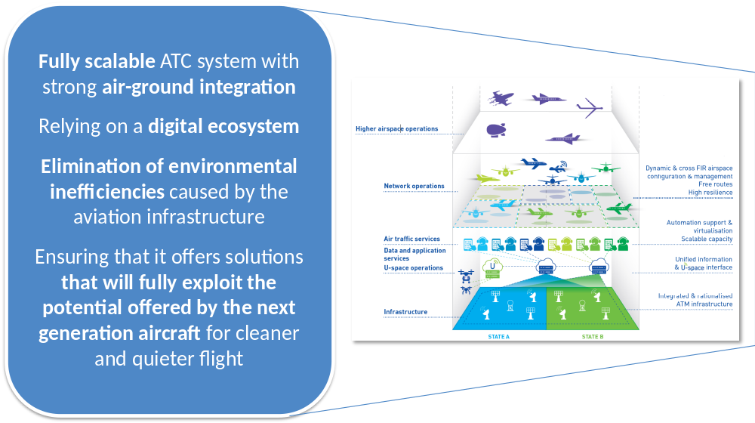
New vision aims at delivering a digital European sky by 2040

Slide 6
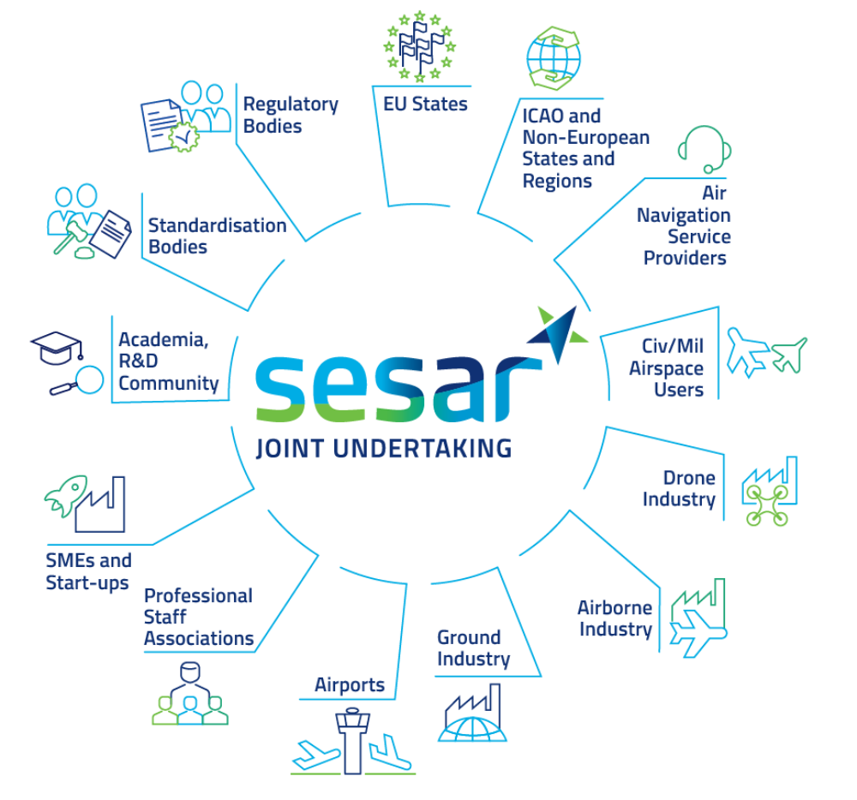



SESAR 3 JU a new instrument to implement the vision
Accelerate through research & innovation the delivery of an inclusive, resilient & sustainable Digital European Sky
50+ founding members representing entire aviation value chain (incl. new entrants)
• Horizon Europe - EUR 600 million
• Eurocontrol – up to EUR 500 million (in-kind & financial contributions)
• Industry - EUR 500 million minimum (in-kind & financial contributions)
Additional funds via Connecting Europe Facility (in coordination with CINEA) to the value of at least EUR 200 million.

Slide 7
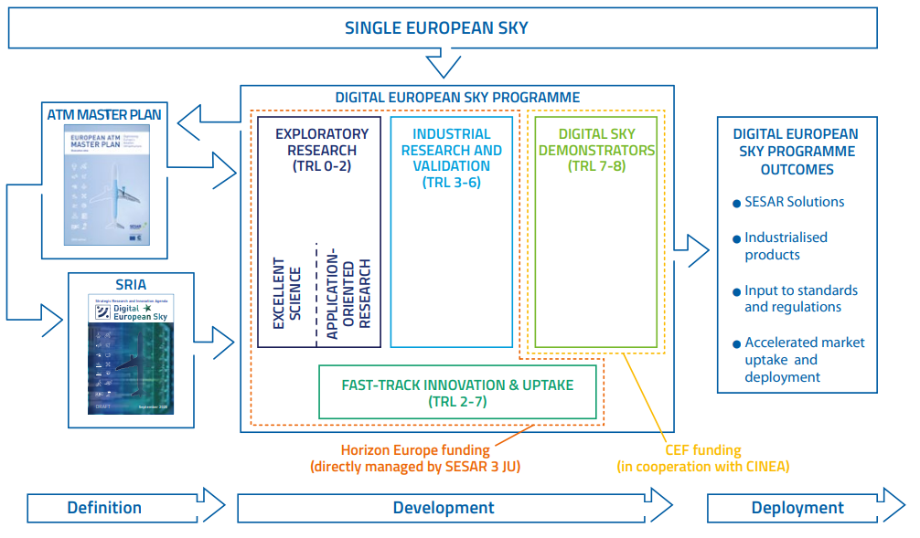
Connected to policy and regulation
The SESAR 3 JU innovation pipeline is part of the broader SESAR project (covering definition) and of the Single European Sky initiative

Slide 8


SESAR 3 JU Work Programmes
Establishes the framework for the definition, planning and execution of the SESAR 3 JU operations from 2021 to 2031;
Defines the overall lifecycle of the R&I programme;
Defines the main principles for budget allocation.
Outlines the scope of R&I activities to be performed in 2022 & 2023;
Defines the Calls Conditions and Technical Content:
  Annex II section 2.2 : Call HORIZON-SESAR-2023-DES-ER-02

Slide 9
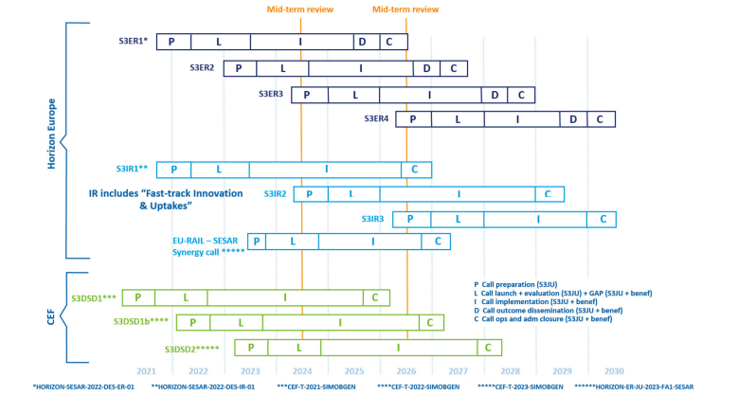
SESAR 3 Calls
S3 ER2 call schedule
Publication : 29 June 23
Info day : 7 July 23
Deadline : 15 November 23
Signed Grants : by 15 July 24

Slide 10









Digital European Sky research and innovation flagships
(“Destinations” for Horizon Europe)

Slide 11
DES EXPLORATORY RESEARCH ER-02
Alfredo Gomez de Segura

Slide 12
ER-02 Call structure
ER
Excellence science and outreach
ATM Application-oriented Research
Connected and automated ATM
WA1 9M€
WA2 16M€
Innovation Flagships are the backbone of the ER-02 call;
Working Areas (WA) defined per R&I Pillar;
WA addresses some flagships;
Topics per WA & Flagship;
Budget allocation per WA.
Air-ground integration and autonomy
Capacity on demand and dynamic airspace
U-space and urban air mobility
Virtualisation and cyber-secure data sharing
Multimodality and passenger experience
Aviation green deal
Artificial intelligence for aviation
Civil-military interoperability & coordination

Slide 13
SESAR 3 Programme principles (ER proposal template section 2.1)
Proposals shall in particular demonstrate:
  A high potential contribution to establishing Europe as the most environmentally friendly to fly in the world
  A significant contribution to the realization of the Digital European Sky vision (SESAR Phase D)
    Fully scalable ATM system supported by a digital ecosystem; we are looking for innovative ATC platforms towards automation level 4 &5 as key enabler of DES
    Strong air-ground integration, exploiting the potential offered by the new generation aircraft
    Delegation of separation responsibility to systems
    Highly resilient and efficient airport operations, passenger centric multimodality
    Single pilot operations
    Full U-space services
A clear innovation and breakthrough potential (vs business as usual) in long terms (2028-2029 and beyond)

Slide 14
WA 1 Excellence science and outreach
Address the research activities necessary to develop innovative ATM concepts beyond those identified in the European ATM Master Plan
Proposals shall apply to the core Key R&I flagship but can pick up research elements from other Key R&I flagships
The list of research elements is not prescriptive:
  Proposals can address additional research elements (not listed in the call) including adequate background and justification to ensure clear traceability with the SRIA R&I needs
Proposals are not requested to address all expected outcomes under each topic:
  Provide solid arguments on how the proposed research will contribute to improve ATM performance (qualitative and if possible quantitative)
9 TOPICS

Slide 15
WA 1 Excellence science and outreach
Proposals shall demonstrate a sound knowledge of the state-of-the-art on current operations and relevant previous R&I work (both in and outside of SESAR) and demonstrate their innovation potential
Justify the complementary with ER-01 if addressing a similar research element
Initial maturity level is TRL0
Minimum target is TRL1
  Proposals can target maturity levels higher than TRL1. However, the type of deliverables and content that are required as evidences for successfully achieving higher maturity levels shall be aligned to those expected for applications oriented TRL2 or Industrial Research activities
9 TOPICS

Slide 16
WA 2 ATM application-oriented research
Comprises the research aiming at bridging the results of ATM application-oriented research with the higher maturity ATM research performed as part of S3JU Industrial Research activities, and providing the necessary scientific support to ATM change.
The list of research elements is not prescriptive:
  Proposals can address additional research elements (not listed in the call) including adequate background and justification to ensure clear traceability with the SRIA R&I needs
Proposals are not requested to address all expected outcomes under each topic:
  Provide solid arguments on how the proposed research will contribute to improve ATM performance (qualitative and if possible quantitative)
4 TOPICS

Slide 17
WA 2 ATM application-oriented research
Proposals shall demonstrate a sound knowledge of the state-of-the-art on current operations and relevant previous R&I work (both in and outside of SESAR) and demonstrate their innovation potential
Justify the complementary with ER-01 if addressing a similar research element
Initial maturity level is TRL1
Minimum target is TRL2
  Proposals can target maturity levels higher than TRL2. However, the type of deliverables and content that are required as evidences for successfully achieving higher maturity levels shall be aligned to those expected for Industrial Research activities
4 TOPICS

Slide 18
PROGRAMME MANAGEMENT
Olivier MONGENIE
Head of Operations Quality Control

Slide 19
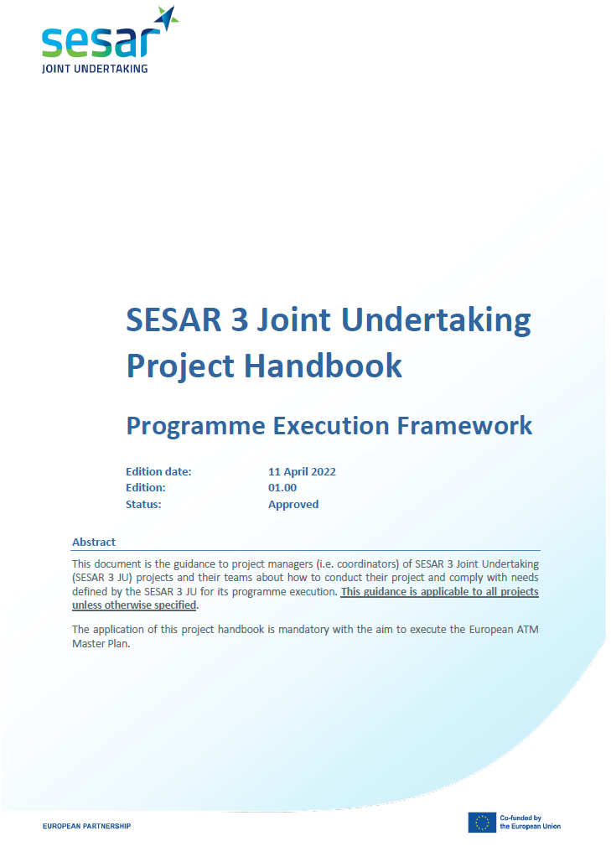
SESAR 3 JU project handbook
Provides an overview of the management of the SESAR 3 JU Digital European Sky (DES) programme
Lists the key processes applicable to all the DES projects
Provides guidance on how SESAR 3 JU projects shall be managed to support project delivery according to SESAR 3 JU expectations and European ATM master plan (ATM MP) ambitions
Included in the call material
Will be further explained at the projects’ kick-off

Slide 20
Grant & project management – key milestones
REPA
Final REPA
Grant management stream
T₀+1
KO meeting
T₀+12
Start REPA
T₀+15
Project
review
T₀+17
Payment
T0+?
Grant amendment
T_{end}
Project closure
T_{end}+5
Payment
Acronym | Definition
CDE | Communication, dissemination & exploitation
DMP | Data management plan
HE | Horizon Europe
KO | Kick-off
PMP | Project management plan
REPA | Reporting & payment process
Project initiation
T₀+14 (max)
HE technical & financial report
T_{end}+2 (max)
Final HE technical & financial report
T₀+1
KO meeting
Programme management stream
T₀+?
Iterative versions of deliverables
T₀+15
Project review
T₀+?
Validation activities
T₀+?
Iterative versions of deliverables
Final CDE period
T₀+3
PMP & CDE plan
T_{end}-6
Exit maturity gate
Confirmed project / solution exit maturity level
& project schedule
T₀+6
DMP
T₀+14 (max)
Project input to review (e.g. maturity self assessment, validation approach) + CDE plan update
T_{end}-8
PJ provides deliverables for maturity assessment
HE milestone
Technical milestone
Regular coordination between the projects and the SESAR 3 JU will ensure quality of the delivery
Project submission
T₀+12
T₀ + 12 months
Notes:
The Programme management processes will be mainly run outside the eGrants tools and will be enabled by SESAR3 JU’s collaboration platform, STELLAR, that will be introduced in a few minutes. A close coordination between the Project and the SESAR 3 JU Programme Managers will be required along the execution of all following programme management processes; it will be facilitated through the SESAR 3 JU’s collaboration platform.

Slide 21
Project initiation – project kick-off meeting
Information to be presented / confirmed at the project kick-off:
SESAR solution¹ title, definition and description with
  Initial maturity level
  Exit target maturity level
  Performance expectation
Project work breakdown structure (one SESAR solution¹ per work package)
Project resources, including
  Work with the transversal projects
  Close coordination with the SESAR 3 JU
  As necessary, involvement of national authority and/or EASA
Communication approach
Baseline on which the project will start working (e.g. SESAR 2020 outcomes)
¹ Applicable to application-oriented ER projects

Slide 22
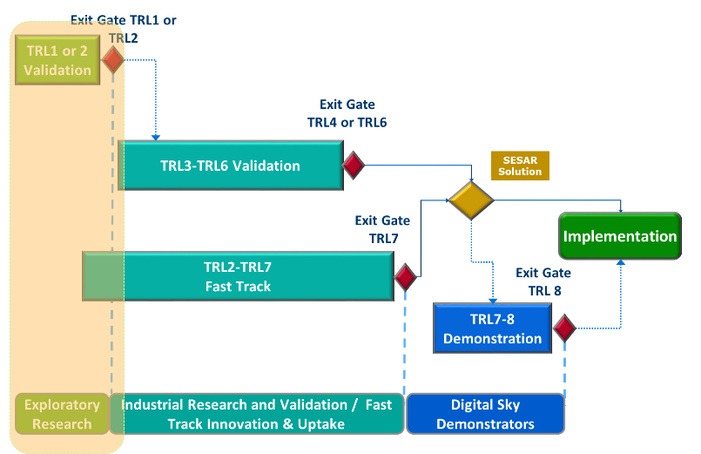
SESAR solutions
Each project shall define SESAR solution(s)¹
  SESAR solution = deployable ATM improvement in a relevant operating environment
  Definition & description according to European ATM master plan vision
  Expected performance (KPA &KPIs)
  Initial and target exit maturity levels
Projects shall apply transversal areas methodologies for safety, human performance, security and environment assessments (if applicable)
¹ Application-oriented ER projects are expected to identify candidate SESAR solution(s) as part of their proposal while ATM excellent science and outreach ER projects may wait for R&I activities to progress to identify candidate SESAR solution(s)

Slide 23
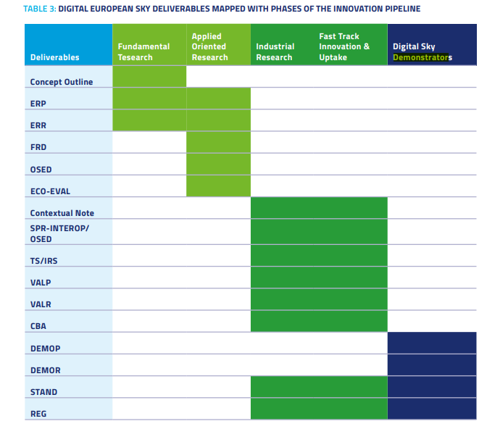
Key exploratory research deliverables
Deliverable | Definition
Concept outline | High level description of the concept with identification of potential benefits and associated risks
ERP | Exploratory research plan
ERR | Exploratory research report
FRD | Functional requirements document
OSED | Operational service and environment description document
ECO-EVAL | Economic evaluation
Concept outline, ERR, FRD, OSED & ECO-VAL are public one approved
All deliverables are subject to a quality assessment by the SESAR 3 JU
All templates will be available at project kick-off
Additional deliverables
PMP (including project schedule)
Communication, dissemination & exploitation plan
Data management plan
Notes:
Concept outline: high level description of the concept with identification of potential benefits and associated risks.
ERP: the exploratory research plan describes the way in which one or more validation exercises or activities are to be prepared and executed in order to achieve the validation objectives of an exploratory research project.
ERR: the exploratory research report consolidates the results obtained by an exploratory research project once the validation activities, experiments, etc. have been completed.
FRD: the functional requirements document represents a formal statement of SESAR technological solution related functional requirements. The content describes "what" the SESAR technological solution has to do but not the "how".
OSED: the operational service and environment description aims at describing the specific activities and interactions of various stakeholders related to a new concept of operations or to a new piece of existing concept.
ECO-EVAL: the economic evaluation assesses the potential benefits that an innovative idea or application under analysis by an exploratory research project could provide against an initial high level estimation of the costs that it may imply.

Slide 24
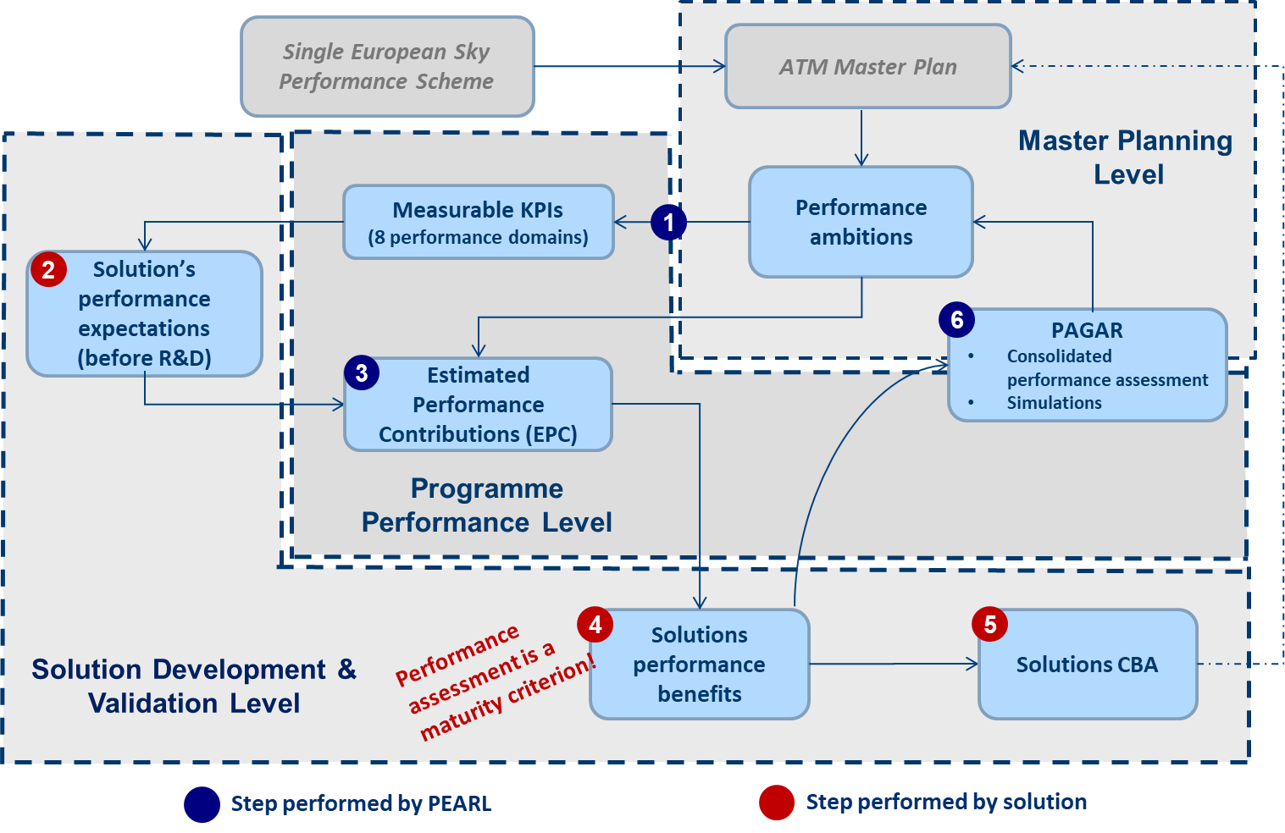
Performance management
Aim: fulfil the ATM master plan performance ambitions
Specific methodologies to apply (guidance material)
Covers safety, security, human performance & environment
Requires close coordination with the SESAR 3 JU and the transversal project dealing with performance management (PEARL)

Slide 25
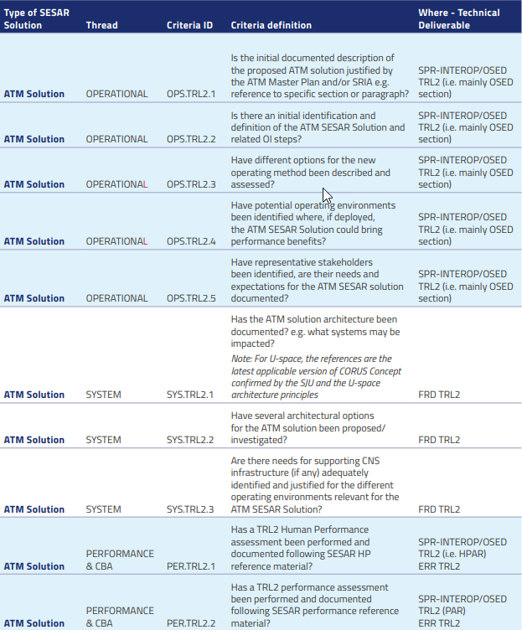
Maturity assessment
Projects shall assess the maturity of their content / SESAR solutions by applying the SESAR maturity criteria, based on evidences supported by technical deliverables
Relevant TRL maturity levels: TRL1 and TRL2
SESAR maturity criteria (see MAWP)
  Structured per threads
  Built progressively from one maturity phase to the next one
  Key focus changes depending on the maturity level
Exit maturity gate = formal milestone led by the SESAR 3 JU at the end of the R&I activity
  Assess and agree of the actual maturity level (TRL) of a SESAR solution
  Agree on recommendations and identify risks or opportunities for the next R&I phase

Slide 26
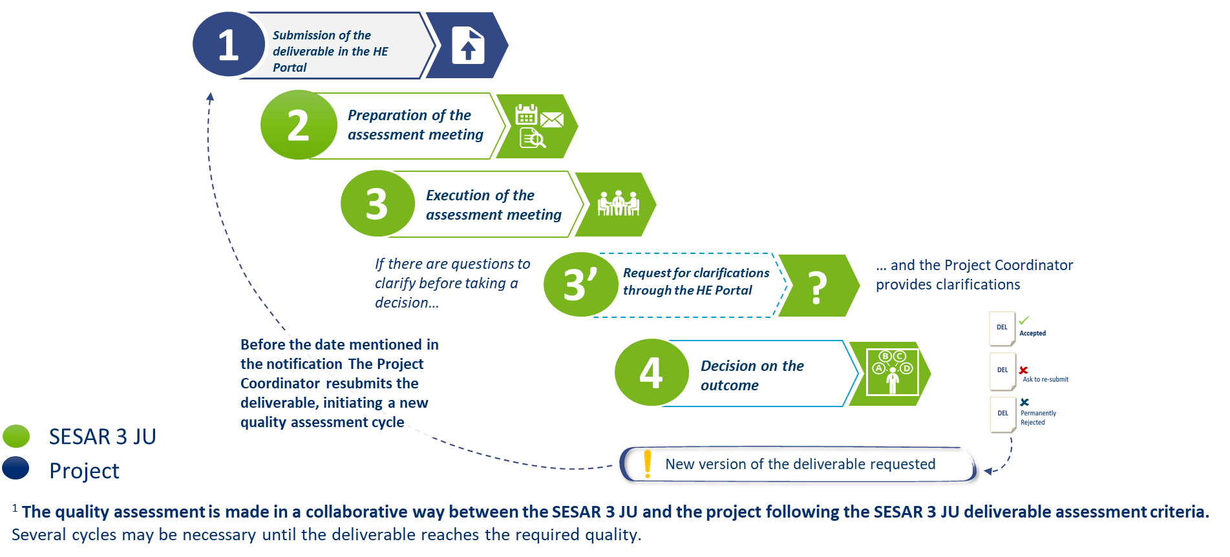
Quality assessment of deliverables
Iterative review of draft deliverables will de-risk the formal assessment of the final deliverable
At start of deliverables drafting, please consider
  Contribution to standardisation and regulatory needs (e.g. coordination with EUROCAE, EASA)
  Applying performance methodologies

Slide 27

EASA in your proposals
Along the development and validation of the SESAR solutions, care shall be taken on the need to engage with the National Authorities and EASA (when required), to address the regulatory issues and to consider the need for developing standards
When relevant, projects shall anticipate the (financial) contribution of EASA in the grant as a participant (beneficiary or third party providing a service)
EASA contribution may include:
  Coordinating the review of the safety argumentation with the competent authorities involved
  Provide guidance to support the safety review
  Supporting the approval and endorsement of the safety cases
Contact during the proposal elaboration phase: SESAR_requests@easa.europa.eu

Slide 28
Final considerations
Proposals shall:
Identify the standardisation and regulatory state of the art as a basis for the development of your project/each SESAR solution and to maximise impact towards industrialisation (ER template section 2.2 & 2.3)
Outline your strategy to develop and consolidate standardisation and regulatory needs and how they should be supported by the appropriate bodies (e.g. standardisation development offices, national supervisory authority, EASA…) (ER template section 2.2 & 2.3)
Demonstrate the measures to maximize impact through dissemination, exploitation and communication (ER template section 2.2 & 2.3)
Provide a work plan and the allocated resources (ER template section 3.1)
  One candidate SESAR solution per work package¹
  Work with the transversal projects
  Close coordination with the SESAR 3 JU
¹ Applicable to application-oriented ER projects

Slide 29
Communication, dissemination & exploitation
Triona KEAVENEY
Senior Communication & Media Relations Officer

Slide 30

Communication is a contractual obligation
In line with the grant agreement (Art. 17 & Annex V), project beneficiaries are obliged to:
Promote activities according to a communications plan.
Display logos of funding bodies and disclaimer
Acknowledge the source of the funding.
Coordinate all planned activities between consortia members and with the SESAR 3 JU
1
2
3
4
Breach of contract obligations
may lead to reduced grant
Notes:
https://ec.europa.eu/info/funding-tenders/opportunities/docs/2021-2027/cef/agr-contr/mga_cef_en.pdf
https://ec.europa.eu/regional_policy/en/information/logos_downloadcenter/

Slide 31

Promote activities according to a communications plan
1
Article 17.1
Inform, promote and communicate activities and results
Develop a communications plan
Target multiple audiences (including the media and the public)
Convey clear and simple messages
Use the right media channels
Communicate throughout the lifetime of the project
Before engaging in a communication expected to have a major media impact, the beneficiaries must inform the granting authority (SESAR 3 JU)

Slide 32


Display logos of funding bodies and disclaimer
2
3
Article 17.2/3 and Annex 5
Logos
Acknowledgement
The project is supported by the SESAR 3 Joint Undertaking and its founding members.
Disclaimer
To be used for:
Activities media relations, conferences, seminars, etc,
All material: website, publications, posters, presentations, roll-ups, etc.
All formats: paper, digital
Infrastructure, equipment, vehicles, supplies or major results funded by the grant
‘Funded by the European Union. Views and opinions expressed are however those of the author(s) only and do not necessarily reflect those of the European Union or SESAR 3 JU. Neither the European Union nor the SESAR 3 JU can be held responsible for them.’

Slide 33
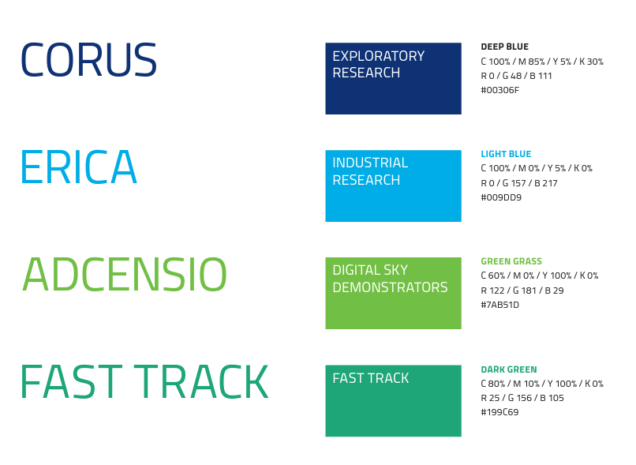
Additional SESAR 3 JU branding components
2
3
Streamlined visual identity for projects:
Project logo style per programme strand
Association with SESAR 3 JU logo, EU emblem and grant agreement text.
To be used in all communications material
SESAR 3 JU will provide logo templates to all projects once established.

Slide 34

Coordinate all planned activities between consortia members and with the SESAR 3 JU
4
Ensures that project communications and outreach milestones are integrated into broader SESAR 3 JU communications scheduling and planning
Enables a consistency check of project strategies, key messages, targeted audiences and communications material and an alignment with the SESAR 3 JU’s core objectives
Provides communications support of the SESAR 3 JU in promoting project events and conferences
Maximises outreach by using SESAR 3 JU communications channels and cooperative arrangements to further cascade relevant content

Slide 35
HORIZON EUROPE CALL
EVALUATION & PROCEDURES
MANUELA ALFE’
Head of Call coordination, Grant Management & ATM expertise

Slide 36
SESAR 3 DIGITAL EUROPEAN SKY CALL
HORIZON-SESAR-2023-DES-ER-02 – Exploratory research
8 December 2023 – 19 January 2024
29 January -9 February 2024
15 November 2023
5 March 2024
3 May 2024
29 June 2023
15 July 2024
Remote Evaluation
Central Evaluation
GAP opened
First GAs signed
All Grant Agreements to be signed
Call publication & Opening
Call deadline

Slide 37
Admissibility
  Same general admissibility conditions as in H2020
  Applications must be submitted before the call deadline, electronically via the Funding & Tenders Portal
  Applications must be complete, readable, accessible and printable, and include a plan for the exploitation and dissemination of results.
  Proposal page limit
  Substantial reduction in maximum length compared to H2020:
  RIAs type of actions: limit for a full application is 45 pages
  Please note that excess pages will be disregarded!

Slide 38
Eligibility
  Consortium composition (collaborative projects)
  at least one independent legal entity established in a Member State, and
  at least two other independent legal entities each established either in a different Member State or an Associated Country.
  NEW! Gender Equality Plan (applicable only from 2022 on)
  Participants that are public bodies, research organisations or higher education establishments from Members States and Associated countries must have a gender equality plan, covering minimum process-related requirements.
  A self-declaration will be requested at proposal stage (for all types of participants).
  Included in the entity validation process (based on self-declaration)

Slide 39



Who is eligible for funding?
  EU countries
  Member States (MS) including their outermost regions
  The Overseas Countries and Territories (OCTs) linked to the MS.
  Non-EU countries
  Countries associated to Horizon Europe (AC)
  Low and middle income countries: See HE Programme Guide.
  Specific cases
  Affiliated entities established in countries eligible for funding.
  EU bodies
  International organisations (IO):
    International European research organisations are eligible for funding.
    Other IO are not eligible (only exceptionally if participation is essential)

Slide 40
Associated Countries
For the purposes of the eligibility conditions, applicants established in Horizon 2020 Associated Countries or in other third countries negotiating association to Horizon Europe will be treated as entities established in an Associated Country, if the Horizon Europe association agreement with the third country concerned applies at the time of signature of the grant agreement.
  Specific situation of UK
  The UK is expected to soon become an associated country to Horizon Europe. UK entities can take part in the first calls for proposals of Horizon Europe
  The UK is associating to the full Horizon Europe programme with the only exception of the EIC Fund (which is the loan/equity instrument of the EIC).

Slide 41
Activities eligible for funding
  Eligible activities are the ones described in the call conditions
  Activities must focus exclusively on civil applications and must not:
    aim at human cloning for reproductive purposes;
    intend to modify the genetic heritage of human beings which could make such changes heritable (except for research relating to cancer treatment of the gonads, which may be financed);
    intend to create human embryos solely for the purpose of research, or for the purpose of stem cell procurement, including by means of somatic cell nuclear transfer;
    lead to the destruction of human embryos.
  SESAR 3 JU topics guarantee an exclusive focus on civil applications, even if the military is considered (eg topic on civil–military interoperability and coordination)

Slide 42
Maximum funding rates- DES calls
Call | Type of action | Funding rate
ER | Research and innovation action | 100%

Slide 43
SPECIFIC CALL CONDITIONS - ER CALL
Award criteria: see BAWP
Additional dissemination and exploitation obligations: see BAWP
Max project duration:
  RIA= 30 months, including 6 months at the end for dissemination
Specific types of deliverables are expected per WA: see BAWP
NB: even though it is not clearly specified in the BAWP, and in line with previous call, the integration of gender dimension is NOT a mandatory requirement

Slide 44
Standard evaluation process
Individual evaluation
Consensus group
Panel review
Finalisation
Experts assess proposals individually. Minimum of three experts per proposal (but often more than three).
All individual experts discuss together to agree on a common position, including comments and scores for each proposal.
The panel of experts reach an agreement on the scores and comments for all proposals within a call, checking consistency across the evaluations.
if necessary, resolve cases where evaluators were unable to agree.
Rank the proposals with the same score
The Commission/Agency reviews the results of the experts’ evaluation and puts together the final ranking list.

Slide 45

Ethics review
  Same criteria as in H2020
  For all activities funded, ethics is an integral part of research from beginning to end, and ethical compliance is essential to achieve real research excellence. An ethics review process is carried out systematically in all Horizon Europe proposals, based on a self-assessment included in the proposal.
  Ethical research conduct implies the application of fundamental ethical principles and legislation in all possible domains of research. This includes the adherence to the highest standards of research integrity as described in the European Code of Conduct for Research Integrity.
  Adapted following lessons learnt
  Focus mainly on complex/serious cases
  Reduce number of ethics requirements in funded projects.

Slide 46



Security scrutiny
  New in Horizon Europe
  Security issues will be checked systematically in all Horizon Europe proposals (in H2020 only proposals submitted to topics flagged as ‘security-sensitive’ were checked). The checks are based on a self-assessment included in the proposal. The focus is on:
  Whether the proposal uses or generates EU classified information
  Potential of misuse of results (that could be channeled into crime or terrorism)
  Whether activities involve information or materials subject to national security restrictions
  The checks based on the self-assessment may trigger an in-depth security scrutiny.

Slide 47
Open Science across the programme
Open science is an approach based on open cooperative work and systematic sharing of knowledge and tools as early and widely as possible in the process. Including active engagement of society
Open
Science
Mandatory immediate Open Access to publications: beneficiaries must retain sufficient IPRs to comply with open access requirements;
Data sharing as ‘open as possible, as closed as necessary‘: mandatory Data Management Plan for FAIR (Findable, Accessible, Interoperable, Reusable) research data
Work Programmes may incentivize or oblige to adhere to open science practices such as involvement of citizens, or to use the European Open Science Cloud
Assessment of open science practices through the excellence award criteria for proposal evaluation. Under quality of participants previous experience on open sciences practices will be evaluated positively.
Dedicated support to open science policy actions
Open Research Europe publishing platform

Slide 48
Measures to maximise impact
To include a draft plan in proposal is an admissibility condition, unless the work programme topic explicitly states otherwise.
Dissemination, exploitation and communication
All measures should be proportionate to the scale of the project, and should contain concrete actions to be implemented both during and after the end of the project
Elements of the D&E&C plan
Planned measures to maximise the impact of projects
Target groups (e.g. scientific community, end users, financial actors, public at large) and proposed channels to interact
Communication measures for promoting the project and its findings throughout the full lifespan of the project
Policy feedback measures to contribute to policy shaping and supporting the implementation of new policy initiatives and decisions
Follow-up plan to foster exploitation/uptake of the results
    Comprehensive and feasible strategy for the management of the intellectual property (the provision of a results ownership list is mandatory at the end of the project)
    If exploitation is expected primarily in non-associated third countries, give a convincing justification that this is still in the Union’s interest.

Slide 49
Specific dissemination and exploitation obligations for DES projects
Additional exploitation obligations:
For the purpose of complying with the objectives set in the Regulation 2021/2085, the SRIA and the European ATM Master plan, beneficiaries must:
- make available for re-use under fair, reasonable and non-discriminatory conditions all relevant results generated in the action, through a well-defined mechanism, in trusted repositories;
- in case the purpose of the specific identified measures to exploit the results of the action is related to standardisation, grant the non-exclusive licence to the results royalty-free;
- in case on linked actions, ensure mutual access to the background and to the results of on-going and closed linked actions, should this be needed for implementing tasks under the linked action(s) or for exploiting results generated by the linked action(s) as defined in the conditions laid down by this (bi)annual work programme and by the call for proposals.
- Beneficiaries must acknowledge and incorporate these obligations in the proposal, outlining the efforts they will make towards meeting them and in Annex I to the Grant Agreement.
Additional dissemination obligations:
- Beneficiaries must make proactive efforts to share on a royalty free basis, in a timely manner and as appropriate, all relevant results with the other grants awarded under the same call.
- Beneficiaries must acknowledge and incorporate these obligations in the proposal, outlining the efforts they will make towards meeting them and in Annex I to the Grant Agreement.

Slide 50
FINANCIAL ASPECTS OF GRANTS
KEY MESSAGES
MANUELA ALFE’
Head of Call coordination, Grant Management & ATM expertise

Slide 51
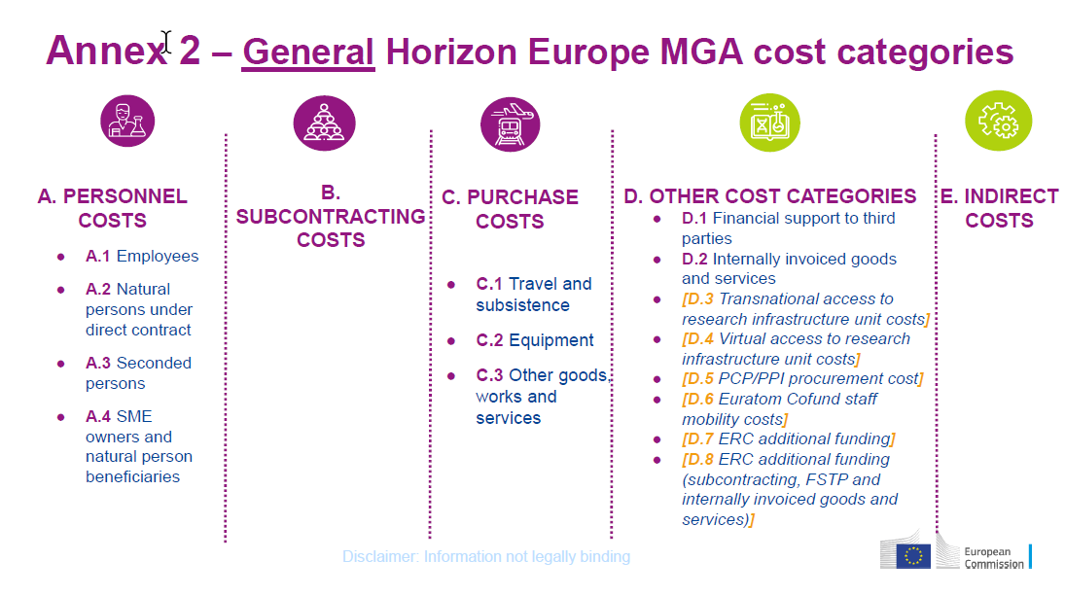
Cost categories in HE

Slide 52
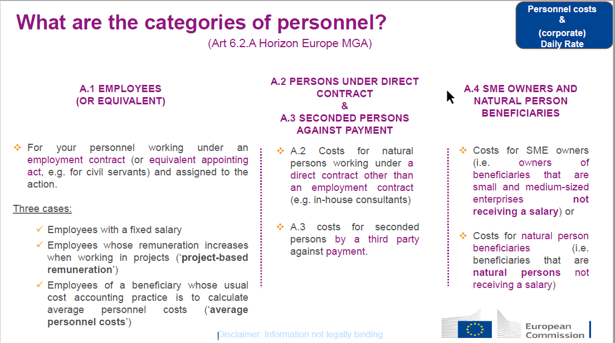
A. Personnel Costs

Slide 53
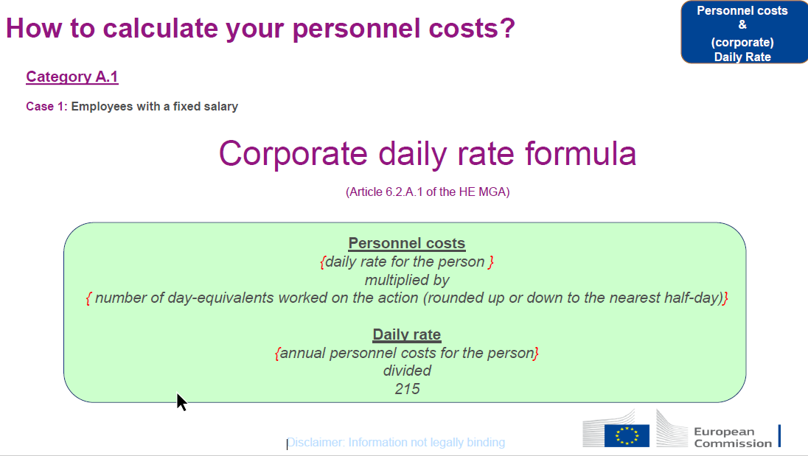

Slide 54
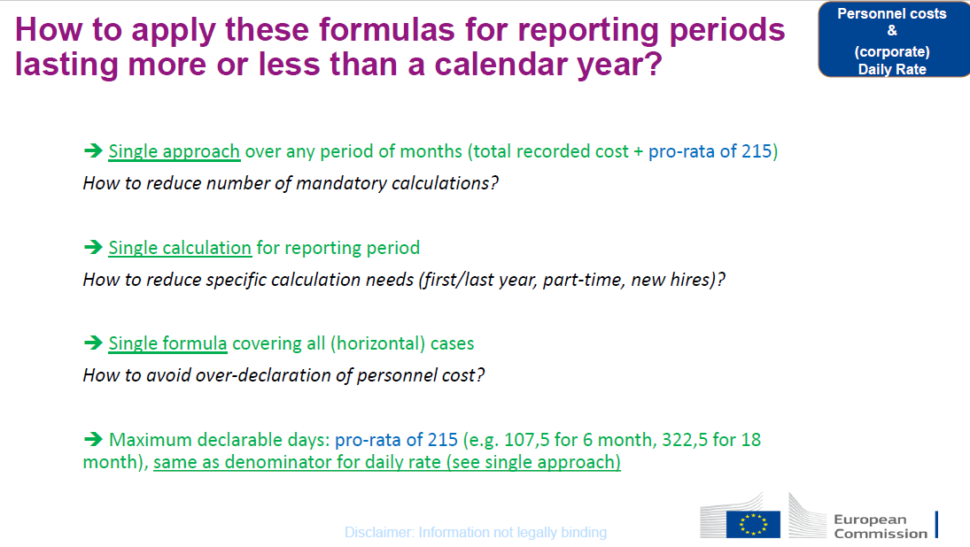

Slide 55
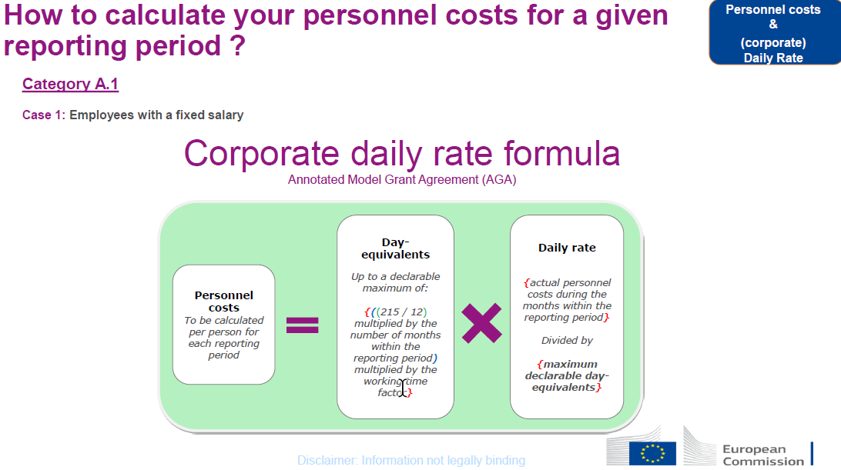

Slide 56
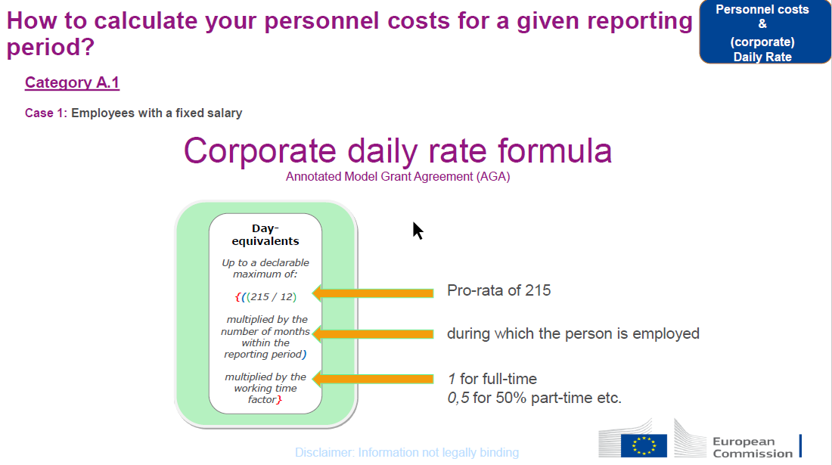

Slide 57
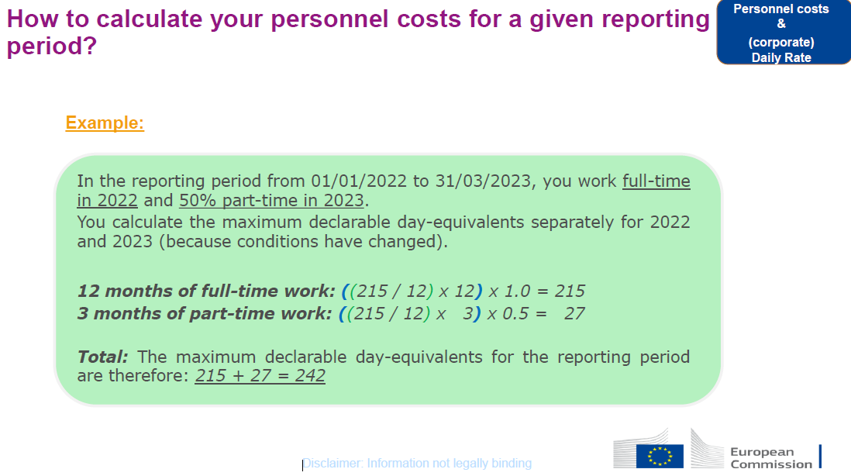

Slide 58
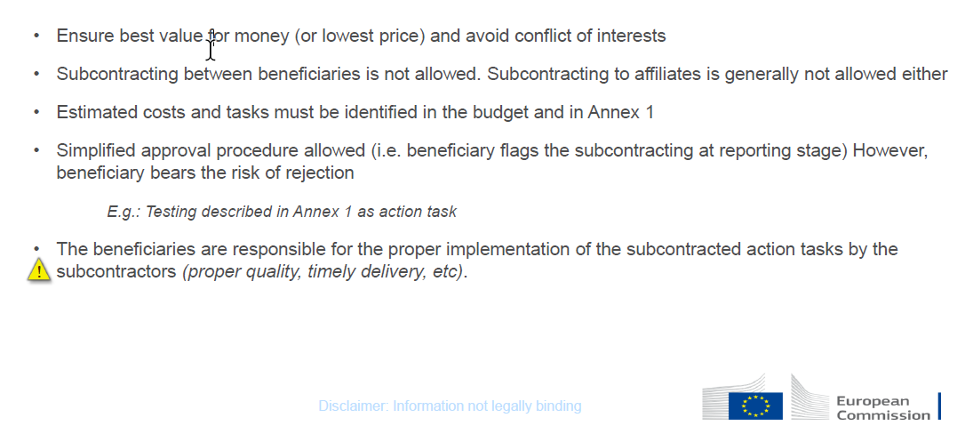
B. Subcontracting

Slide 59
C. Purchase Costs
May cover:
  Travel, accommodation and subsistence (Article 6.2.C.1)
  Equipment (Article 6.2.C.2)
  Other goods, works or services, if necessary to implement the action (Article 6.2.C.3)
  e.g.: CFS, consumables and supplies, promotion, dissemination, protection of results, translations, publications, support provided by EASA, etc.
  Must be declared as actual costs
  Ensure best value for money and avoid any conflict of interests

Slide 60
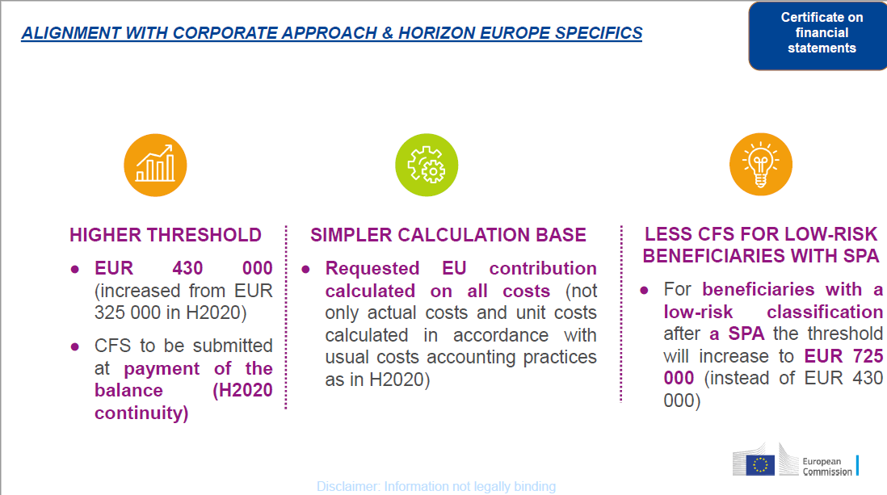
Certificate on financial statements
* SPA: Systems and process audit – Annotated Grant Agreement Article 24.4

Slide 61
D. Indirect costs
Indirect costs will be reimbursed at the flat-rate of 25% of the eligible direct costs (categories A-D, except volunteers costs, subcontracting costs, financial support to third parties and exempted specific cost categories, if any).

Slide 62
TIPS & TRICKS FOR
PROPOSAL SUBMISSION
MANUELA ALFE’
Head of Call coordination, Grant Management & ATM expertise

Slide 63
FINDING INFORMATION

Slide 64
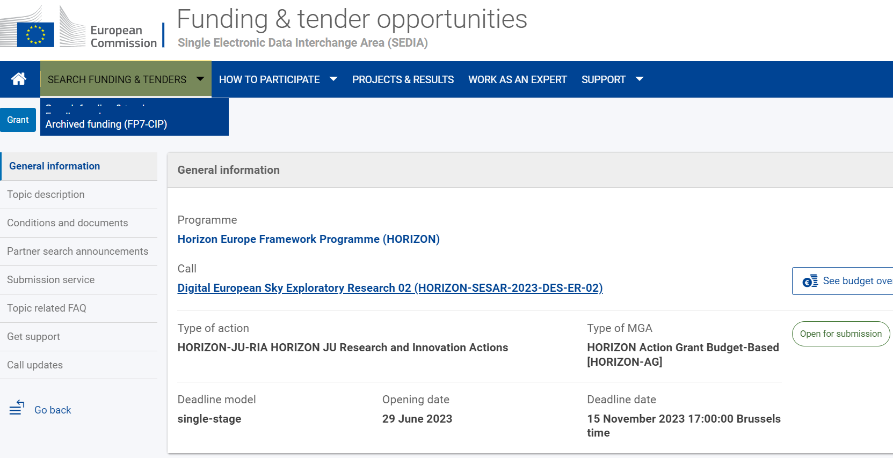
Available Information
All relevant call documentation is available on the Funding & Tenders opportunities (including presentations on Horizon Europe)

Slide 65
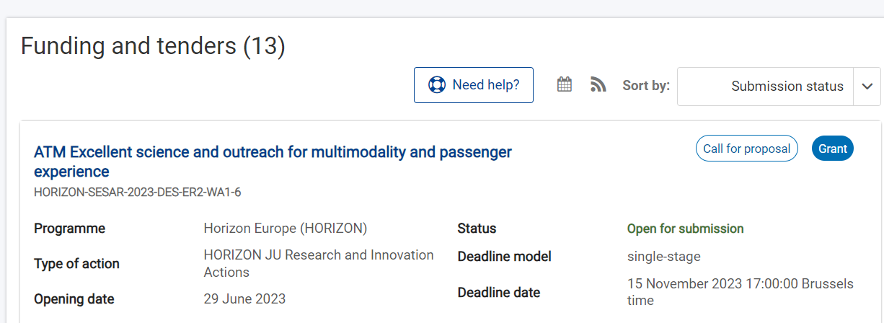
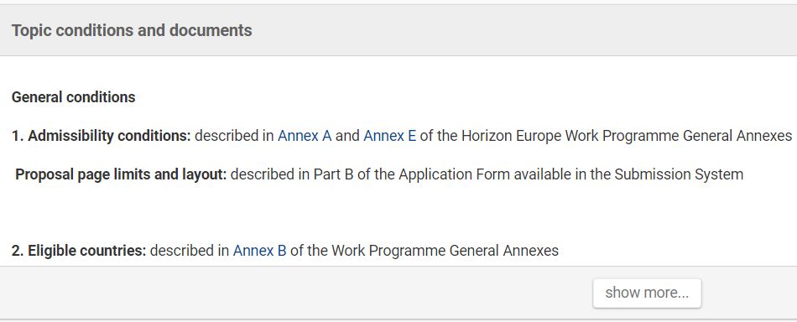
Available Information /1
Click on any of the topics
Expand here

Slide 66
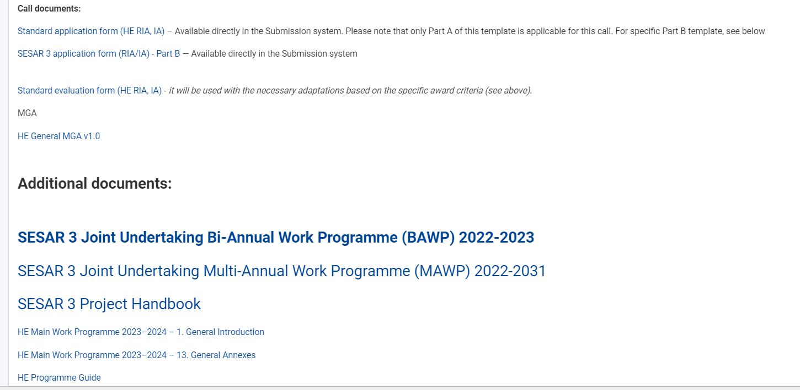
Available Information /2
Here you find all relevant documentation

Slide 67
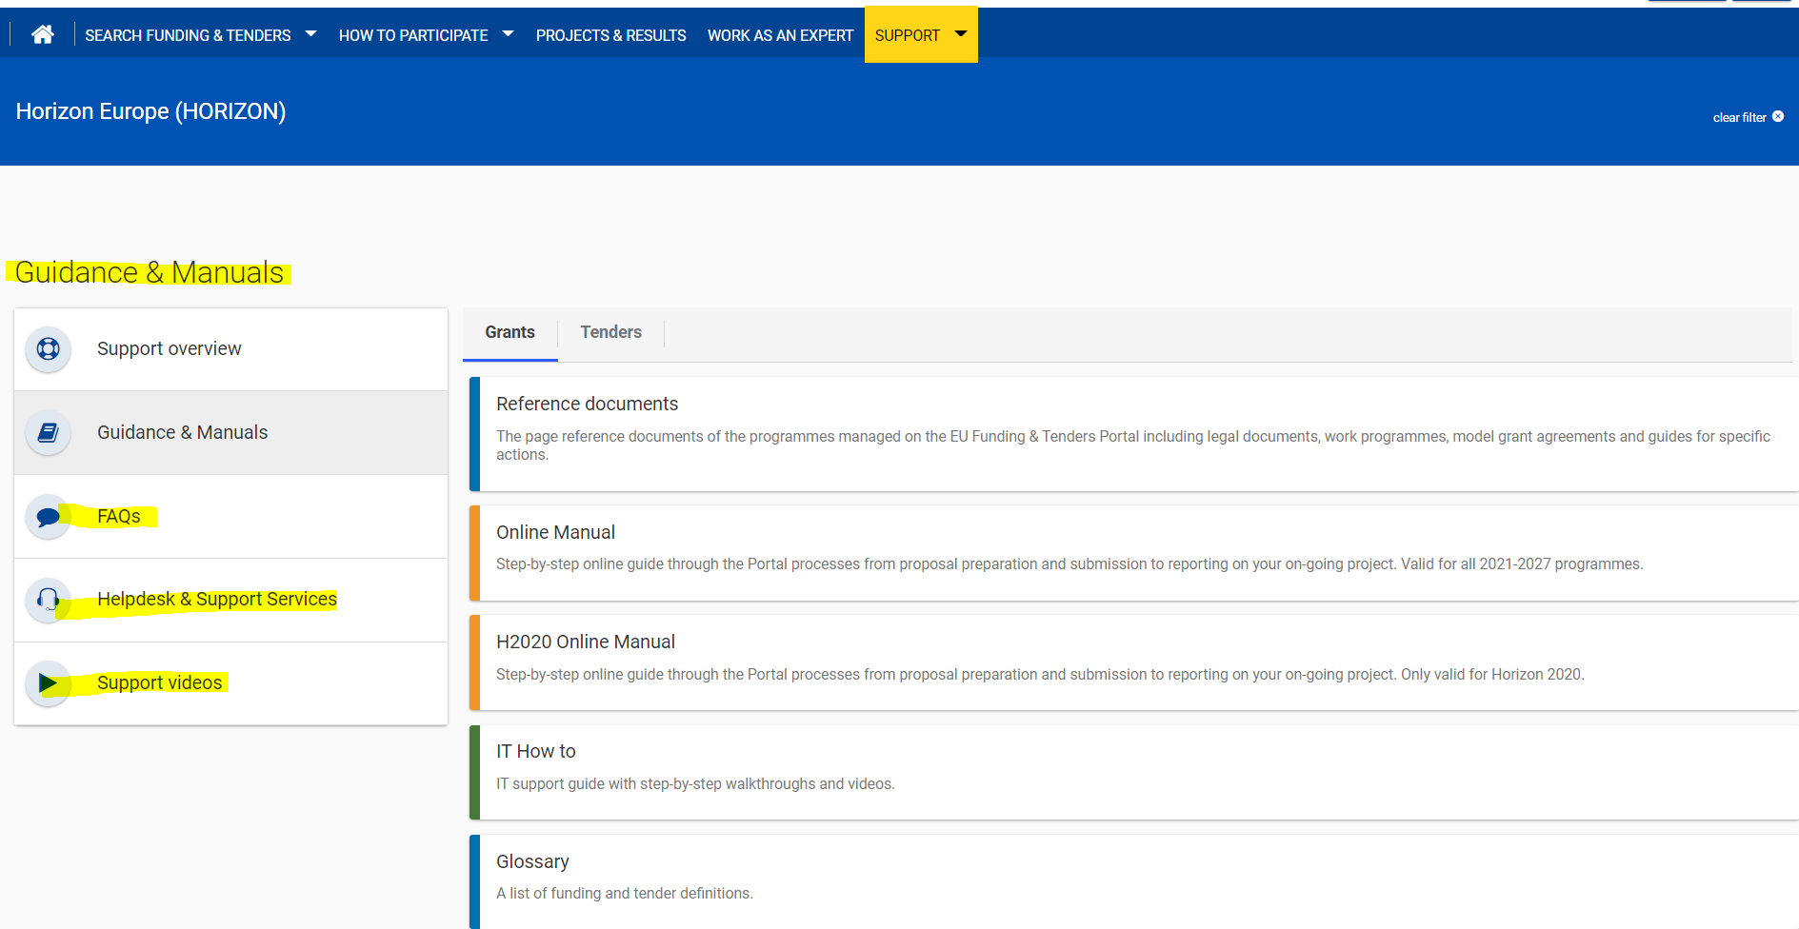
Finding Support /1

Slide 68
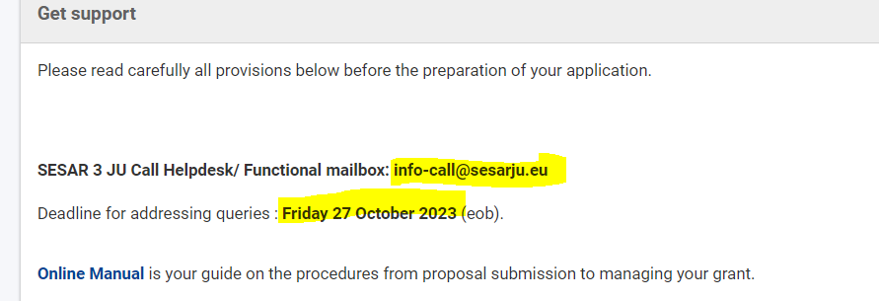
Finding support /2

Slide 69
In Summary
Read all relevant documentation on the Participant Portal – and in particular Topic conditions and documents
Consult the guidance on proposal submission in the H2020 online manual:
  https://ec.europa.eu/info/funding-tenders/opportunities/docs/2021-2027/common/guidance/om_en.pdf
Send your questions to the SESAR 3 JU Call Helpdesk:
info-call@sesarju.eu

Slide 70
PREPARING YOUR PROPOSAL

Slide 71
Electronic submission
Prepare proposal
Online for structured part – Administrative forms
Upload non structured parts – Technical annex – pdf file
  READ WELL THE PROPOSAL TEMPLATE PART B
Submit the proposal well BEFORE the deadline
DO NOT WAIT FOR THE LAST MINUTE
Submission failure rate : approx. 1%
Only reason for failure: waiting until the last minute
technical problems
starting the upload too late
trying to reach the helpdesk 5 minutes before the deadline

Slide 72
In summary
Make sure that you are very familiar with the topic description and call conditions;
READ all documentation;
Follow the proposal templates;
Cover ALL evaluation criteria and subcriteria;
Plan resources adequately and in line with the objectives to achieve;
Do not forget the importance of communication, dissemination & exploitation activities:
  Be innovative
  Justify when your deliverables are confidential

Slide 73
Thank you for your attention

