Slide 1
RACOON Operations
Antonio Nuzzo – RACOON Operational Leader
Andrea De Innocentis – Linate Operational Focal Point
Matteo Ergotti – Malpensa Operational Focal Point

Slide 2
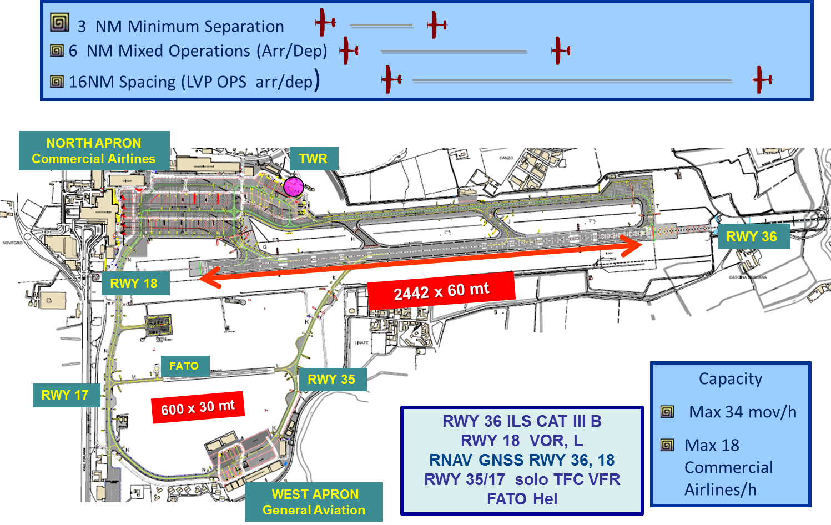
Milano Linate –LIML- Airport Layout
2015 Movements: ≈ 118.700
25% General Aviation Traffic

Slide 3
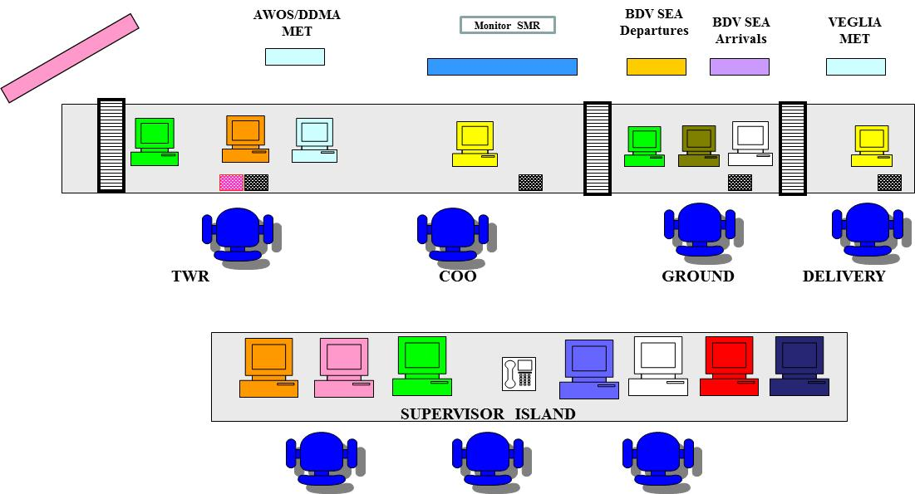
Linate Tower Operational Layout
Layout operativo e cosa abbiamo remortato in RACOON (due cerchi per evidenziare posizioni remotate)
Hot Spot con immagine di hot significato (HP RWY 36)
Remotati tutti i sistemi funzionali alla allo svolgimento dei task del CTA + nuovi sistemi
(immagine postazione operativa)

Slide 4
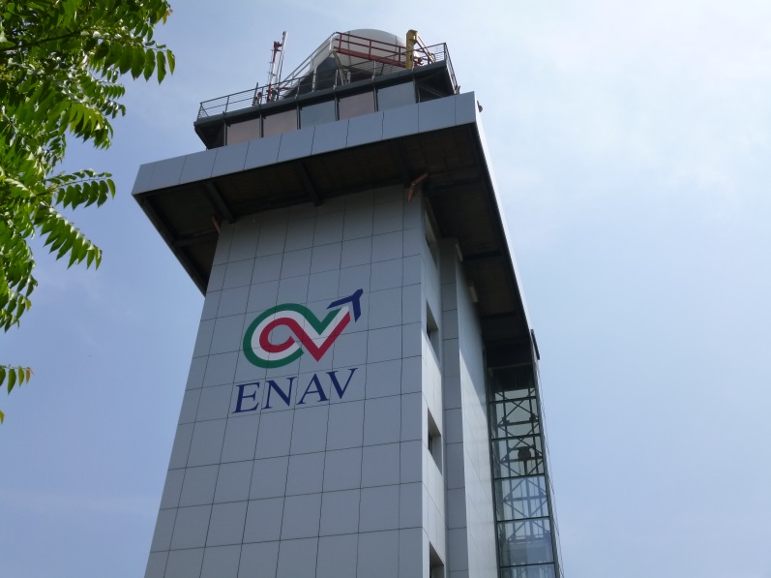
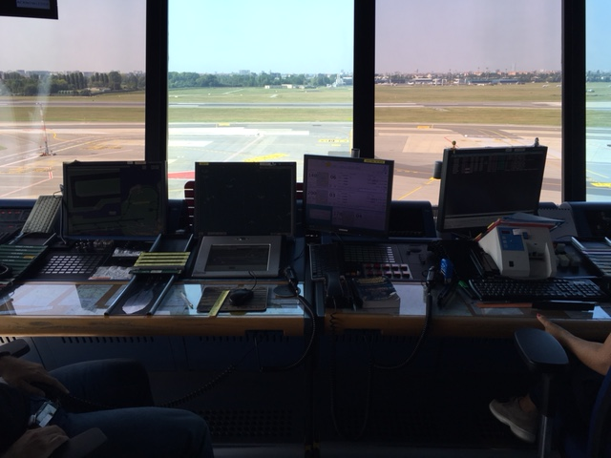
INTEGRATION WITH NEW GENERATION SYSTEMS LIML
NOT ONLY WE DID REMOTE WHAT ATCOs USE TODAY….

Slide 5




INTEGRATION WITH NEW GENERATION SYSTEMS LIML
BUT WE INTEGRATED NEW GENERATION SYSTEMS

Slide 6
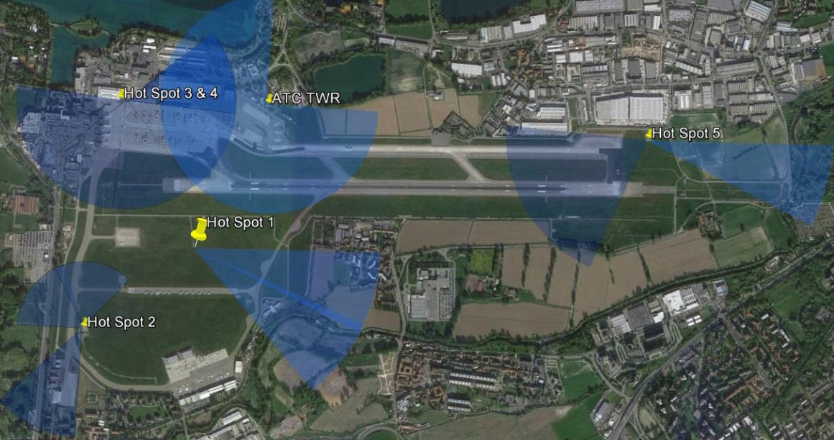
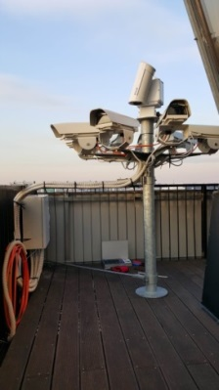
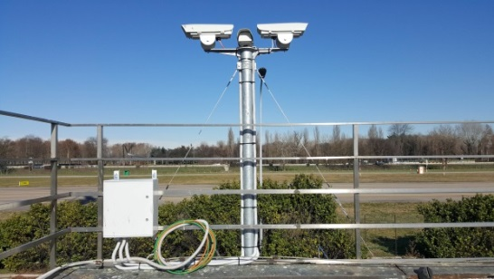
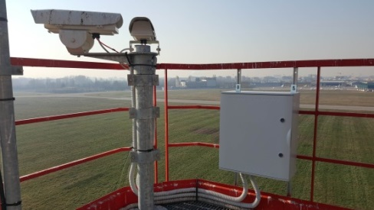
Milano Linate –LIML- Camera Layout
Visible PTZ camera
Fixed visible cameras
Outdoor microphone
Night vision
Tracking
Zooming
Enhanced view

Slide 7
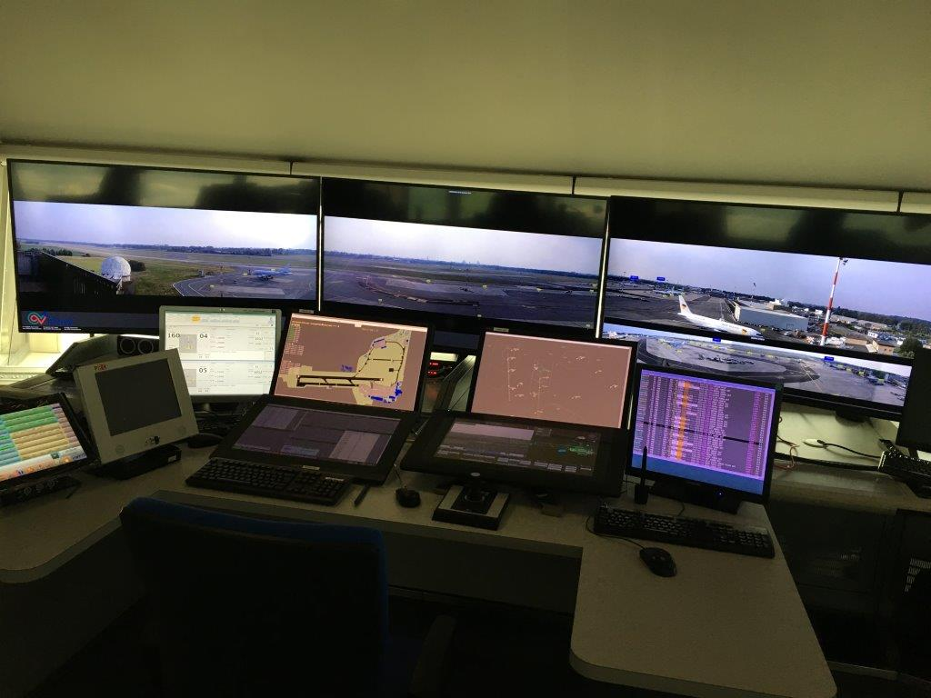

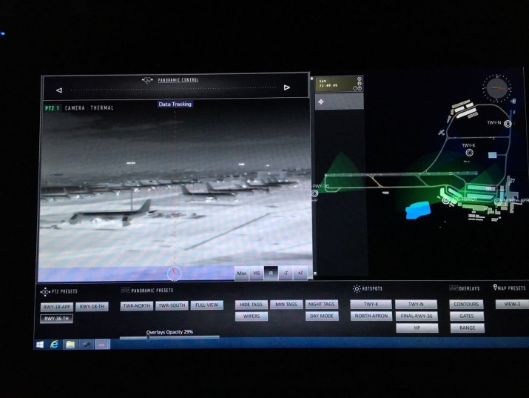
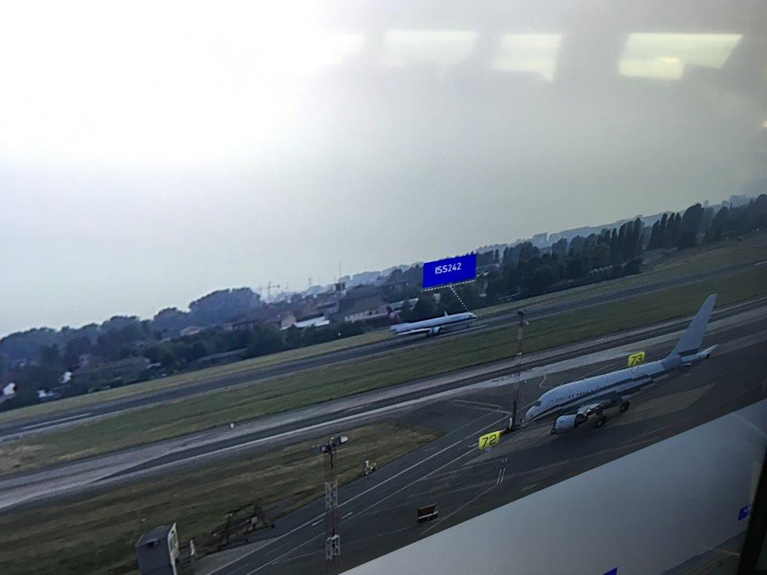

Slide 8
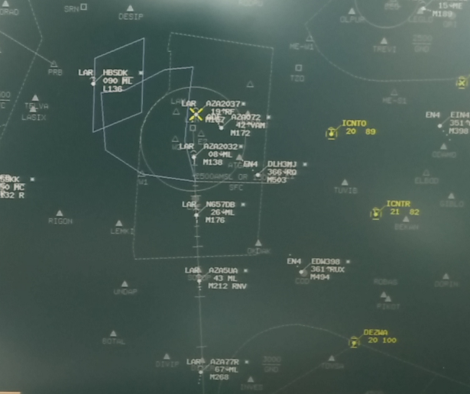
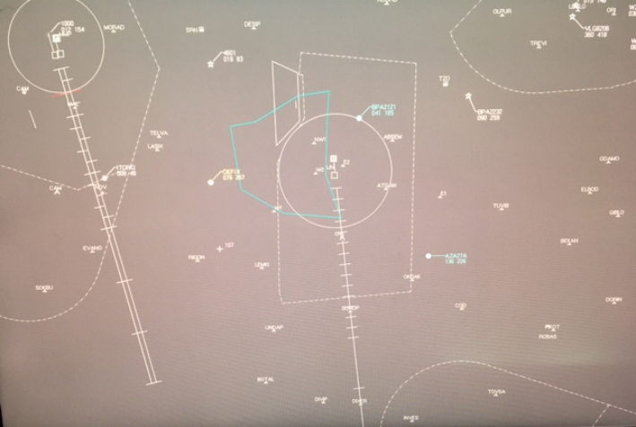


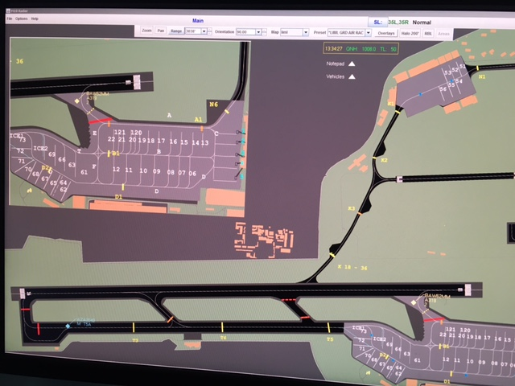
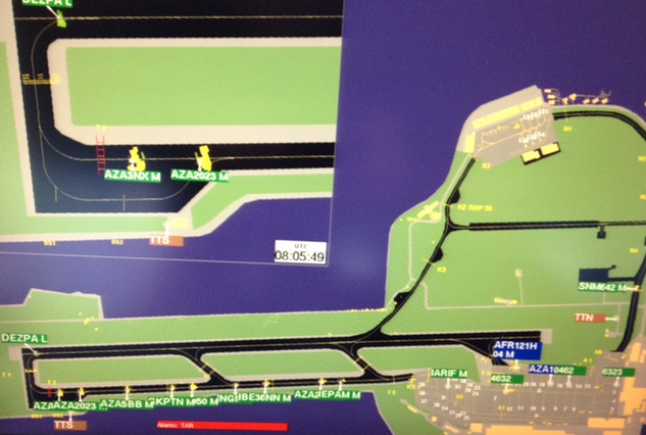
SURVEILLANCE
BEFORE
LATER

Slide 9
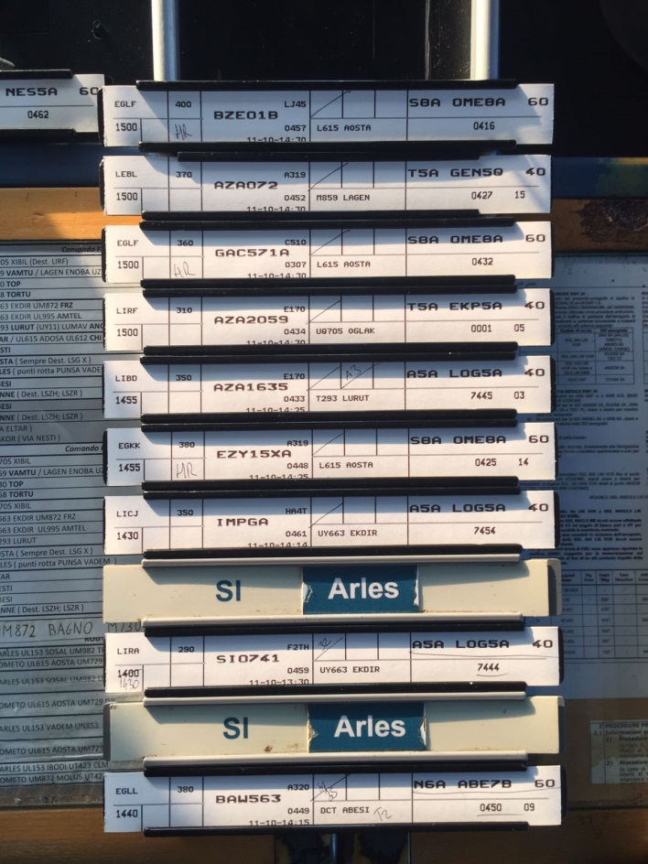
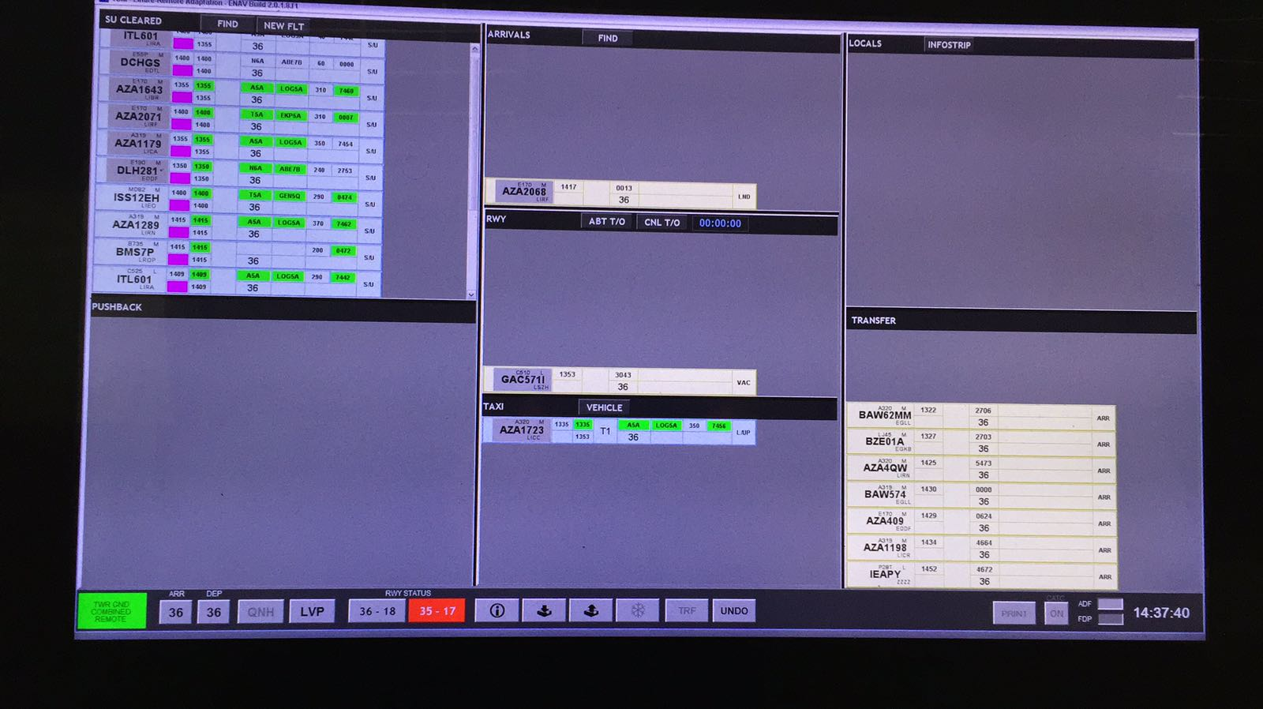
EFPS
BEFORE
LATER

Slide 10
Milano Linate –LIML- Camera Layout
Visible PTZ camera
Fixed visible cameras
Outdoor microphone
Night vision
Tracking
Zooming
Enhanced view

Slide 11
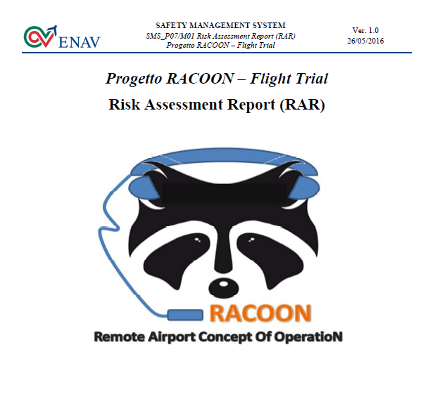
Safety in RACOON
Safety issues considered since Project Kick off Meeting
Italian Regulator (ENAC) and Airspace Users always in the loop
Complete Safety Assessment delivered in July 2016
Recommendations and Nominal Conditions for Flight Trials execution :
  Frequency override tested and working
  Visibility not less than 3000 m
  Clouds not worse than BROKEN 1000 ft.
  No shower rain conditions
  Good Runway breaking action
  No wind-shear reports
  RWY 36 in LIML - 35 R/L in LIMC in use
  No visual approach allowed
  Reduced VFR activity
  Prefix “Remote” to be used before “TWR” in every Remote TWR communication to AUs involved in the validation activities
  NOTAM to be published to inform AUs about validation activities
  ATIS message when Live Trials in progress

Slide 12
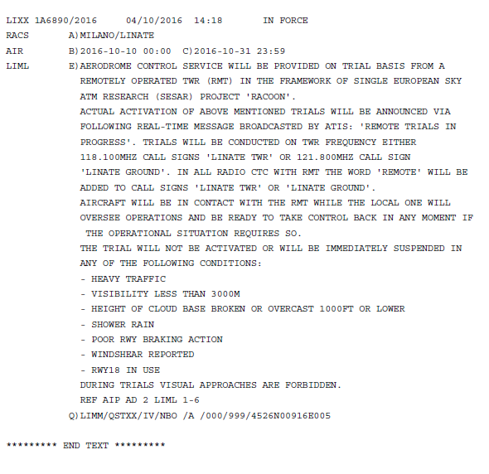
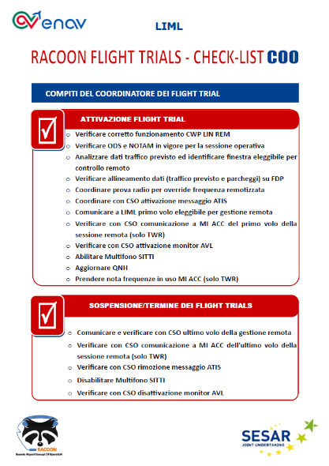
Trial organization
Platform Operational acceptance
ATCOs Training (September 2016)
Shadow mode activities
NOTAMs issued and ATIS for all AUs
Dedicated Checklists for ATCOs
Internal Operational Instructions
Result: 82 Commercial Flights controlled remotely

Slide 13
Preliminary Results - Linate
ATCOs indicated that Remote Single Airport concept is viable and acceptable. Working in a remote tower module does not negatively impact their performance and does not require relevant adjustment and/or change in the conventional working method.
The augmented reality such as Runway/taxiway overlays and the label tagging a/c on the OTW, pre-setting for OTW visualization were appreciated by ATCOs.
The possibility to visualize and zoom into critical aerodrome areas such as RWY Threshold, RWY Holding Point or the final approach segment was appreciated.
The ATCOs opinion on the capacity to effectively judge the distance and the separation by the visual reproduction was not clear.

Slide 14
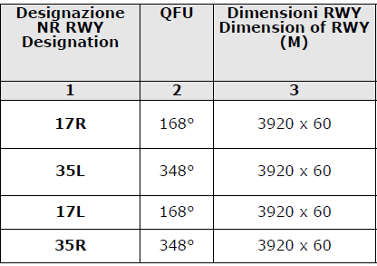
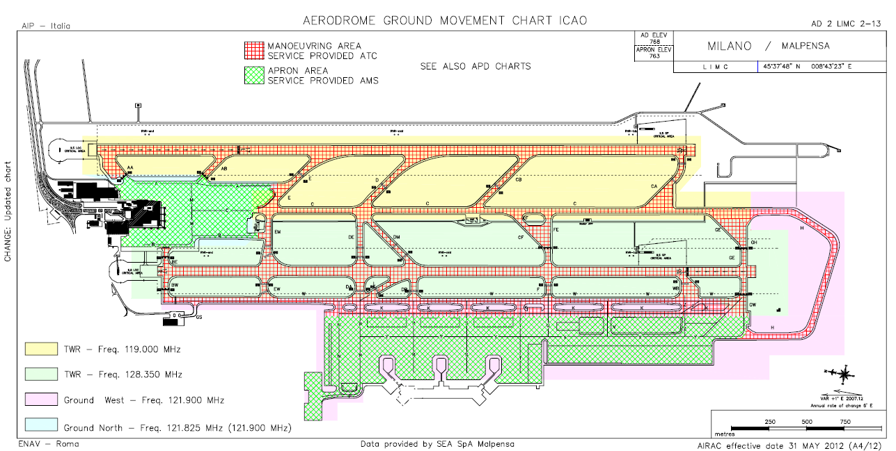
Milano Malpensa –LIMC- Airport Layout
Airport Capacity:
70 mov/hour
Max 40 arr/dep
RWY 17L
RWY 35R
808 mt
RWY 17R
RWY 35L
Segregated Operations
Independent Parallel Departures
Dependent Parallel Approaches:
  6 Nm separation on the same LOC
  3 Nm stagger on different LOC
2015 Movements: ≈ 160.000
< 3 % General Aviation Traffic

Slide 15
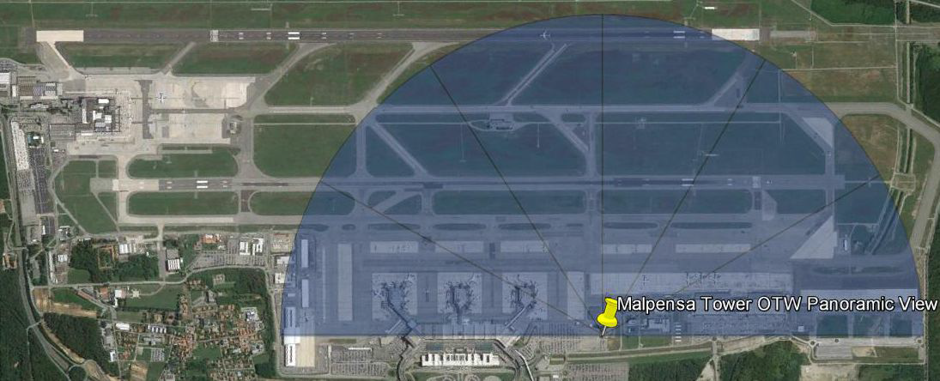
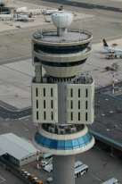
Malpensa Airport Layout – Camera View

Slide 16
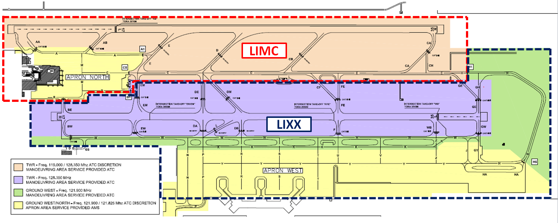
Multiple Airport Lay Out (LIMC & LIXX)
TWR

Slide 17
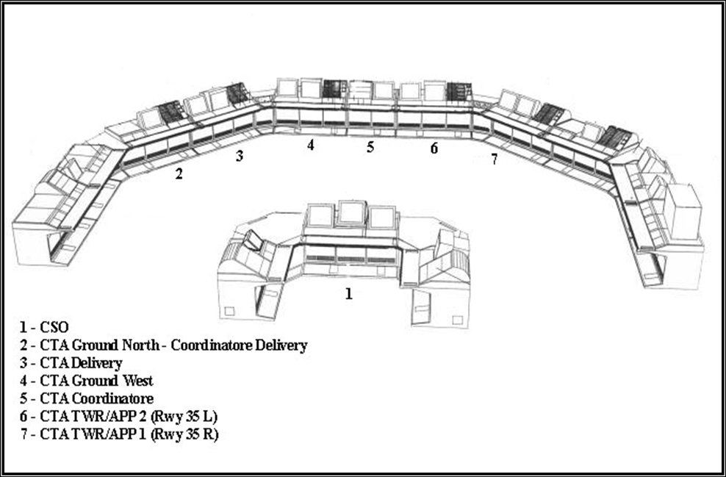
Ops Room Lay-out - MALPENSA
PLN
EXE TWR
EXE GND
SPV

Slide 18
LIMC/LIXX Preliminary Results
The experimental setting arranged for the Malpensa (local) and LIXX (remote) scenario was characterized by a “lower level of realism”. ATCOs working method was focused on the use of the radar rather than LIXX OTW provided by RACOON platform, which were used quite rarely.
The augmented reality such as Runway/taxiway overlays and the label tagging of a/c on the OTW, and pre-setting for OTW visualization were appreciated by ATCOs and judged useful.
RACOON devices were considered quite intuitive and easy to use, but more training needed with the actual tools.
In terms of perceived workload and situational awareness, the evaluation of the multiple airport scenario recorded quite positive results. Additional support tools are required.
Working in a remote tower module does not negatively impact performance in managing traffic effectively even if adjustments and/or changes in conventional working method are required.
Result: 36 Commercial Flights controlled remotely
Low traffic was a requirement !

