Slide 1
RACOON: Alitalia participation
Carlo Pacenti
Fuel Efficiency & Projects Mgr.

Slide 2
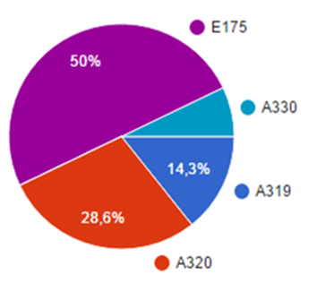
Alitalia feedbacks
50 Alitalia flights participated in the trial
In addition to NOTAM and ATIS messages, in advance of the trial, an internal operative communication was distributed to flight crews.
Furthermore Alitalia chose to send questionnaires to the involved crews to get their feedbacks.
percentage of received feedbacks per Aircraft Type
Feedback summary:
No differences were perceived by pilots versus “standard” operations, being the only change the "Remote" phraseology used.
The Remote Tower control provided no changes in terms of Role and Responsibilities (between Pilots and ATC) and no crew member expressed the need of a dedicated training session.
Thanks to the communication distributed (NOTAM, ATIS, the internal operative communication) pilots had a good situation/trial awareness.

