Slide 1


RACOON Project
Daniele Teotino - ENAV
RACOON Project Manager
Head of SESAR JU Activity Coordination
RACOON Open Day - ENAV Malpensa Tower, 11 November 2016

Slide 2
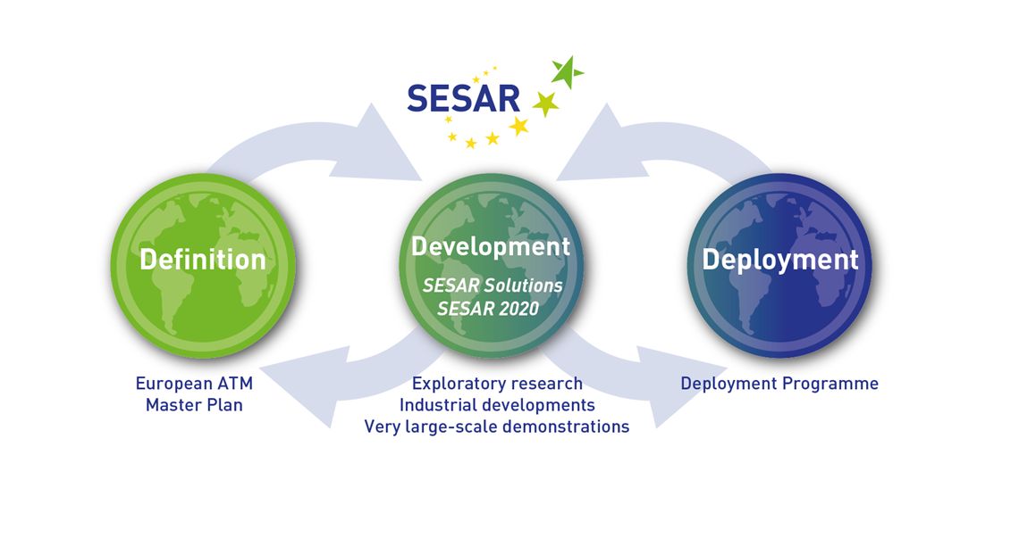
SESAR life cycle
To define, develop and deploy the technology that is needed to increase ATM performance and build Europe’s intelligent air transport system
RACOON Open Day – 11/11/2016

Slide 3
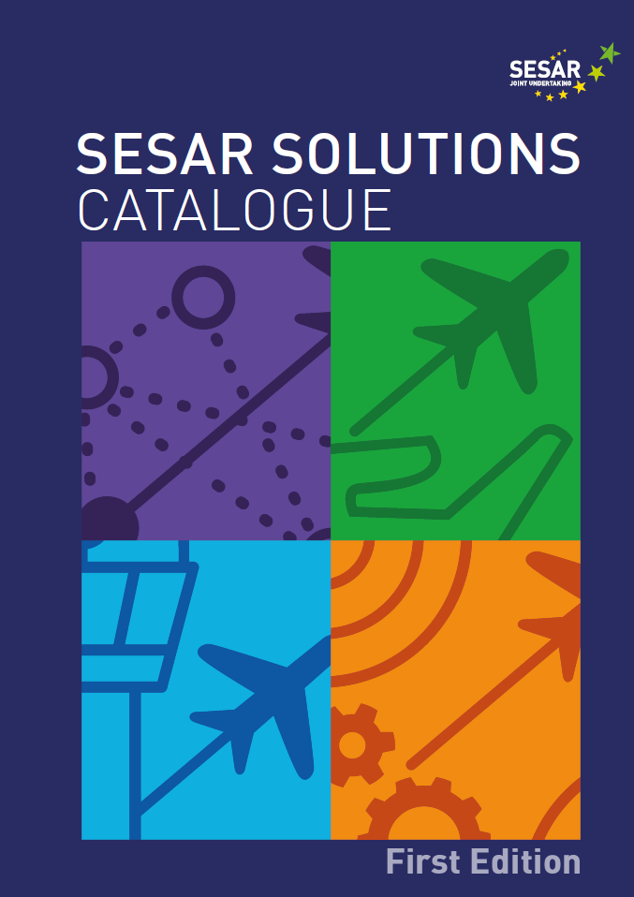

SESAR Solutions
SESAR Solutions refer to new or improved operational procedures or technologies that aim to contribute to the modernisation of the European and global ATM system.
63 SESAR Solutions, divided into 4 areas (Key Features)
24 Solutions are already being deployed across Europe
RACOON Open Day – 11/11/2016

Slide 4
Remote Tower Solutions
Remote tower services for a single low-density airport
Single remote tower operations
for medium traffic volumes
Remote tower for two low-density
aerodromes
BENEFITS
Increased cost efficiency
Increased accessibility to
and support for regional economies
RACOON Open Day – 11/11/2016

Slide 5
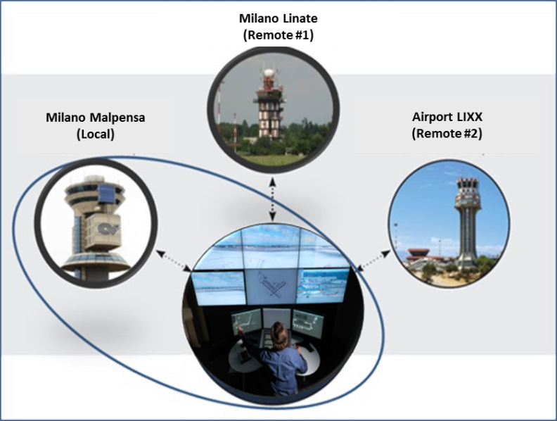
RACOON in a Nutshell
SESAR JU Very Large Scale Demonstration
First Italian initiative on Remote TWR solutions
Challenging objectives:
    Single Remote and Multiple Local/Remote
    GNSS monitoring solution
Challenging scenarios Milano Malpensa and Linate: the 2nd and 3rd airport in Italy
High technical and operational complexity
Tight schedule : 2-year project (2014-2016)
RACOON Open Day – 11/11/2016

Slide 6

Keys of Success
Gain from SESAR developments and other Stakeholders experience
Strong Partnership and team working
Involvement of Operational Staff since the very beginning
Working in parallel on technical and operational issues
Problem solving approach – never give up!
Clear roadmap to the Flight Trial execution
RACOON Open Day – 11/11/2016

Slide 7







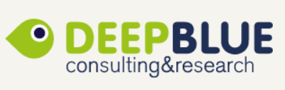



The Partnership
RACOON Partnership
… and as Supporting Partners:
RACOON Open Day – 11/11/2016

Slide 8

The Demonstration Roadmap
Real Time Simulations executed in October 2015
Infrastructure completed in July 2016
Safety Assessment completed in July 2016
Shadow Mode & Training conducted
in September 2016
Flight Trial set-up completed in September 2016
Flight Trials successfully completed in October 2016
RACOON Open Day – 11/11/2016

Slide 9
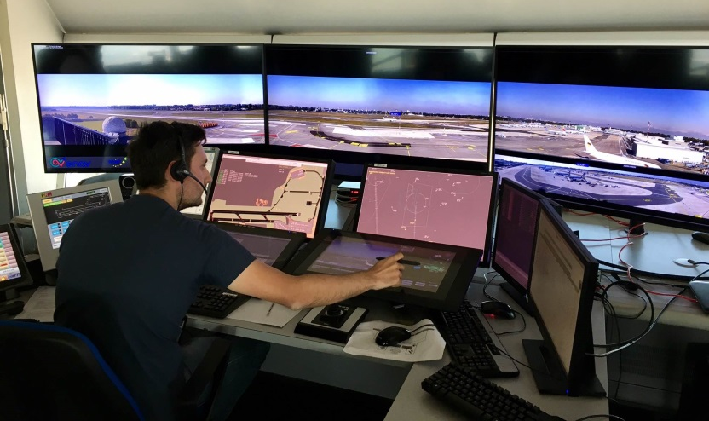
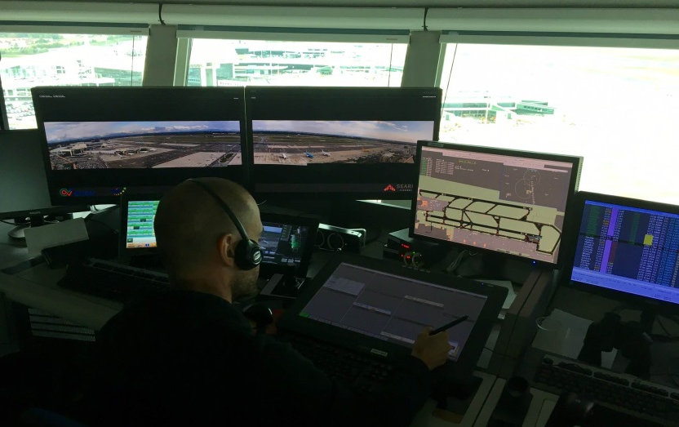
Flight Trial Campaign
More than 100 flights remotely managed through the RACOON Remote Tower Centre:
  82 flights on Linate – Remote Single Airport
  36 flights on Malpensa – Multiple Airport (Local/Remote)
  More than 60 flights in Linate with local control flying RNP-APCH procedures for GNSS monitoring solution purpose
RACOON Open Day – 11/11/2016

Slide 10
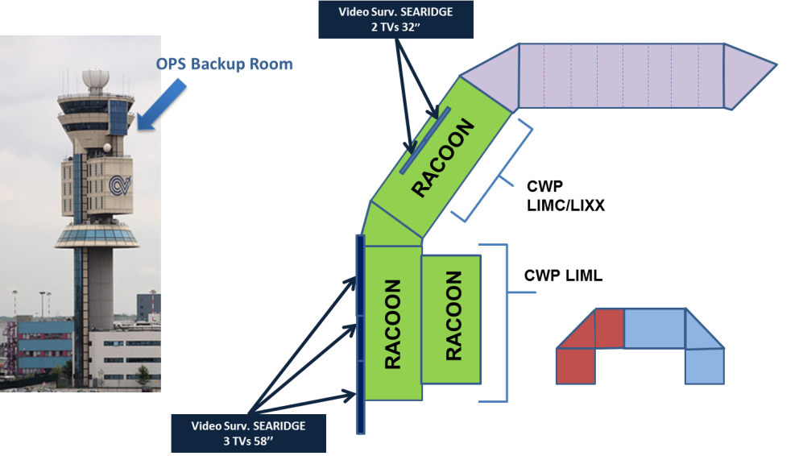
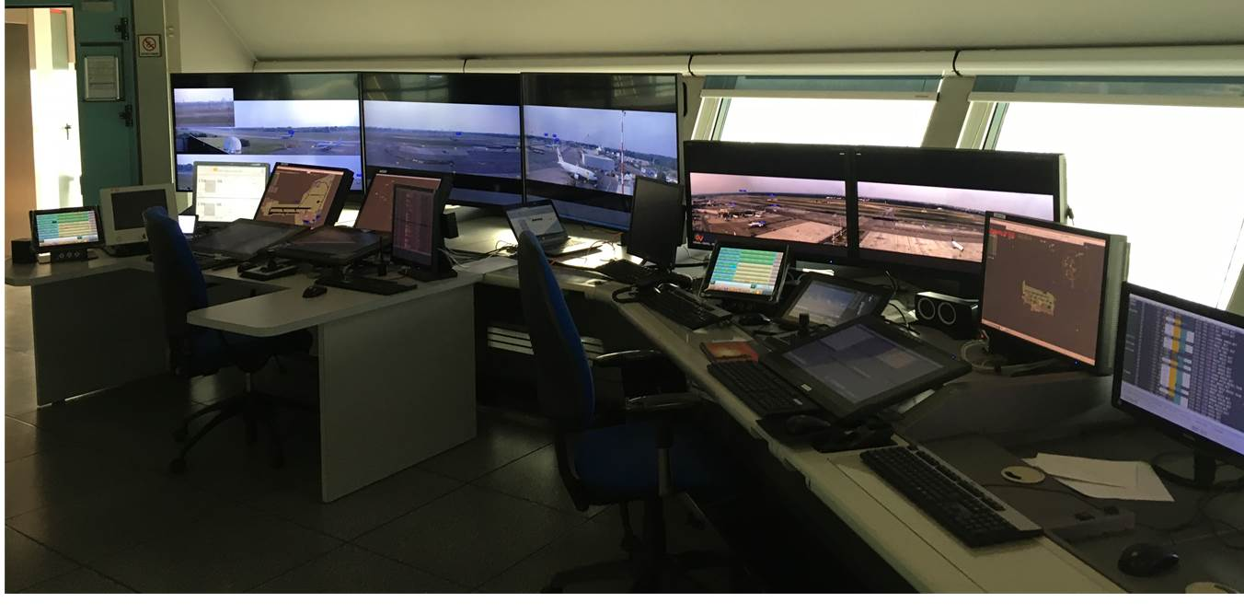
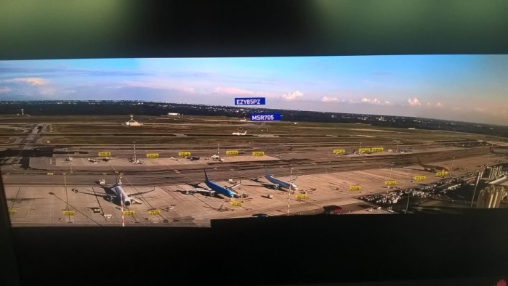
The Test-bed
Full Operational capabilities
Electronic Flight Strip-based environment
Advanced video features:
  Night vision/Infra-red
  Tracking
  Zooming
  Hot-spot cameras
  Preset views
  Information as overlay (radar labeling, contours, gates)
RACOON Open Day – 11/11/2016

Slide 11
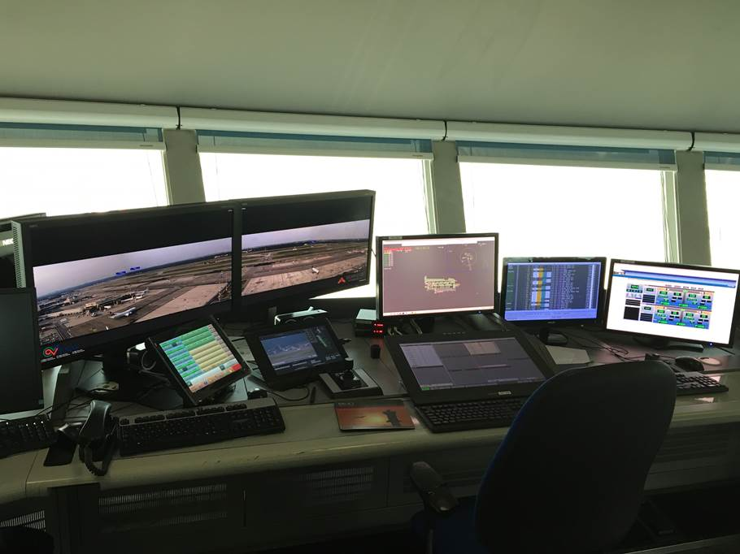
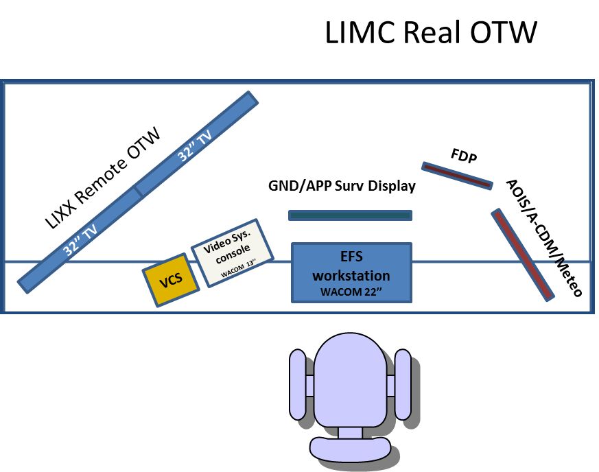
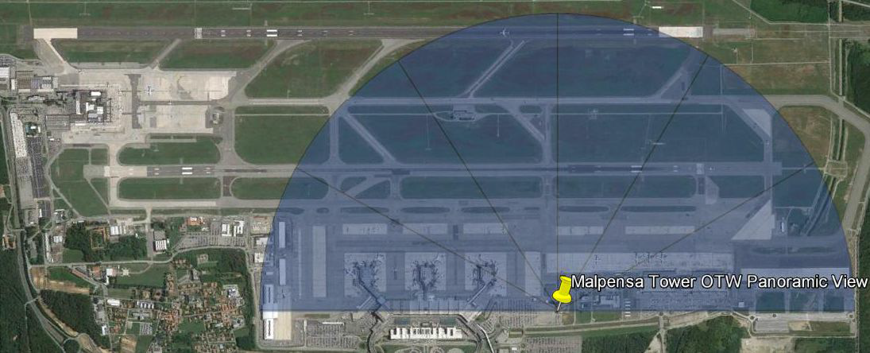
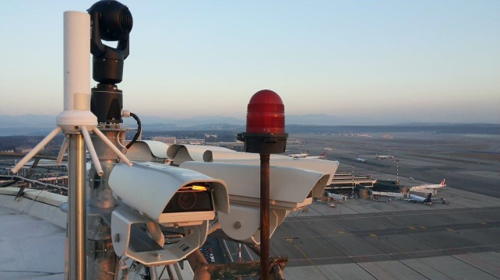
The Malpensa Remote Tower Module
RACOON Open Day – 11/11/2016

Slide 12
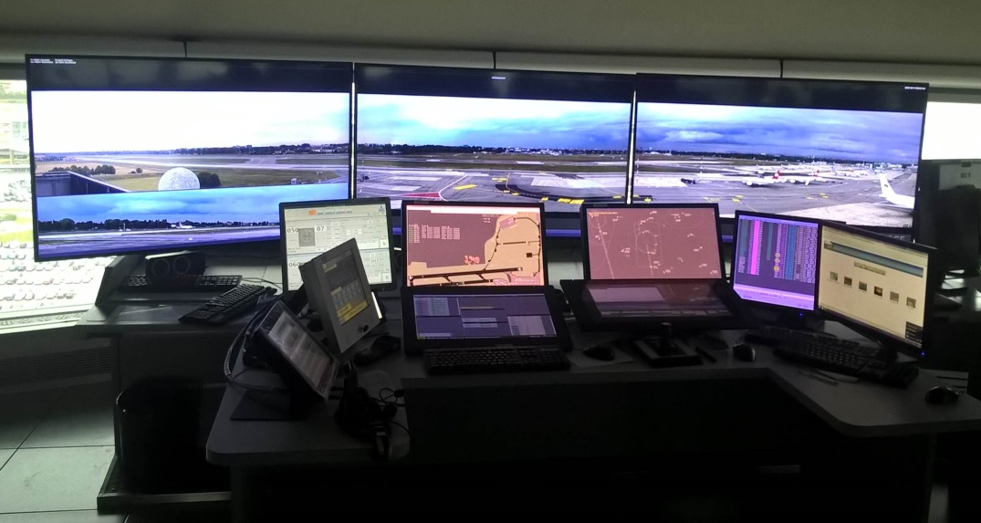
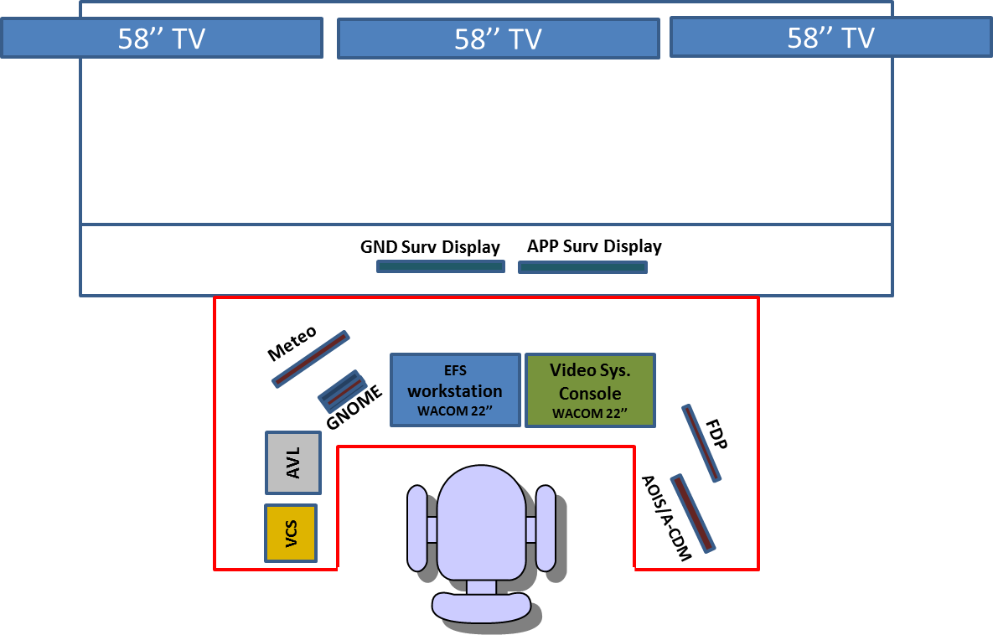
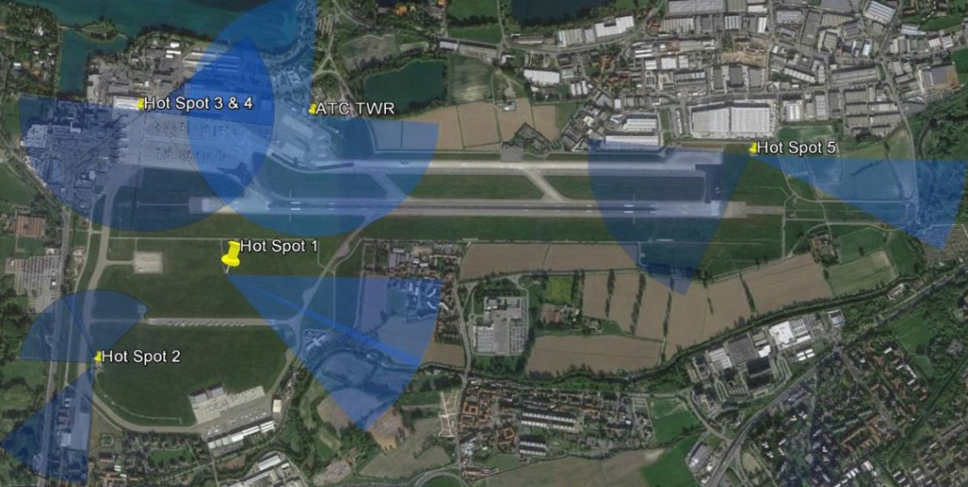
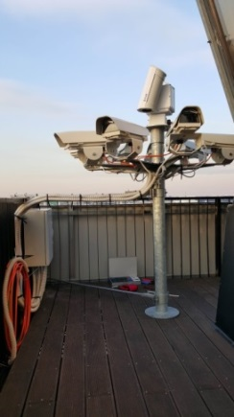
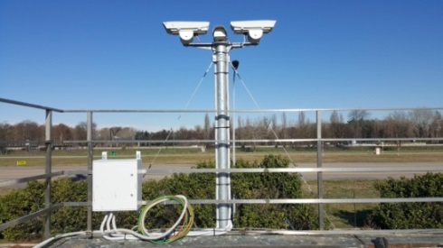
The Linate Remote Tower Module
RACOON Open Day – 11/11/2016

Slide 13

Thanks for your attention
RACOON Open Day – 11/11/2016

