Slide 1
S.E.A. ROLE IN RACOON
Paolo Sordi
Airport Operations Processes & General Aviation Manager

Slide 2
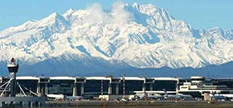
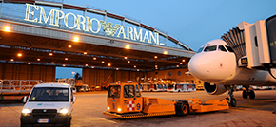
SEA - MILAN AIRPORTS MANAGING COMPANY
SEA (Società Esercizi Aeroportuali) is the group responsible for managing Milan Malpensa and Milan Linate airports providing all services and related activities. It is one of the ten biggest airport operators in Europe for goods and passenger traffic, while it is the second-biggest in Italy for the number of passengers handled and the biggest in the country for goods transported.
Situated in one of the most developed catchment areas in Europe, the airports of Milan have demonstrated constant, rapid and virtuous growth.
The richest catchment area in Italy (produces nearly 1/3 of Italy’s GDP);
14.2 million companies (24% of the total number in Italy) situated here;
Nearly 40% of Italy’s import/export market based here;
Strategic position, connected to the heart of Europe.

Slide 3
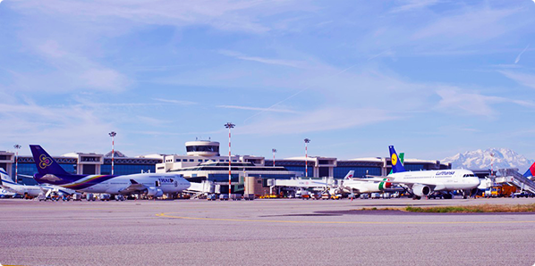
SEA - MILAN AIRPORTS MANAGING COMPANY
Milano Linate and Malpensa Airports represent
The second-biggest airport system in Italy and ninth-biggest in Europe for passenger traffic;
Leading airport system in Italy, sixth-biggest in Europe for goods traffic;
Over 180 destinations across the world, with no stopovers.
Milan Malpensa and Milan Linate constitute an airport system that guarantees civilians and economic operators an extensive network of links with Italy, Europe and the rest of the world, thus contributing to the economic and social development of the North of Italy and the country as a whole.

Slide 4
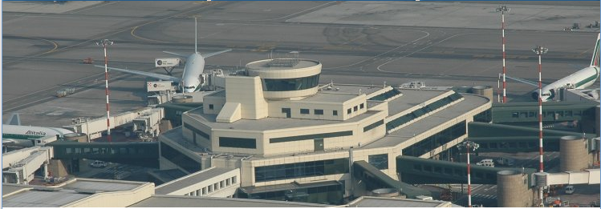
SEA ROLE IN THE PROJECT
In Italy, as in many countries, airport lightning belong to ANSP provider ENAV at all airports.
Linate and Malpensa are an exception to the rule because at these airports, for historic reasons, the Managing Company S.E.A. owns and maintain airport lightning.
Moreover S.E.A. owns and operate a fiber optic LAN between the two airports, LAN that has been used to transfer video and Gnome signals between Linate and the Remote Tower Centre at Malpensa.
For these reasons S.E.A. participation in RACOON was instrumental for the success of the project.

Slide 5
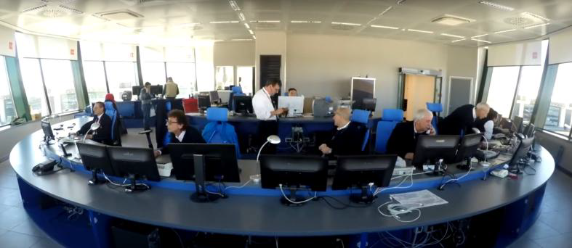
SEA ROLE IN THE PROJECT
For SEA, RACOON represented an occasion to test possible solutions and technologies in airport monitoring (video camera, remote sensors, etc..).
The success of the project highlighted also the possibilities, offered by signals remotization, in terms of emergency-contingency solutions.

Slide 6
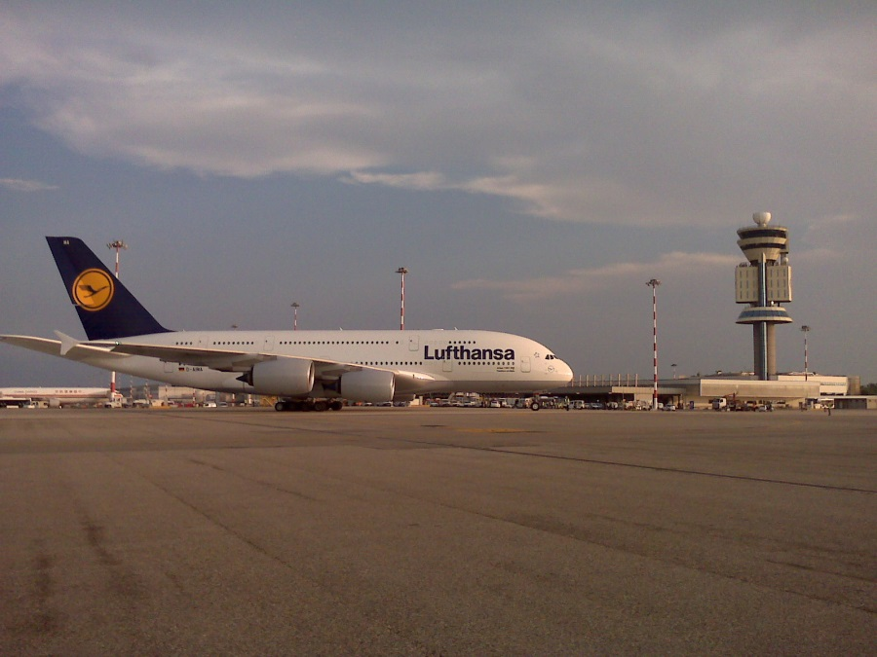
SEA ROLE IN THE PROJECT
It is necessary to bear in mind that hackers attacks, terrorists attack, black out, damages of various entity and cause could impede the correct Tower Operations thus blocking airport operations.
A remote installation could grant, at least, partial airport operability depending upon level of sophistication.

