Slide 1


Slide 2

Communication is a contractual obligation
Horizon Europe - Article 17 and Annex V
Project beneficiaries are obliged to:
Promote activities according to a communications plan.
Display logos of funding bodies and disclaimer
Acknowledge the source of the funding.
Coordinate all planned activities between consortia members and with the SESAR 3 JU
1
2
3
4
Breach of contract obligations
may lead to reduced grant
Notes:
https://ec.europa.eu/info/funding-tenders/opportunities/docs/2021-2027/cef/agr-contr/mga_cef_en.pdf
https://ec.europa.eu/regional_policy/en/information/logos_downloadcenter/

Slide 3

Promote activities according to a communications plan.
1
Article 17.1
Inform, promote and communicate activities and results
Develop a communications plan
Target multiple audiences (including the media and the public)
Convey clear and simple messages
Use the right media channels
Communicate throughout the lifetime of the project
Before engaging in a communication expected to have a major media impact, the beneficiaries must inform the granting authority (SESAR 3 JU)

Slide 4


Display logos of funding bodies and disclaimer
2
3
Article 17.2/3 and Annex 5
Logos
To be used for:
Activities media relations, conferences, seminars, etc,
All material: website, publications, posters, presentations, roll-ups, etc
All formats: paper, digital
Infrastructure, equipment, vehicles, supplies or major results funded by the grant
Acknowledgement (For Horizon Europe projects only)
The project is supported by the SESAR 3 Joint Undertaking and its founding members.
Disclaimer
‘Funded by the European Union. Views and opinions expressed are however those of the author(s) only and do not necessarily reflect those of the European Union or SESAR 3 JU. Neither the European Union nor the SESAR 3 JU can be held responsible for them.’

Slide 5
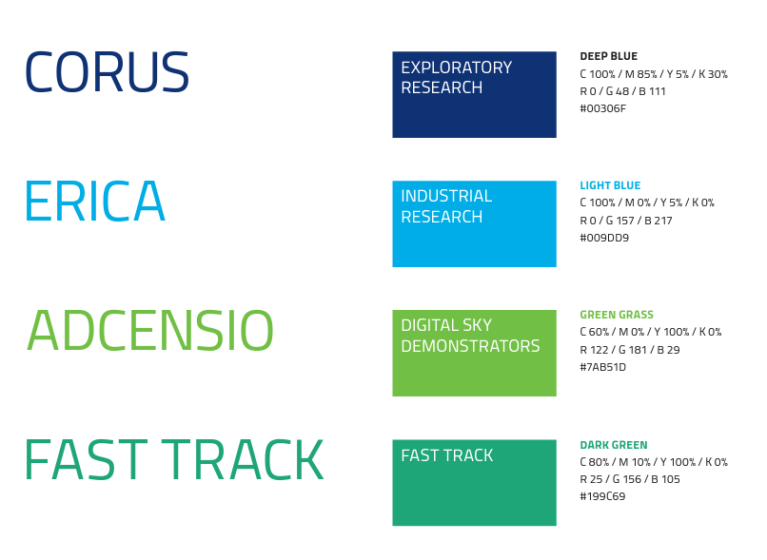
Additional SESAR 3 JU branding components
2
3
Streamlined visual identity for projects:
Project logo style per programme strand
Association with SESAR 3 JU logo, EU emblem and grant agreement text.
To be used in all communications material
All logos are available in STELLAR under the call name.

Slide 6
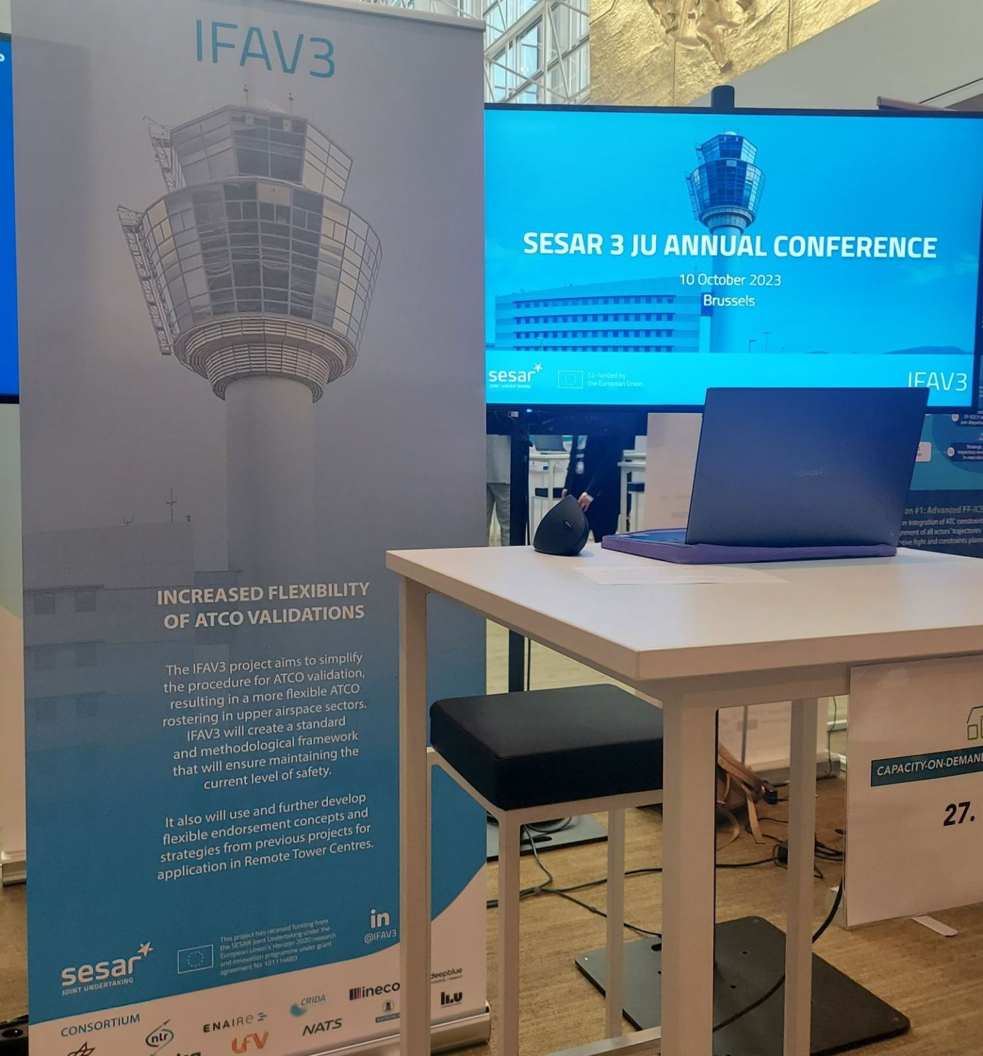
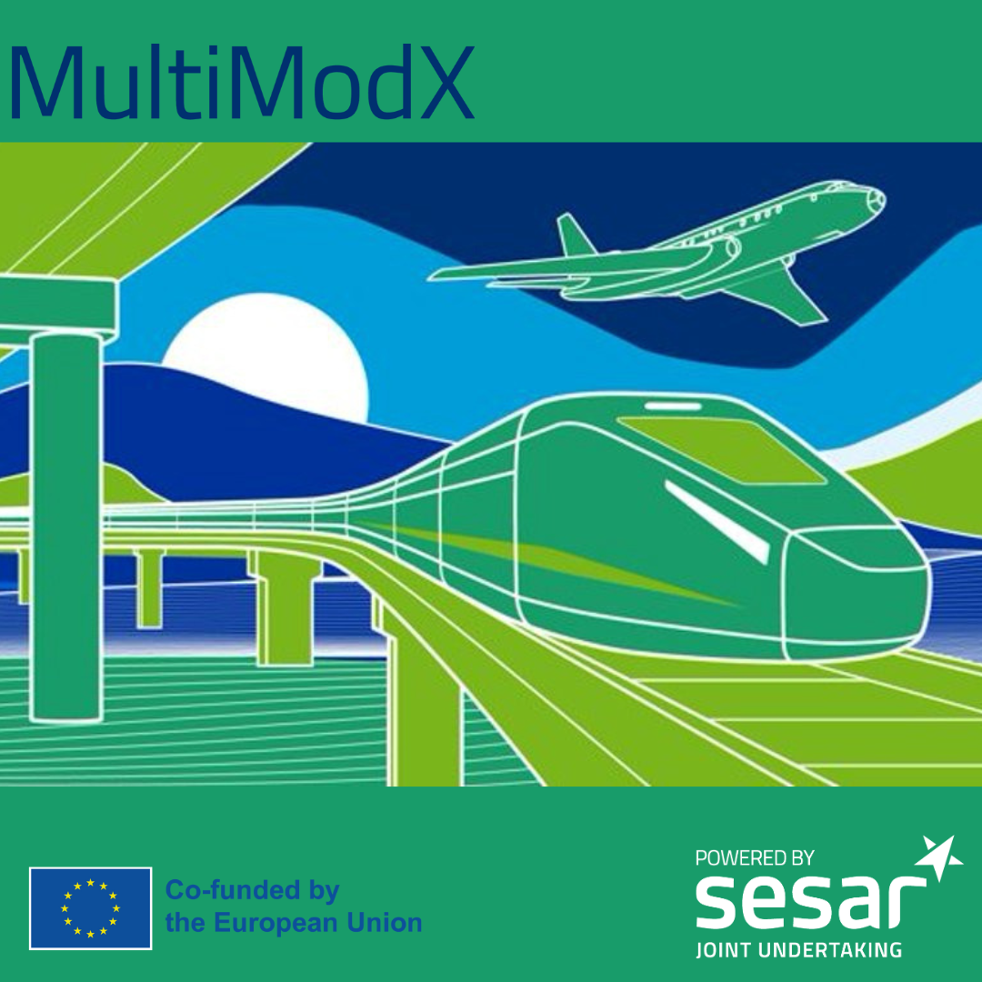
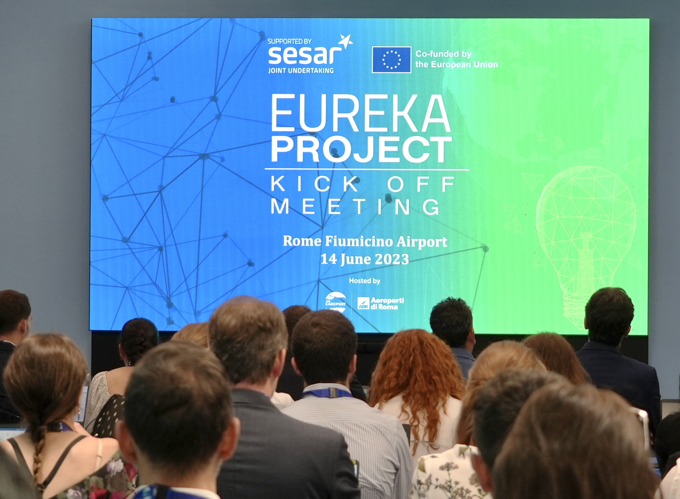


Examples of project branding
2
3

Slide 7

Coordinate all planned activities between consortia members and with the SESAR 3 JU
4
Ensures that project communications and outreach milestones are integrated into broader SESAR 3 JU communications scheduling and planning;
Enables a consistency check of project strategies, key messages, targeted audiences and communications material and an alignment with the SESAR 3 JU’s core objectives;
Provides communications support of the SESAR 3 JU in promoting project events and conferences;
Maximises outreach by using SESAR 3 JU communications channels and cooperative arrangements to further cascade relevant content.
Projects will be requested to appoint a communications point of contact (PoC).

Slide 8
SESAR JU website
SESAR JU logos and visual identity charter
EU emblem and guidance on its use
E-newsletter and subscription
Guidance | Project's teaser videos guidelines Full communications guidelines on the SESAR 3 JU collaborative platform (STELLAR) Project presentation template
Social media channels | @SESAR_JU (Twitter), @SESAR Joint Undertaking (LinkedIn), SESARJU (Youtube) @HorizonEU (Twitter) and @European Commission (LinkedIn) @cinea_eu (Twitter), cinea - european climate, infrastructure and environment executive agency (LinkedIn)
Social media hashtags | #ATM #DigitalSky #innovation #SESARJU HorizonEU #MobilityStrategy #Uspace #HorizonEurope #CEFTransport
Key publications | https://www.sesarju.eu/publications
Videos | SESAR 3 JU animation: https://youtu.be/KWL9DJwMewE Digital European Sky: https://www.youtube.com/watch?v=chx27ZrlPoM&t=156s

Slide 9
