Slide 1
Welcome to the
SESAR Innovation Days!
Dirk Schaefer, EUROCONTROL

Slide 2


Slide 3
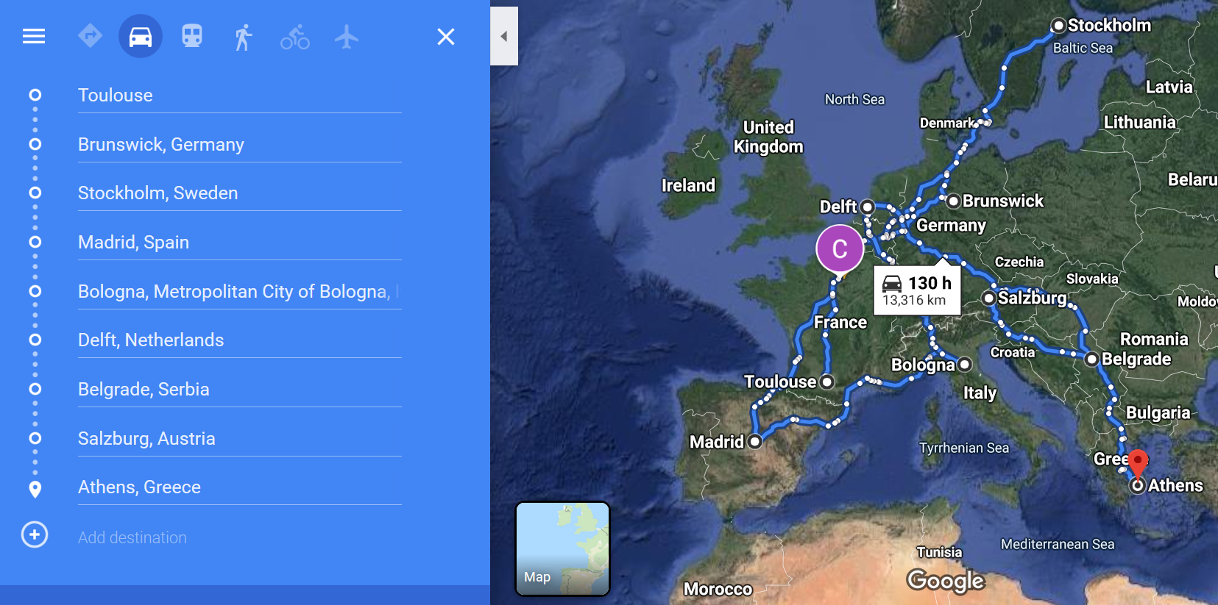

Slide 4
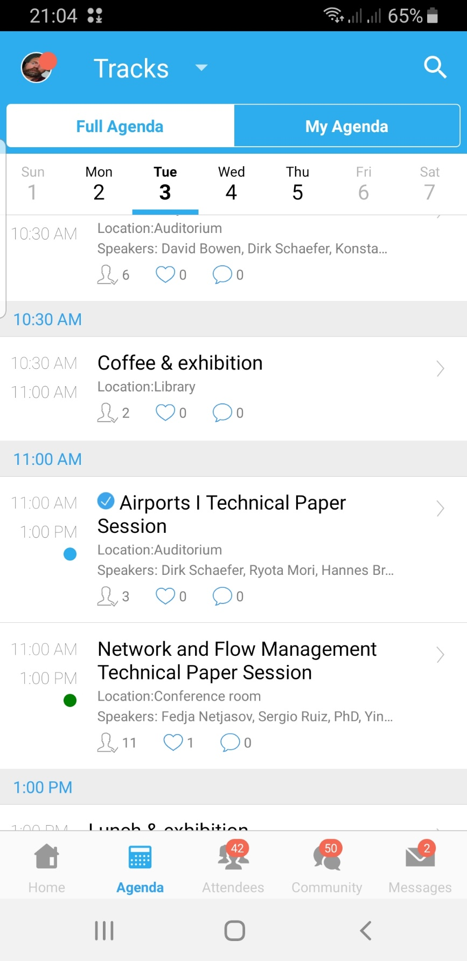
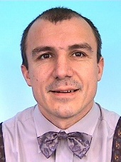
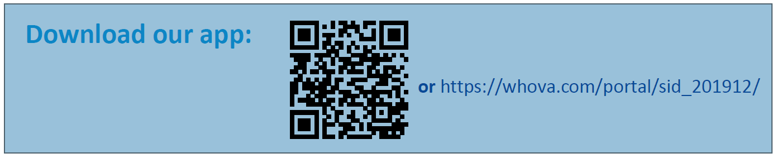
Please use the App and check for latest news – requires downloading Whova
App has all the information you need, you can schedule your sessions
Thanks to Rémy!
Presenters please meet your session chairs in the room where your session takes place in the break prior to the session
30 min for each presentation (including Q&A) – exact timing required to allow audience to switch between sessions

Slide 5
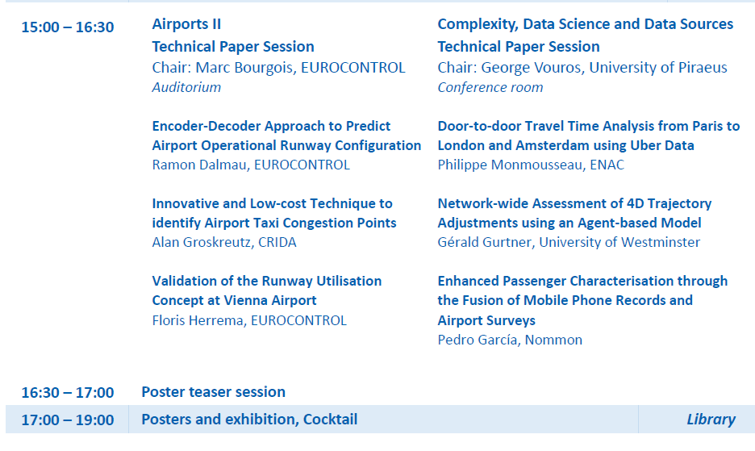
Poster teaser session on Tuesday at the end of the technical paper sessions
8 poster teasers in each of the two technical sessions – schedule has been sent to presenters
Cocktail and poster session thereafter
PC dinner after the cocktail

Slide 6
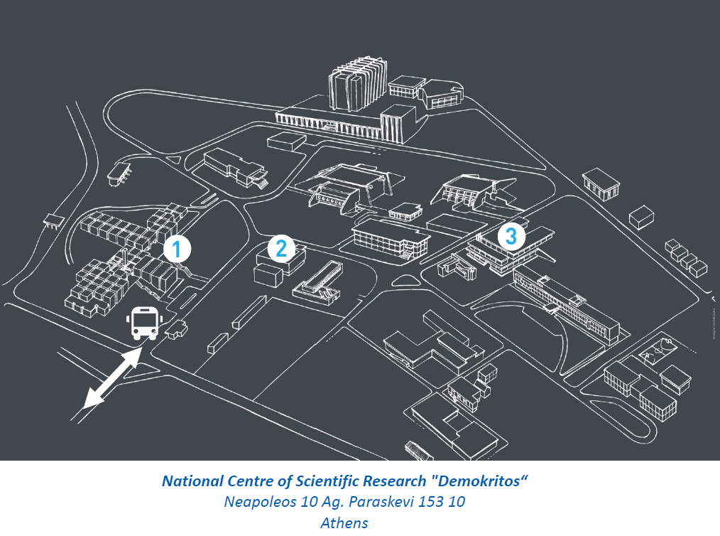
1: Auditorium, Foyer, Conference Room
2: Library
3: Meeting Rooms

Slide 7
1: listen and debate
2: eat & drink
3: other stuff

Slide 8
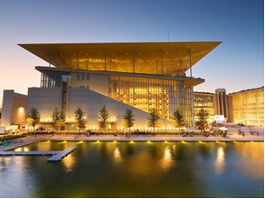
Networking event
You have registered (or did not) with your registration for the SIDs
Buy your tickets (35€) and bring them along for the dinner
If you registered but can’t come please let the registration desk know
There is a waiting list – come and see the registration desk

Slide 9
Other things
Speakers please upload final versions of the presentations and paper updates (if any) after the SIDs
Photography: pictures will be taken, please see registration desk if you have a problem with this

Slide 10
Enjoy the SESAR Innovation Days!

