Slide 1
Research & Innovation in AI for Aviation
Moderated by the SESAR JU

Slide 2
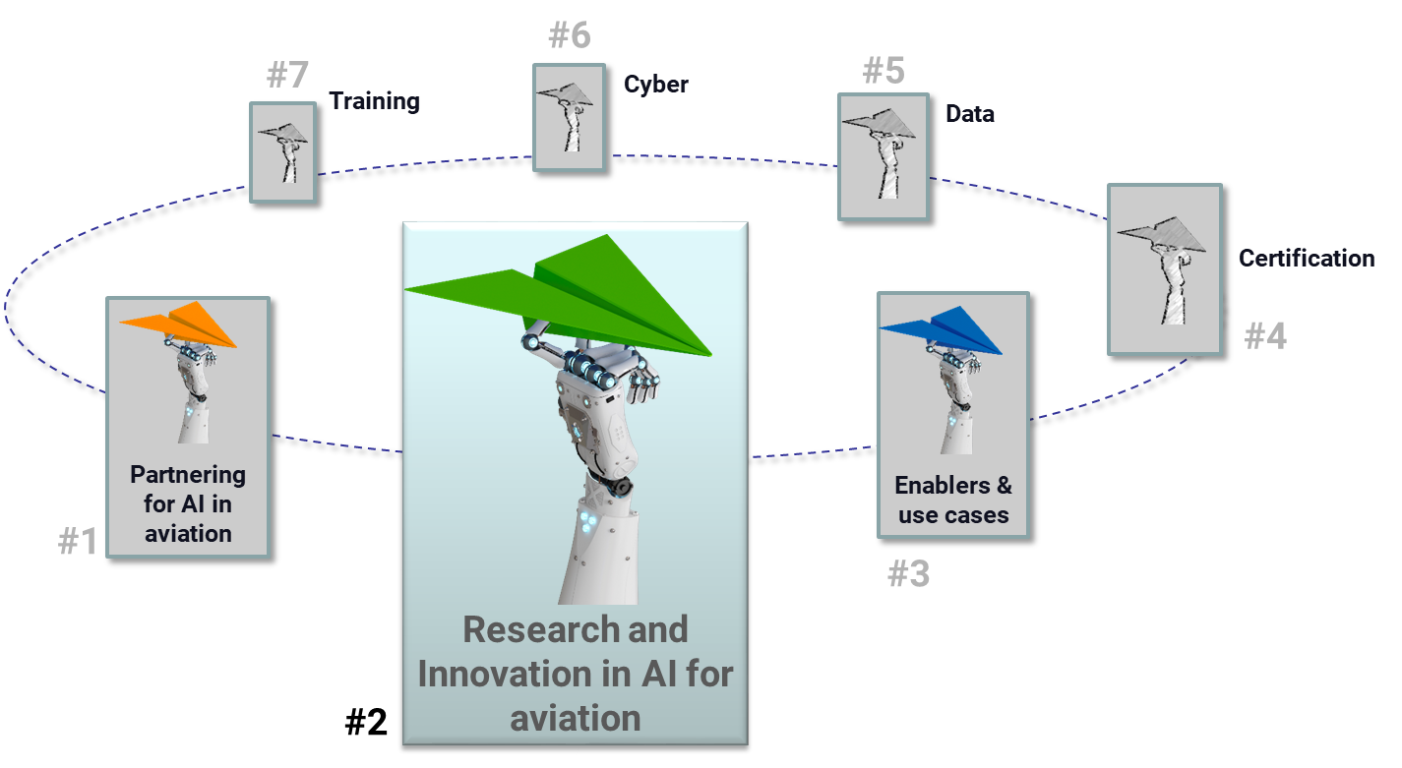
Our session today
How advanced is Research and Innovation in AI for aviation?

Slide 3
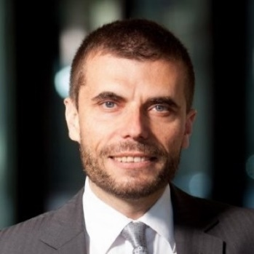
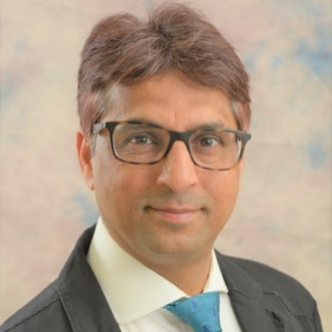


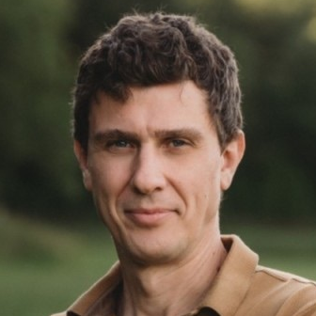
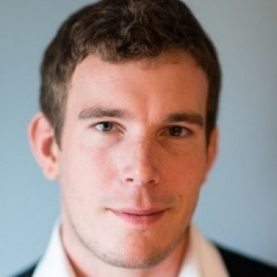
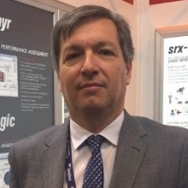
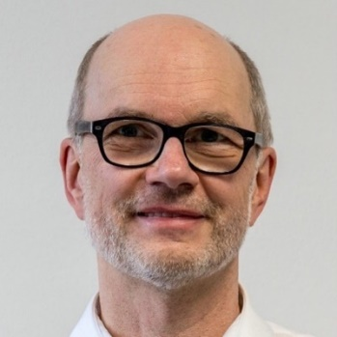




Our panellists today
Florian Guillermet
Executive Director
Sameer
Alam
Associate Professor, Nanyang Technological University, Deputy Director, ATM Research Institute.
George Papageorgiou
Director of Advanced Technology
Robin
Hughes
Former Head of Engineering, LFV Director of Autonomous Systems, RISE
Ricardo Saenz Amand
Director of Defence and Security Programmes, GMV
Hartmut Helmke
Scientific Researcher

Slide 4
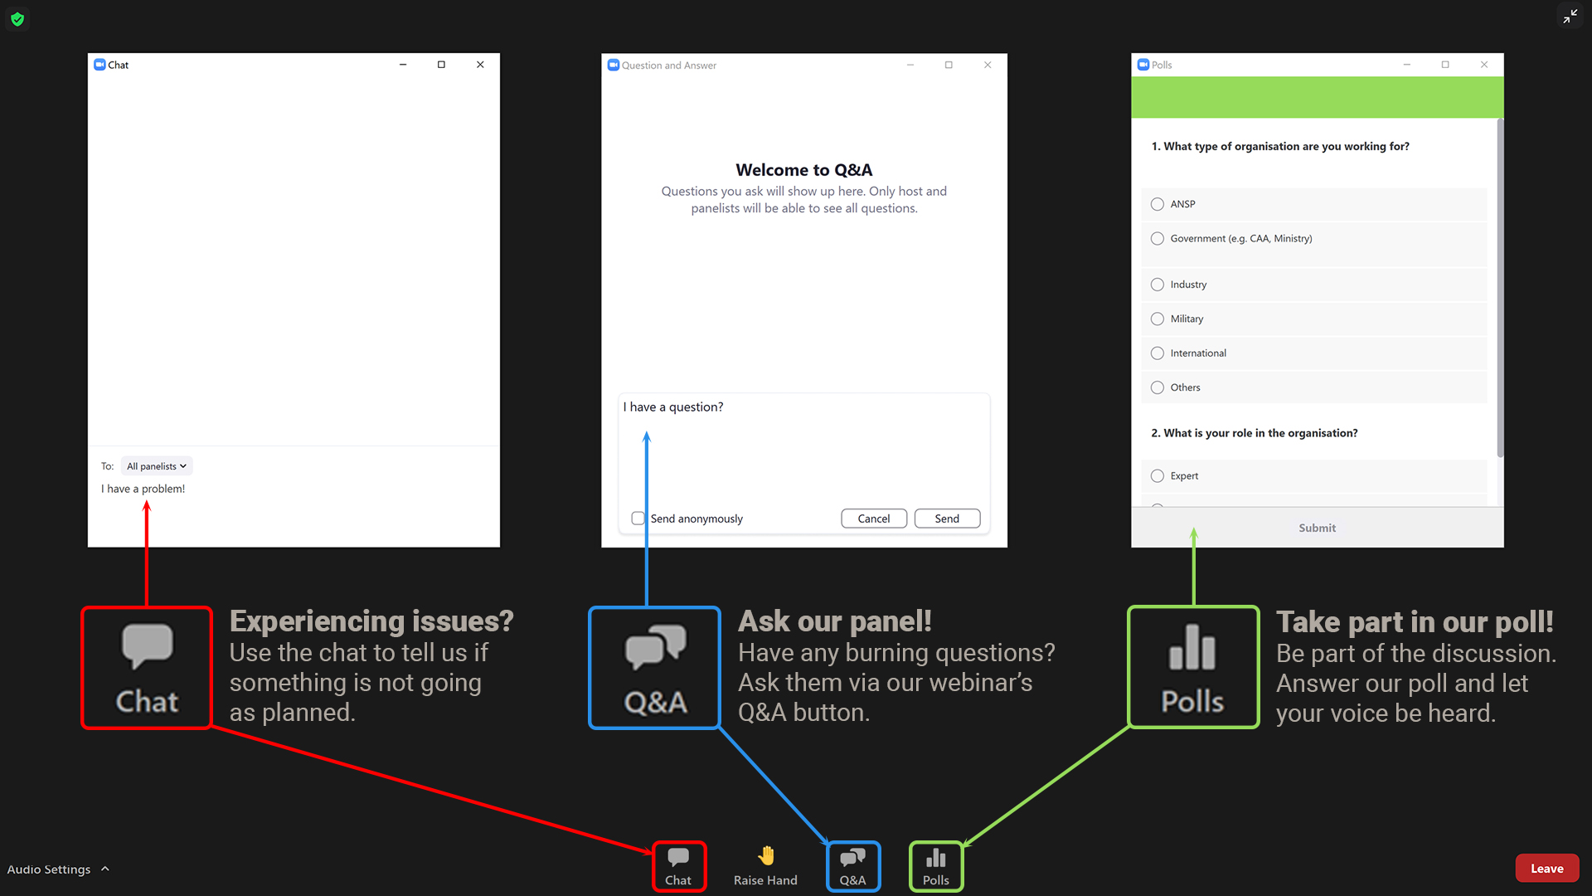


Slide 5
    THANK YOU
    to our panellists &
    participants!

Slide 6
    Stay tuned for our next
    “FLY AI” webinar on:
    CANSO AI White Paper: AI enablers & ATM use case
    12 April

