Slide 1
COTTON.- Capacity Optimisation for Trajectory Based Operations
Eva Puntero – ATM R&D engineer at CRIDA A.I.E. - epuntero@e-crida.enaire.es
Danlin Zheng – ATM R&D engineer at CRIDA A.I.E. - dzheng@e-crida.enaire.es

Slide 2

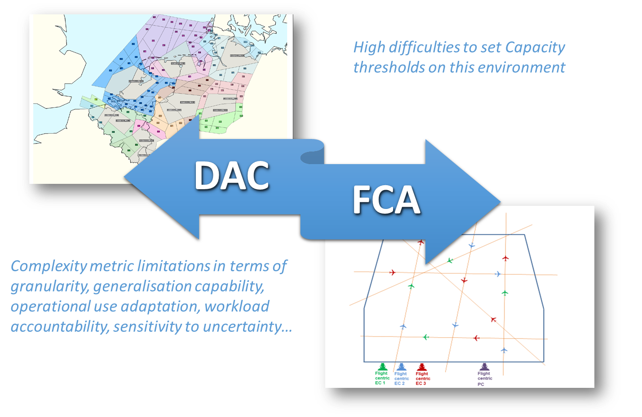
Problem Statement
Capacity
Demand
Complexity and Workload is assessed at sector level
Capacity Thresholds are linked to operational sectors
How should DAC and FCA coexist?
Uncertainty Management relies on human expertise
Notes:
Trajectory-Based Operations brings together many different improvements that allow the uncertainty of trajectory prediction to be better managed and reduced (e.g. downlinking of the Extended Projected Profile, sharing of detailed information on the ground through SWIM (IOP), the use of 4D contracts during the flight or increasing adoption of airport CDM).
Current systems and operational processes mostly rely on human experience to deal with uncertainty. The result is often that a very imprecise balance is struck between demand and capacity, leading to capacity going unused, thus rendering the DAC process inefficient and difficult to automate.
Although several state-of-the-art techniques have been developed to determine the uncertainty associated to an aircraft trajectory prediction (based on machine learning [9], statistical analysis [10][11], or model driven parametric analysis [12]), COTTON identified a need to work on the integration of the available uncertainty models into the Capacity Management processes

Slide 3
COTTON Overview
Capacity
Demand
Develops Probabilistic Complexity integrating demand uncertainty
To analyse controllers’ workload and airspace configurations´ capacity
To manage capacity in Dynamic Airspace Configuration and Flight Centric ATC environments

Slide 4
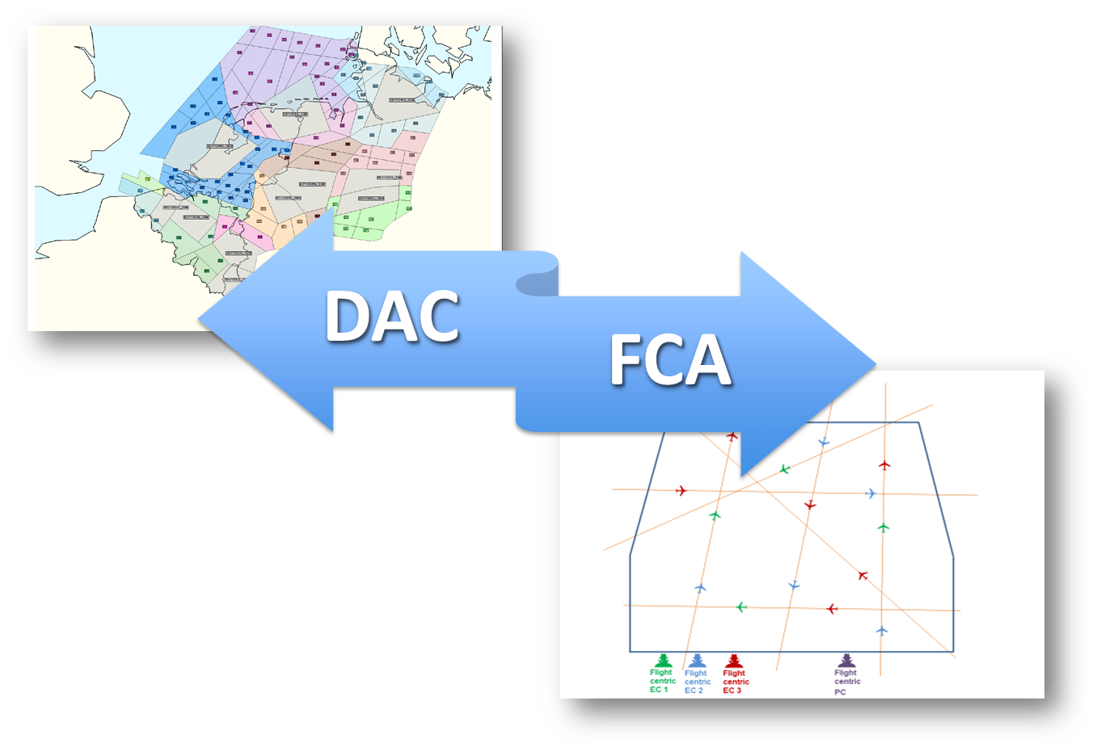

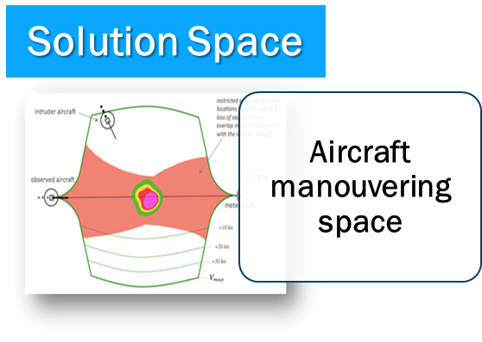
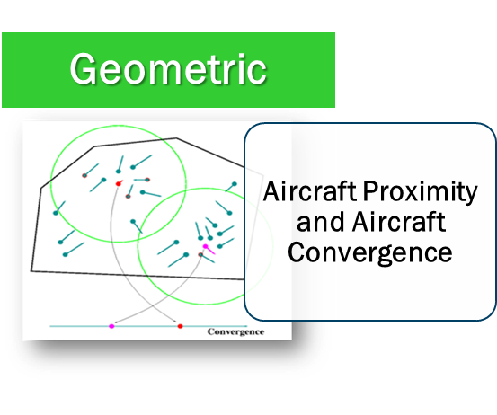
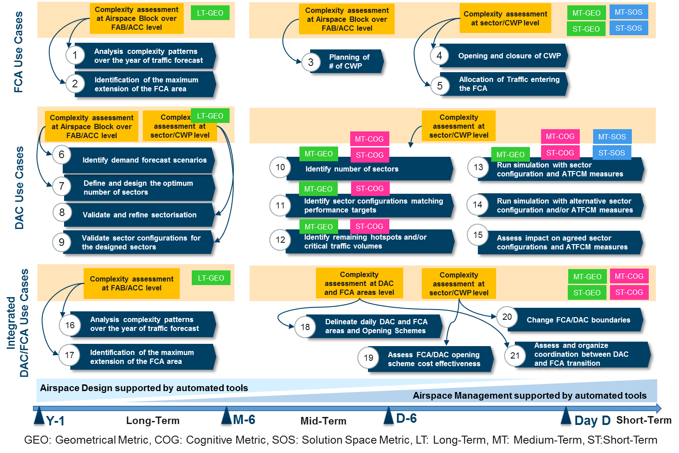
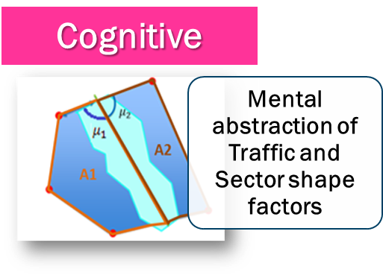
COTTON Results
Example of COTTON Application
Improved Complexity Assessment
DAC/FCA enhanced processes
DAC/FCA Integration

Slide 5
Improvement of DCB effectiveness
More cost effective and stable airspace configuration planning
Cost-efficiency
Capacity
Better detection rates for overloads.
Reduction of capacity buffers.
Reduced number of sectors and aircraft per sector
More balanced workload
The remaining hotspots are better mitigated.
Safety
Equal or reduced number of conflict and conflict severity
Higher Flexibility on the ANSP strategy for airspace design
Notes:
Identify DAC sector configurations matching performance targets
Identify DAC remaining hotspots and/or critical traffic volumes
More accurate estimation of capacity using complexity
Better prediction of actual overloads improving ATCo productivity
More cost effective planning of the airspace configuration
Increase capacity by reducing capacity buffers needed to ensure safety

Slide 6

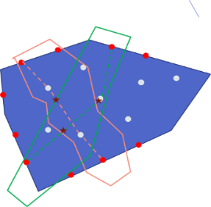
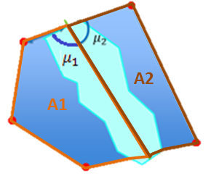

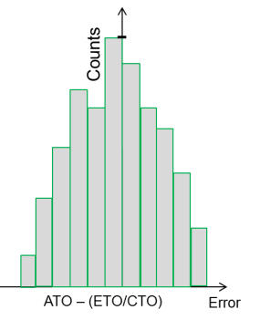
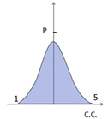
Probabilistic Cognitive Complexity
Cognitive Complexity Parameters
Flows inter-actions
Nº evolving flights
Sector shape factors
Potencial conflicts
Nº non-standard flights
Probabilistic complexity
Demand uncertainty
COTTON tool

Slide 7
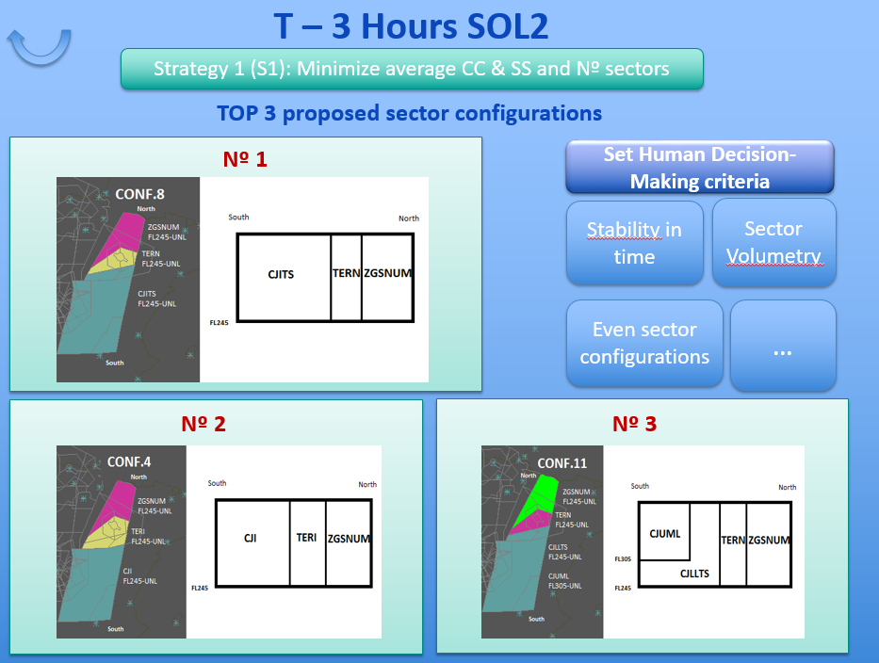
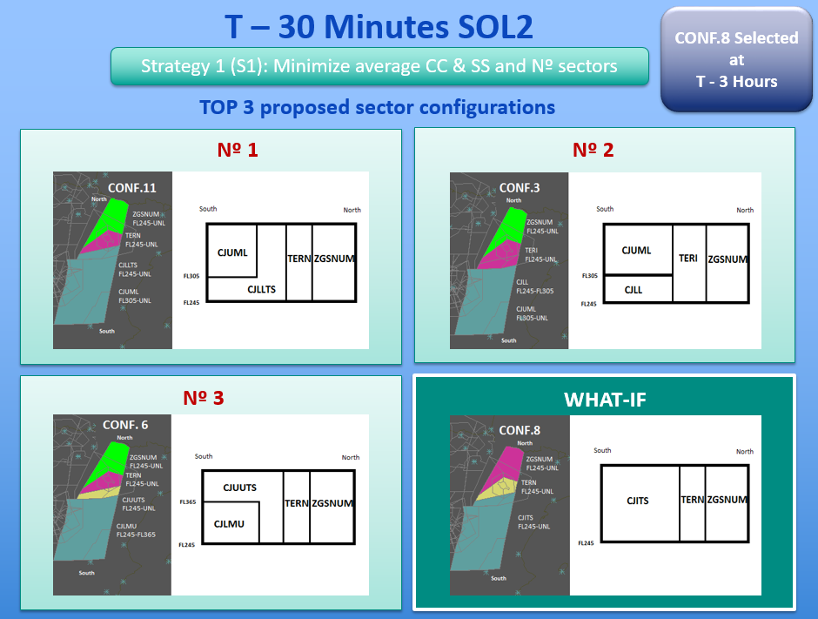
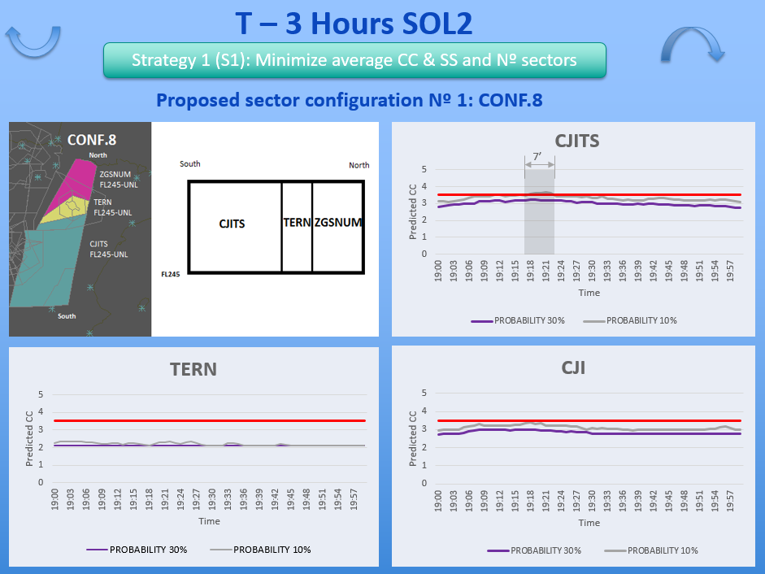
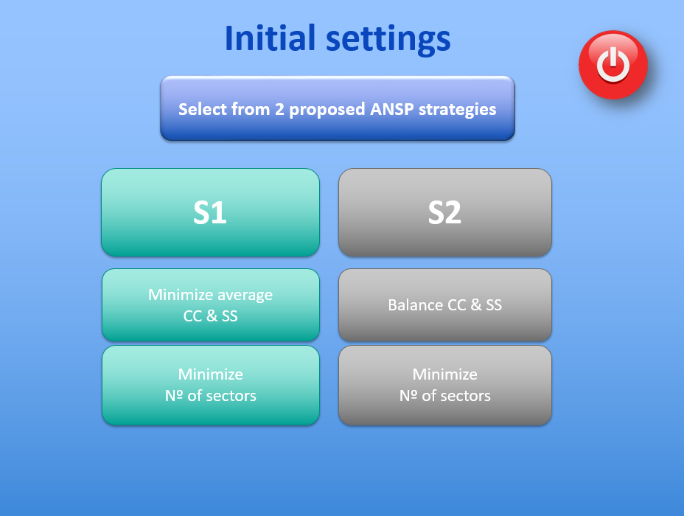
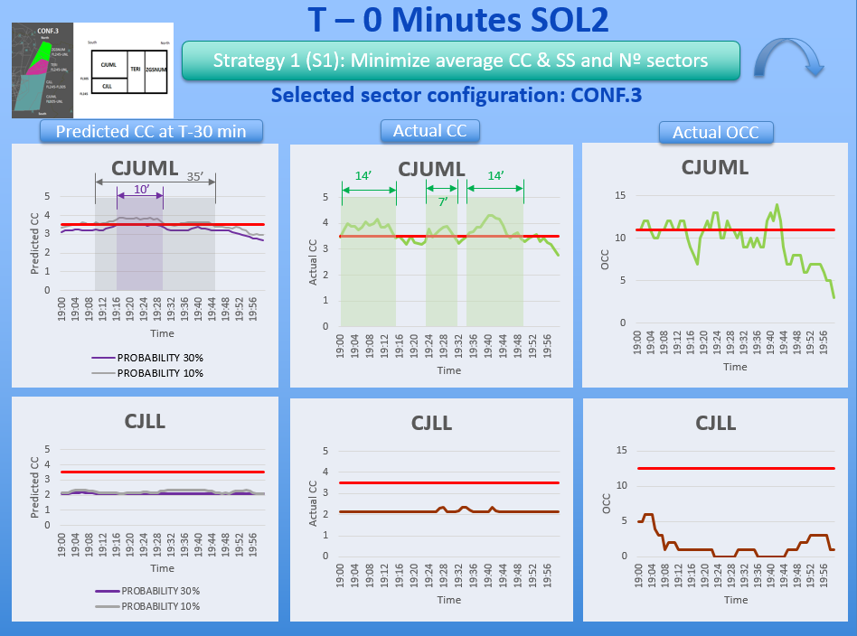
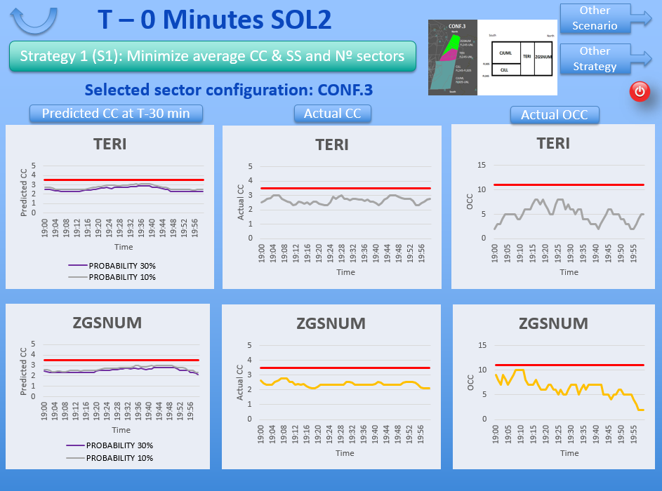



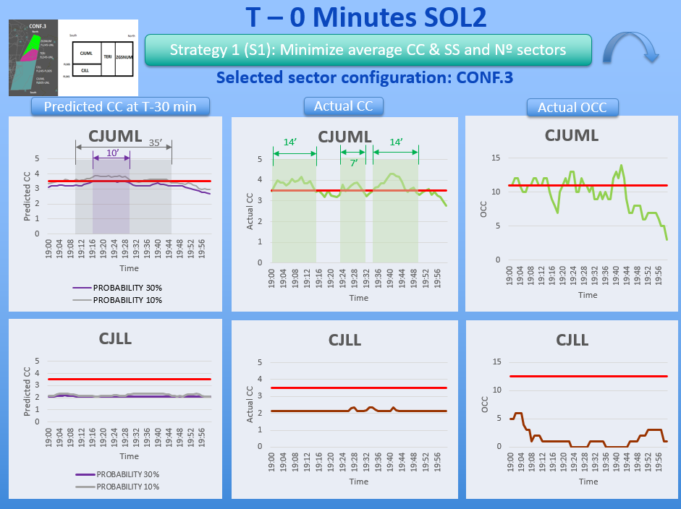
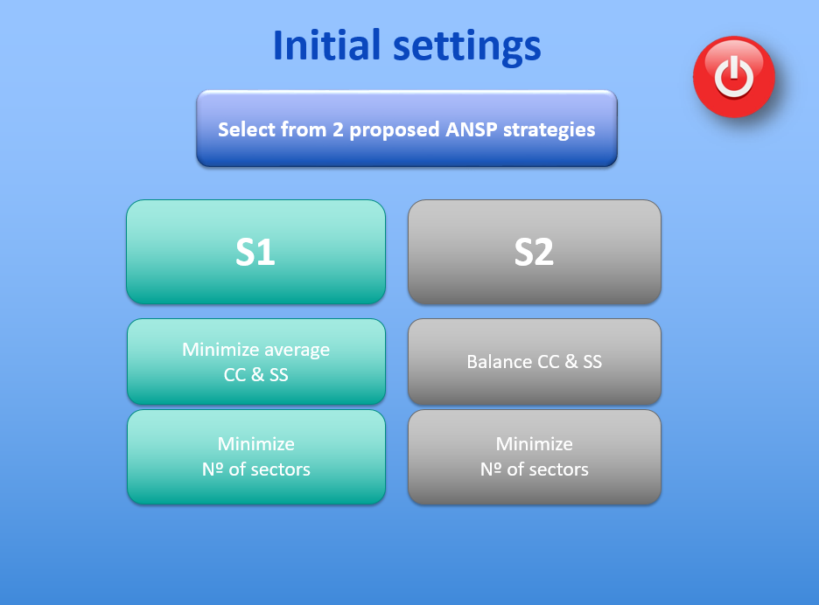
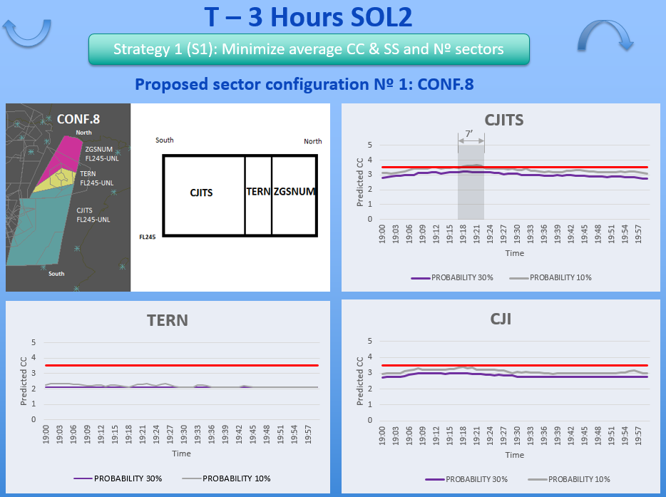
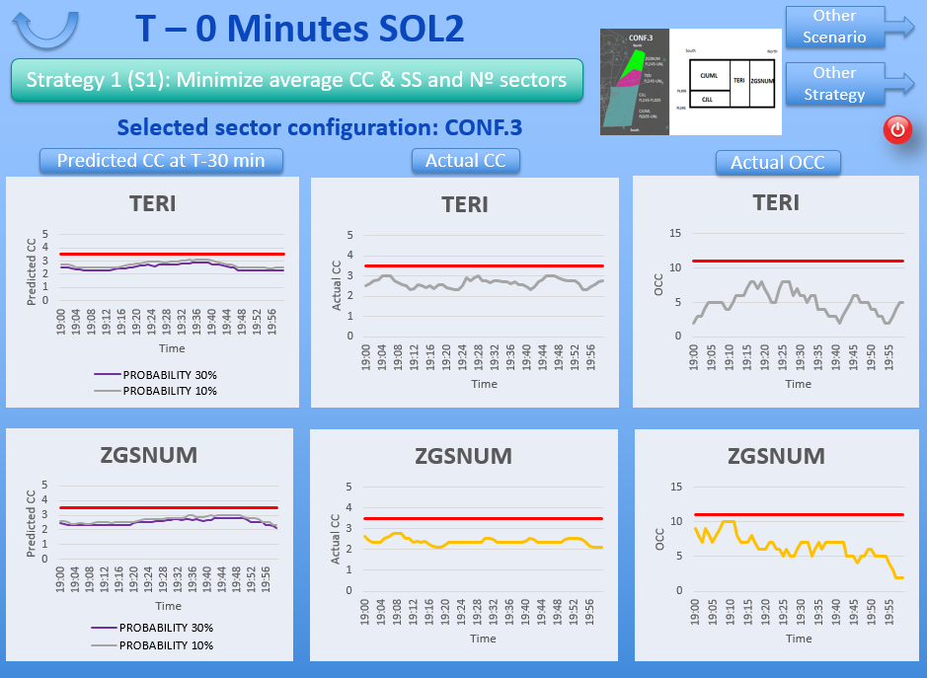
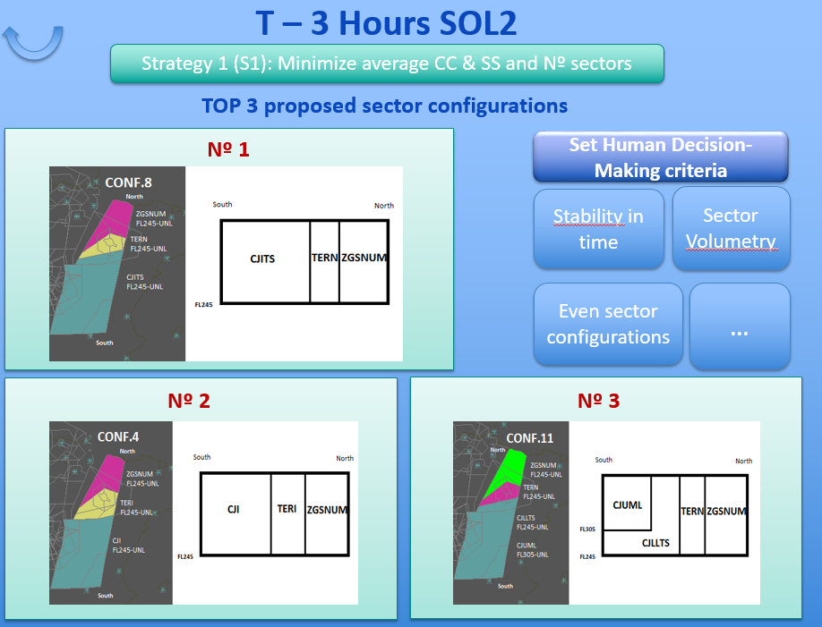
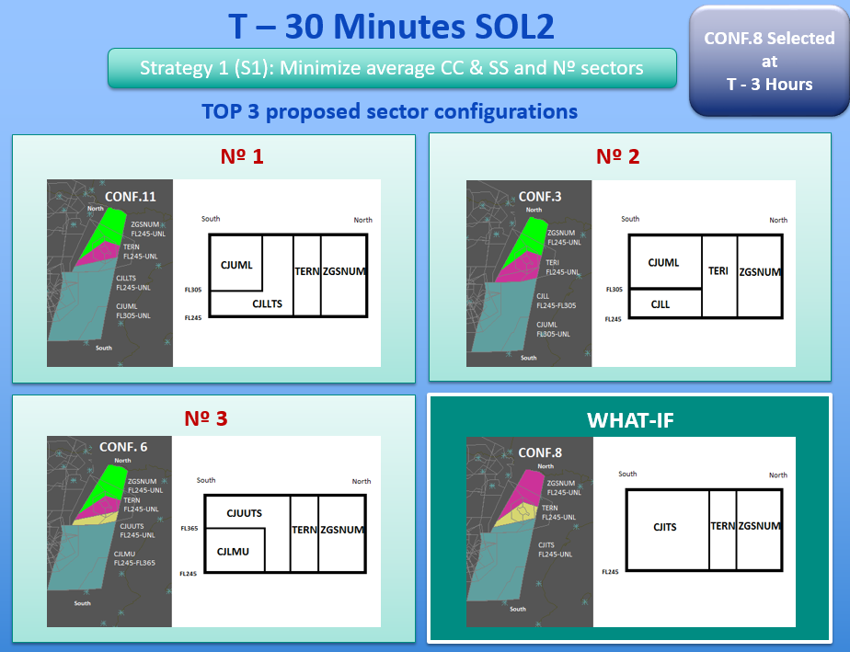
DAC tool proposed by COTTON
Fine tune Cost-Function parameters
Monitor Cognitive (traffic and sector) Complexity
Review sector configuration plan suitability as time evolves
Validate the predicted complexity values with the actual complexity and Occupancies
Select optimal sector configuration at specific time horizon

Slide 8
Next steps
Refine ANSP strategies to ensure the stability of the configuration plan
Cost functions need refinement in terms of
  Underload detection
  ML/AI techniques might be useful to improve predictability.
The presentation of benefits of each configuration per KPA to help decision-making.
Human in the loop activities are needed
  to complement human performance assessment and test complexity thresholds
  to evaluate Human involvement in the decision-making and automation
COTTON results to be included within SESAR IR:
Solution 44: Dynamic Airspace configuration
Solution 45: Enhanced Network Traffic Prediction and shared complexity representation
Solution 73: Flight centric ATC

Slide 9
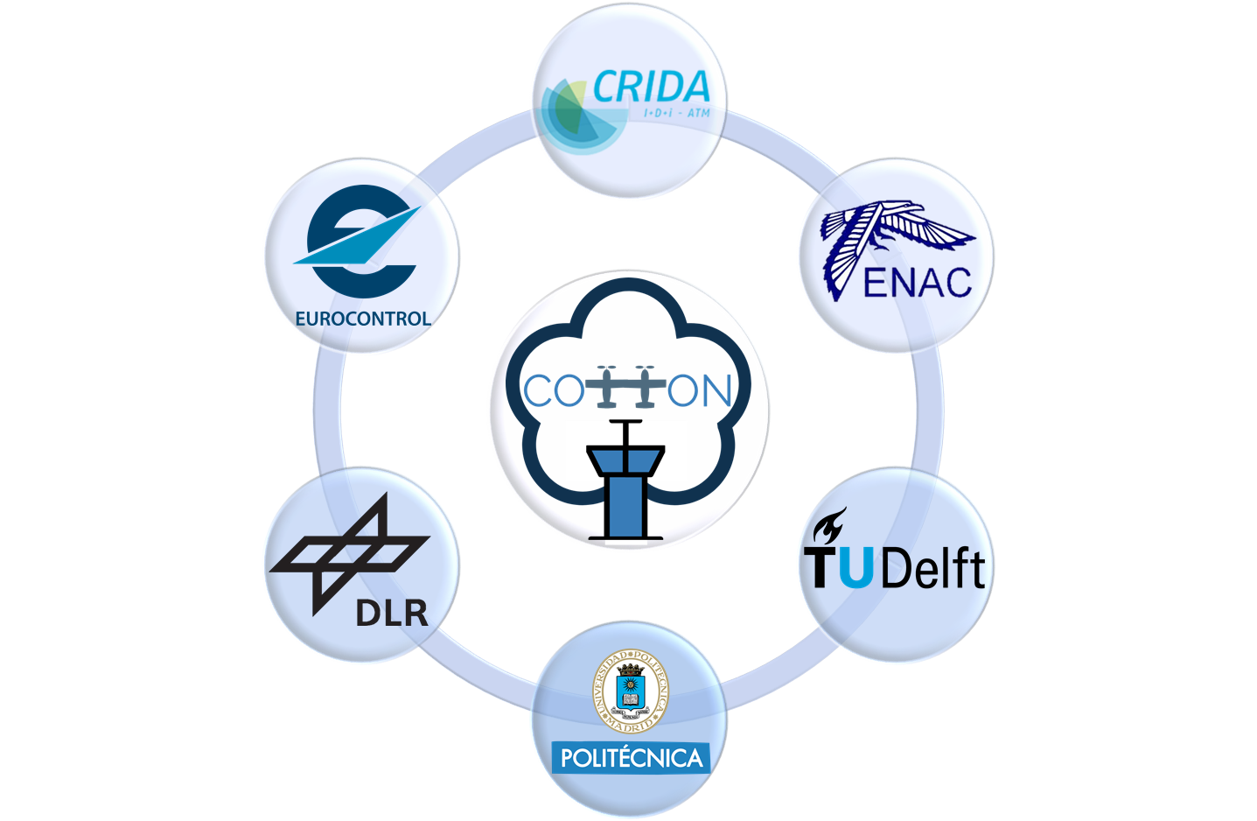
Thank you for your attention!
Find out more about COTTON in…
http://cotton-er.eu/
D2.1: Impact of trajectories’ uncertainty in complexity methodologies
D2.2: Innovative complexity assessment to support Capacity Management processes
D3.1: Enhanced Capacity Management considering DAC and FCA
D4.1: Validation Plan
D4.2: Validation Report
D5.3: Final Project Results Report

