Slide 1


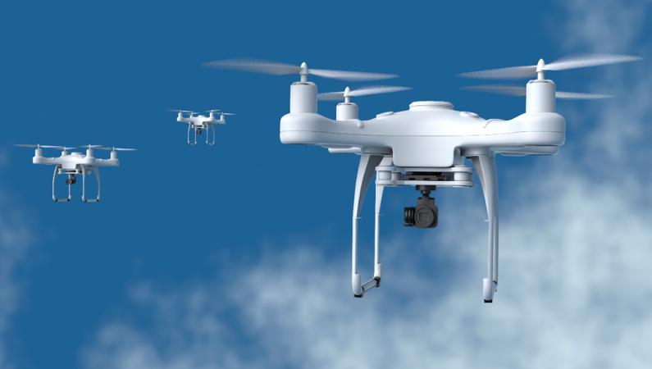

Potential of AI
Notes:
AIs potential to affect ATC in the long run (full automation)
AIs role to help us adjust stepwise to the full automation future
The need to focus research on both near term automation/digital assistance and long term full automation to ensure readiness for the future.

Slide 2

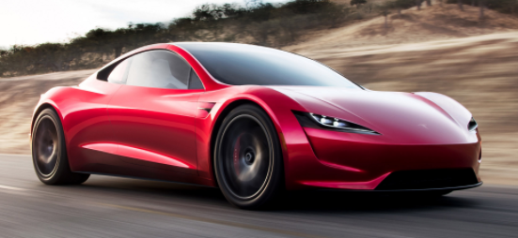


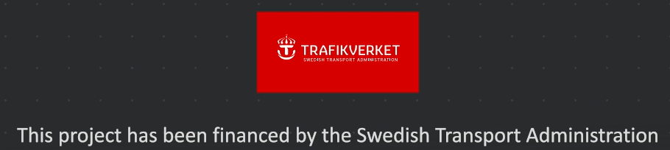
Advanced autoplanner background
Notes:
Automation of cars and regulators acceptance for autopilot functions in chaotic environment
Strong ATCO involvement
”AI mature” partnership
Funding by Ministry of Transportation
Transfer from datadriven ML development to algorithm development using AI functionality

Slide 3

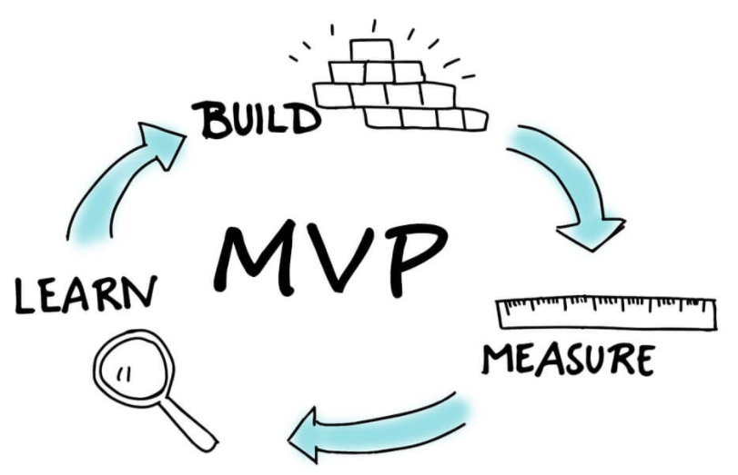


Key factors for success
Notes:
Full automation focus, rather than HF focus
New ways of working
Small and dedicated development team
Agile, design thinking methodology, minimum viable product
”Safetycase enabled” development through explainable AI

Slide 4

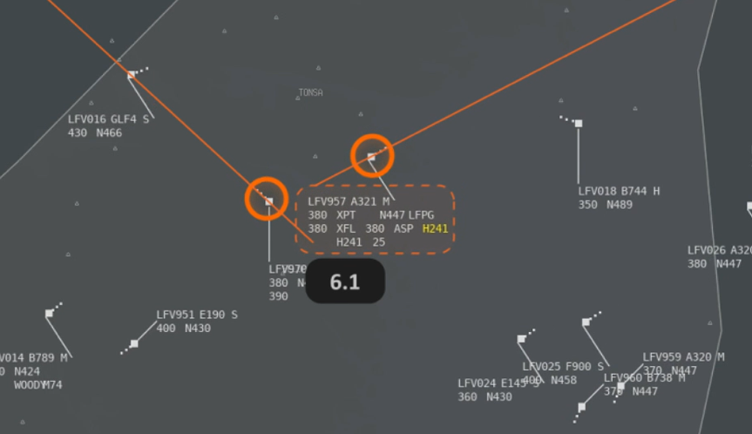
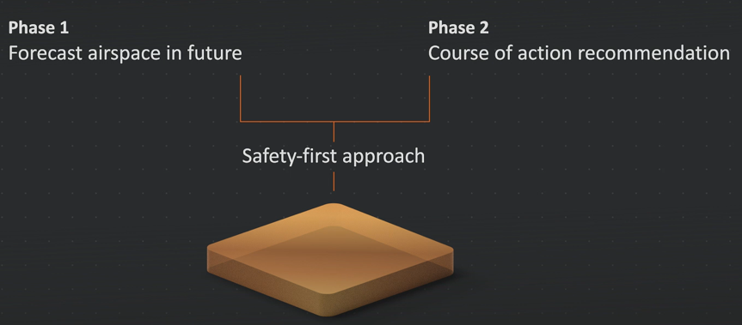
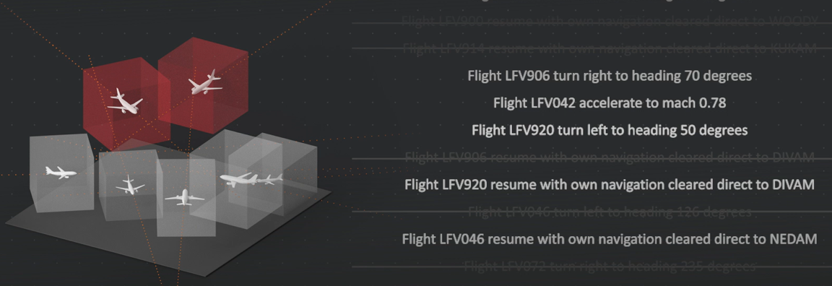
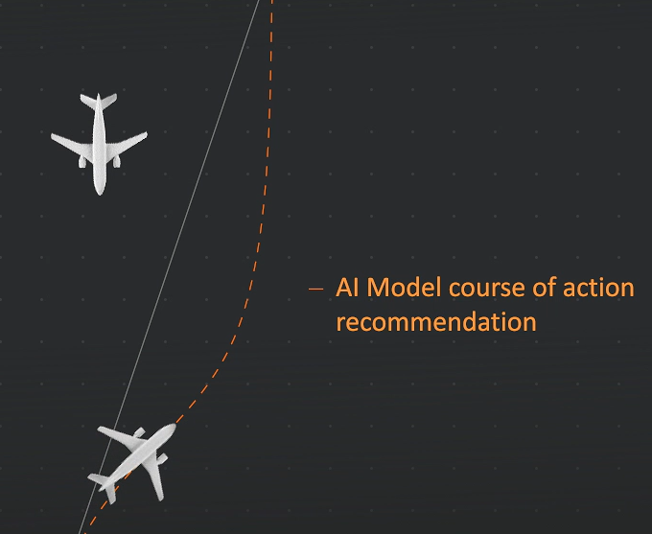
Results
AI Model successfully separates aircraft and controls
them safely and efficiently through the sector.
Notes:
4D chess
Model forecasts airspace in future
Rule based course of action recommendation based on aircraft characteristics
”Bring back to course” functionality
Successful separation as well as safe and efficient control

Slide 5
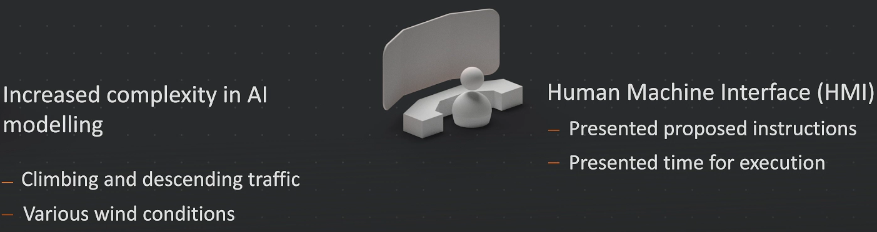
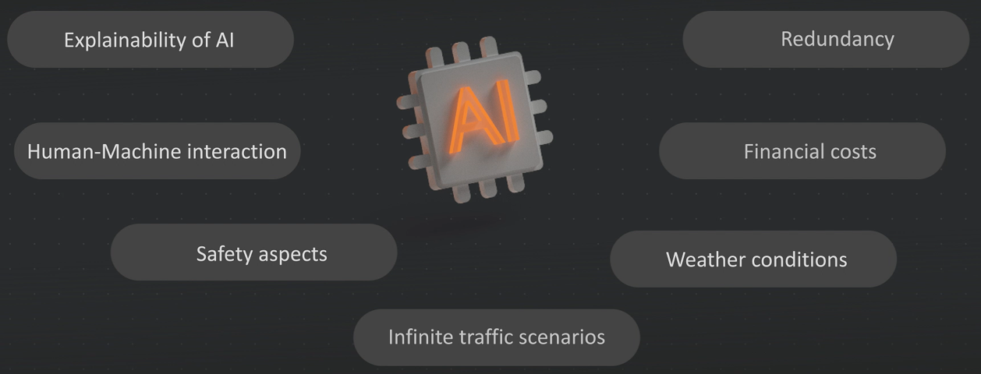
Future challenges
Notes:
Continue to increase complexity
Continued focus on full automation but with HMI aspects in mind
Iterative/agile development

Slide 6



Learning points

Slide 7
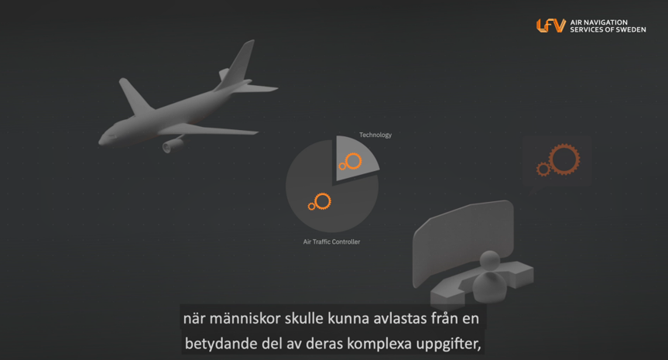
https://www.lfv.se/en/news/news-2020/ai
Thank you! robin.hughes@ri.se , robin.hughes@lfv.se, linkedin.com/in/robin-hughes-955a3a22

