Slide 1

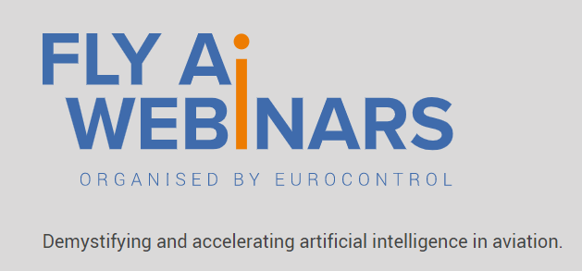


Fly AI Webinar #2. R&I in AI for Aviation. A Defence View
© GMV - All rights reserved

Slide 2
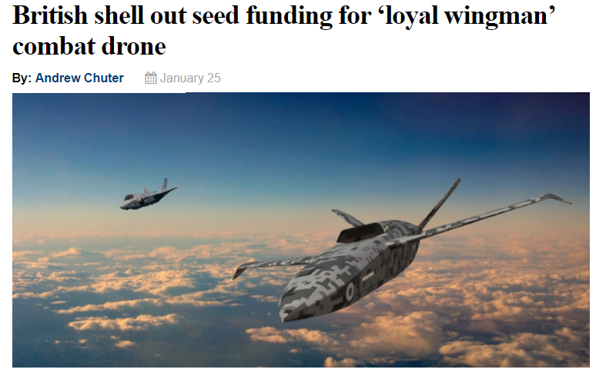
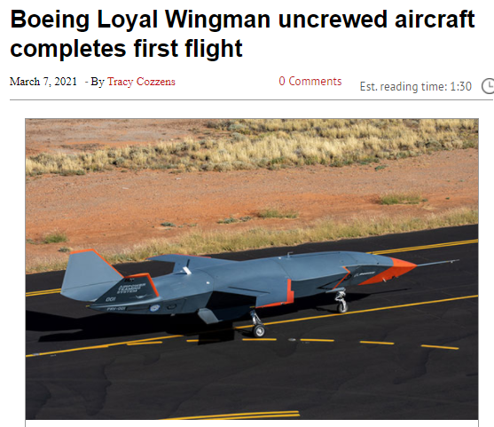
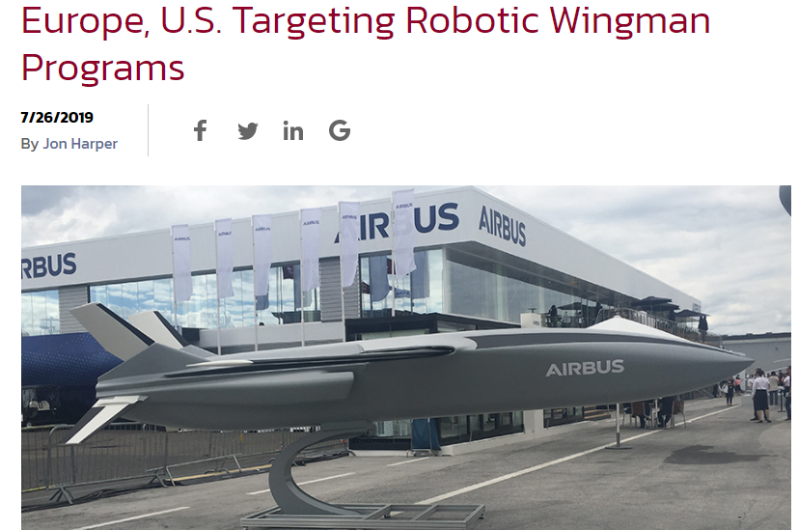
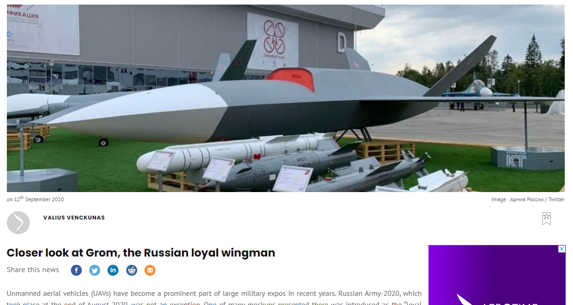
Fly AI Webinar #2. R&I in AI for aviation
Works in progress…
New paradigm: from current UAS to high performance & high autonomy aircraft

Slide 3
Fly AI Webinar #2. R&I in AI for aviation
Drivers for Higher Levels of Autonomy in the Defence domain
Keep low cognitive workload for the pilot of the command aircraft
Resilience to contested environments, in real missions communications are subject to interference
Survivability, implying reactive and deliberative decision making
Survivability, even when the command aircraft has been neutralized
Limited information of the environment, requiring self adaptation (unstructured environments)
Technology Challenges
Keep human-in/on-the-loop. Critical for effector management.
Certification of AI in mission critical and safety critical applications – dependability
Be accepted by the pilot and operational commanders – trustworthiness
Lack of data sets for AI training, intensive use of modelling and simulation

Slide 4
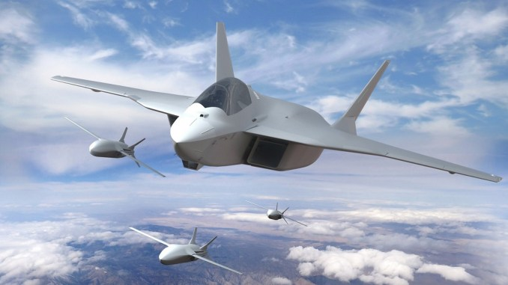
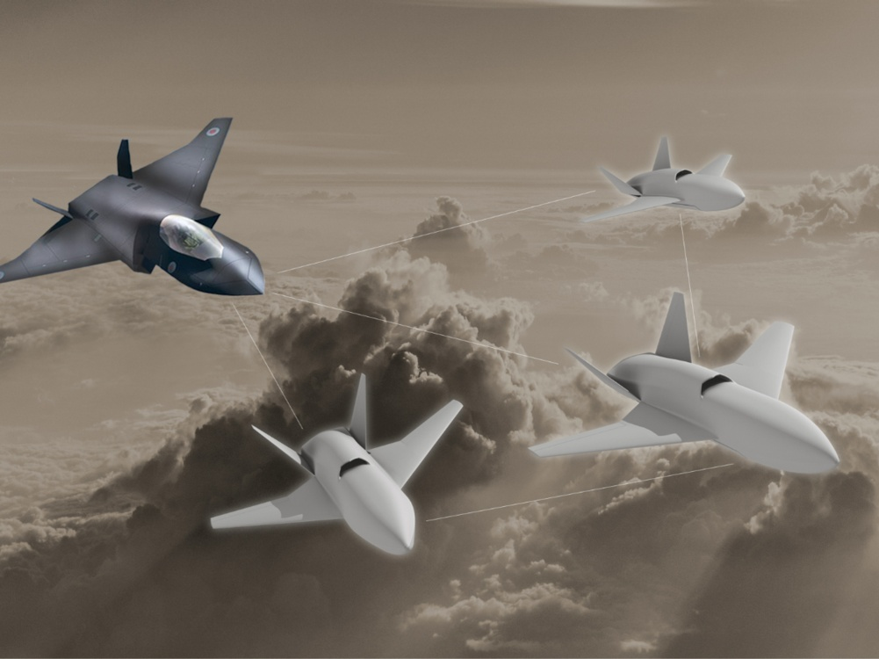
Fly AI Webinar #2. R&I in AI for aviation
R&I Defence initiatives in Europe
FCAS Programme Remote Carrier. France, Germany, Spain
TEMPEST Programme LANCA. UK, Italy, Sweden
EDIDP DRONEDGE-E
EDIDP iMUGS (UGVs)
PADR OCEAN2020
EDA/ESA ATENA AI for Terrain Relative Navigation in Unknown Environments
EDA AI in Guidance, Navigation and Control for Aerial Applications (AI-GNCAIR)
EDA Safe Autonomous Flight Termination (SAFETERM)
(*) excluding national R&D programmes
PADR European Commission Preparatory Action on Defence Research
EDIDP European Commission European defence industrial development programme
Image courtesy of Airbus. https://www.airbus.com/newsroom/stories/Future-Combat-Air-System-Owning-the-sky-with-the-Next-Generation-Weapons-System.html
Image courtesy of Team Tempest https://www.raf.mod.uk/what-we-do/team-tempest/

Slide 5


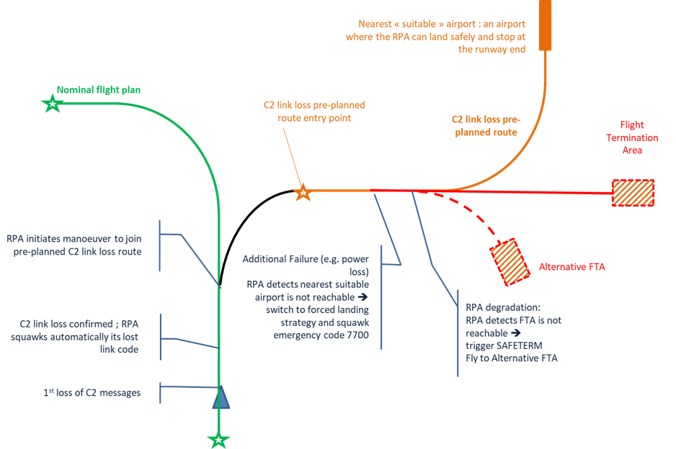
SAFETERM – Safe Autonomous Flight Termination
EDA OB PROJECT - 19.ISE.OP.200
Project Scope
SAFETERM is aimed at enhancing current Medium Altitude Long Endurance (MALE) and large tactical Remotely Piloted Aircraft System (RPAS) Flight Termination Systems and procedures
SAFETERM is assessing and validating the different technological and certification approaches in order to ensure a predictable yet adaptive RPAS behaviour in case of emergency leading to a Flight Termination
SAFETERM primary mission consists on locating autonomously a suitable location to terminate a flight, in case of multiple failures minimizing the threats to population
SAFETERM aim: RPAS to behave as “Sully”

Slide 6
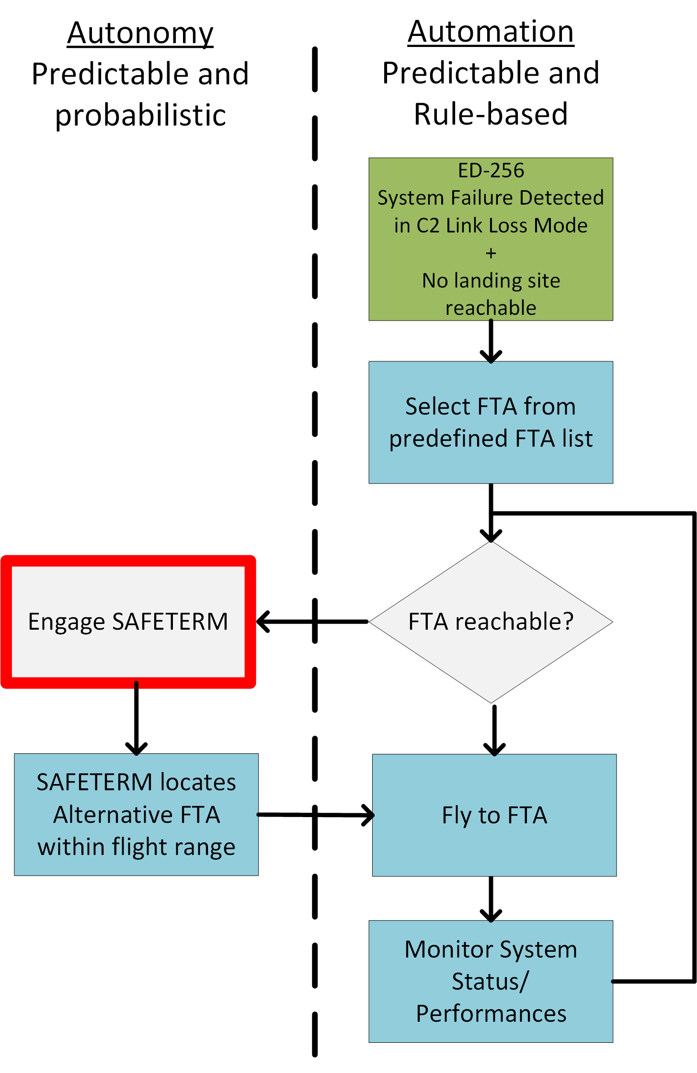
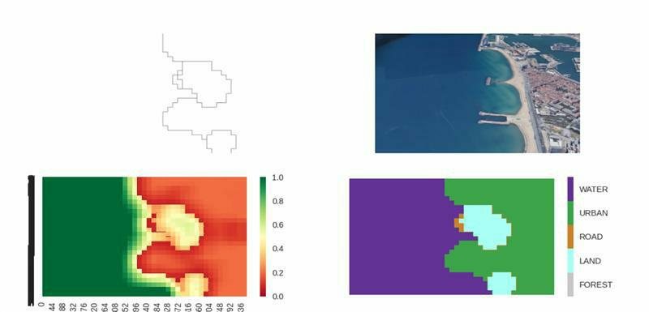
Safe Autonomous Flight Termination
Technology
SAFETERM team is exploring the use of state of the art Artificial Intelligence/Machine Learning technologies to enable a higher autonomy level for RPAS in emergency situations
Selection of the Alternative Flight Termination Area (AFTA) obeys to the following criteria:
Minimize ground damage and casualties
If possible, land the RPA instead of crashing within the AFTA
Criteria to prioritize the termination areas:
        Large body of water
        Large flat ground area
        Smaller flat ground area

Slide 7
TECHNOLOGY CHALLENGES
Major Areas for Future Development
  CERTIFICATION
  EXPLANABILITY
  VERIFICATION
  DEPLOYMENT
  TRAINING
  Certification roadmap is under study. The procedures for creating safe instances of AI systems is being discussed in various groups such as SAE/EUROCAE G34
  The approach focuses on Learning Assurance
  Decisions made by AI Systems need to be understood in order to validate the functions to be executed and ensure safety
  Self explanatory AI algorithms are needed in order to assess how the AI algorithm is processing data
  Resilience and robustness need to be verified for aeronautical applications
  Adversarial and variational examples need to be produced for assessing algorithm behaviour
  Lightweight images of AI algorithms need to be produced to run on aeronautical platforms while ensuring that the HW is compliant with safety requirements
  Offline training, FPGA acceleration, partitioning, synchronization, etc
  Gathering of extensive datasets are required for adapting algorithms to real Systems
  Variations of terrain, sensors, payloads, flight constraints, etc

Slide 8

Fly AI Webinar #2. R&I in AI for aviation
Thank you
Ricardo Sáenz Amandi
Defence and Security Programmes Director
Email: rsaenz@gmv.com
www.gmv.com
© GMV – All rights reserved

