Slide 1
Automatic Speech Recognition for ATCo Support
An application of Artificial Intelligence and its steps from the Idea to Exploratory Research to Industrial Research
Hon. Prof. Dr. Hartmut Helmke,
German Aerospace Center, DLR
Project Lead of AcListant®,
AcListant®-Strips,
PJ.16-04-ASR-W1,
MALORCA, HAAWAII

Slide 2
How many training data is used by Google for training their speech recognizer?
300 hours
3,000 hours
30,000 hours
300,000 hours
3,000,000 hours

Slide 3
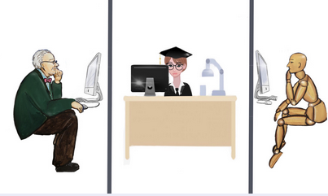
What is Artificial Intelligence?
“Artificial Intelligence is the development of computer systems that are able to perform tasks that would require human intelligence” Schetinin et al. (2018)
In 1940s / 1950s a system multiplying numbers faster than a human was intelligent.
During the 1980s / 1990s: it was chess playing.
Now, we think autonomous cars or zero-person-cockpits are intelligent systems.
Turing-Test

Slide 4
Application Areas of
Artificial Intelligence
Computer Vision
Natural Language
Processing
Machine Learning
Robotics
Unsupervised Learning
Supervised Learning
Automatic
Speech Recognition
Behaviour Prediction
(Deep) Neural Networks
Reinforcement Learning
Expert Systems
Planning & Optimization
DLR Applications with respect to Speech Recognition

Slide 5



Automatic Speech Recognition & Understanding for Air Traffic Management Applications
Aircraft: THY5KJ, DLH3ER
Commands:
THY5KJ DESCEND 3000 ft
THY5KJ REDUCE 180 kt …
Assistant Based Speech Recognition
hello good morning
turkish five kilo juliet
reduce one sixty or greater
descent three thousand feet
Surveillance Data, Flight Plan Data
Weather Data
Command Prediction
TYK5KJ
Voice To Text
Concept Recognition
30
ATCO
Avoid manual input
Reduce ATCo workload
THY5KJ REDUCE 160 none OR_GREATER
THY5KJ DESCEND 3000 ft
M. Kleinert, H. Helmke, H. Ehr, Chr. Kern, D. Klakow, P. Motlicek, M. Singh, and G. Siol, “Building Blocks of Assistant Based Speech Recognition for Air Traffic Management Applications,” 8th SESAR Innovation Days, Salzburg, Austria, 2018.

Slide 6

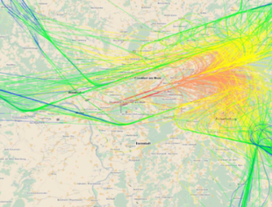


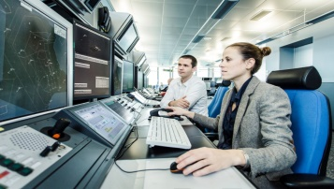
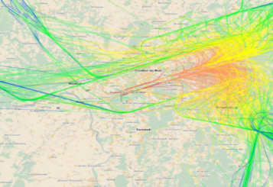



Machine Learning of Speech
Recognition Models for Controller Assistance
Dusseldorf
Assistant
Based
Speech
Recognition
Arthur Samuel (1959):
Machine learning is the field of study that gives computers the ability to learn without
being explicitly programmed”
Group of experts
Prague, Vienna
Instead of (highly skilled and paid) experts, machine learning is used.
Assistant
Based
Speech
Recognition
Radar Data
Voice Recordings
Automatic Learning
Process
H. Helmke, O. Ohneiser, J. Buxbaum, and C. Kern, “Increasing ATM efficiency with assistant-based speech recognition,” 12th USA/Europe Air Traffic Management Research and Development Seminar (ATM2017), Seattle, Washington, USA, 2017.

Slide 7





Speech Recognition and Machine Learning Roadmap
Machine Learning
SESAR PJ16-04
Pilot, Ops-Room
Prague: 0.6%
Vienna : 3.2%
Tower
Prediction
Vienna Ops Room
ASR
COTS
Ontology
60 l, Workload Reduction
95%
AcListant®-Strips
#97 Remote Tower
2014 2015 … 2018 2019 2020 … 2022
From Exploratory Research to Industrial Research to the Future in the Ops Room
J. Rataj, H. Helmke, O. Ohneiser: “AcListant® with Continuous Learning: Speech Recognition in Air Traffic Control”
in Lect. Notes Electrical Eng., Vol. 731, (Ed): AIR TRAFFIC MANAGEMENT AND SYSTEMS IV, 978-981-33-4668-0, 488801_1_En (6)

Slide 8

compared to
Google (US company) uses
300,000 hours of
training data
*
22 hours of voice recordings from Prague

Slide 9
Thank you very much for your attention

Slide 10
How many training data is used by Google for training their speech recognizer?
Google has used 13,000 times more training data than
MALORCA for Vienna resp. Prague
(300,000 versus 22 hours).
300 hours
3,000 hours
30,000 hours
300,000 hours
3,000,000 hours

