Slide 1
ADAPT Advanced prediction models for flexible
trajectory-based operations
Tatjana Bolic, Lorenzo Castelli
Università degli Studi di Trieste
15 June 2020

Slide 2





Overview
Current flight and capacity planning
ADAPT objectives
Models and model testing
Data Visualisation Tool

Slide 3
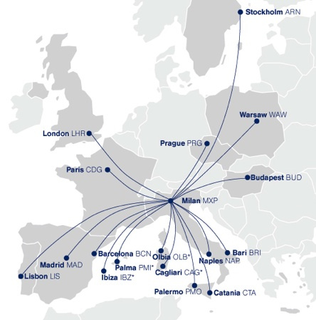
Current flight and capacity planning in European ATM system
Airlines
  Schedule known six months ahead

Slide 4
Current flight and capacity planning in European ATM system
Airlines
  Schedule known six months ahead
  Trajectory planning flexible
ANSPs
  Initial rosters
  Updates
Day of operations
Initial roster
12 months ahead
Initial capacity
Updates
Historical traffic
Demand – capacity imbalance
Initial flight plan
120-3 hours ahead
Delay
No need to consider airspace capacity

Slide 5
ADAPT objectives
ADAPT designed and tested models
  Provide information on flight flexibility and saturated portions of airspace
  Could enable strategic collaborative planning
To enhance predictability while at the same time preserving and quantifying flexibility
  Predictability through earlier fully shared information on trajectories and airspace capacities
  Flexibility expressed as Time Windows (TW)
Notes:
Predictability is a result of earlier flight planning based on fully shared information on trajectories and airspace capacities.

Slide 6
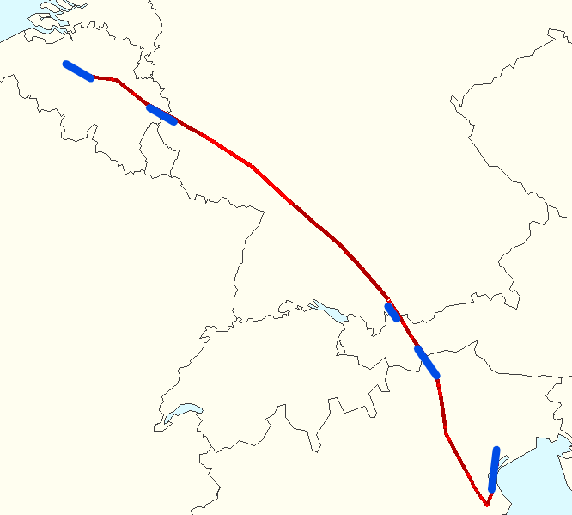
Time Window
The TW is checked for entry into each sector/airport
The smallest TW along the trajectory is assigned to the flight
The duration delineates the degree of flexibility granted to the flight
Assigned departure time/
Sector entry time

Slide 7
Two modelling steps
Assign a trajectory to each scheduled flight:
  Strategic Air Traffic Assignment model
    Trajectories
    Scheduled departure times (TW opening times)
      Respect the capacity of the network
      Minimise flights’ operational costs
      Guarantee predictability and flexibility
Quantify flexibility
  Time Windows model (TW duration)

Slide 8
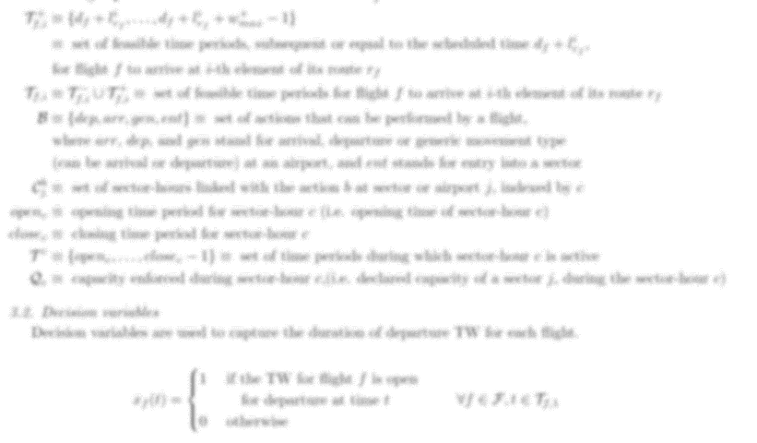



Models
…
…
…
…

Slide 9
Model testing
One day of real air traffic data (DDR2) – 1 September 2017
  30 000 flights
    Aircraft type
    Departure times
    Trajectory options
  Airspace configuration
    As on a day
  Costs

Slide 10
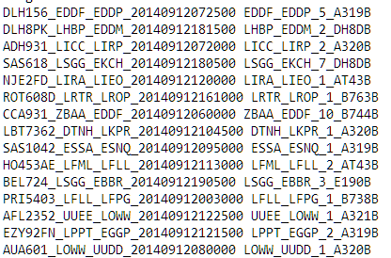
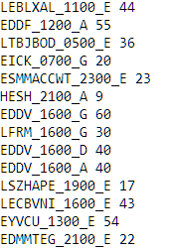
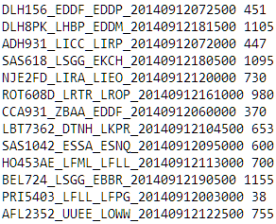
Results
Models work on this scale
Acceptably fast for strategic/pre-tactical time horizon
What can we see from them?

Slide 11
Data visualisation tool
Key concepts:
Constrained flight - the duration of its TWs is shorter than the maximum allowed duration (15 min)
Saturated (critical) sector-hour - the capacity limit has been reached
Criticality index - measures the degree of criticality of a sector-hour as the total additional number of the time periods that all flights constrained by the same sector-hour would have if it had sufficient capacity

Slide 12
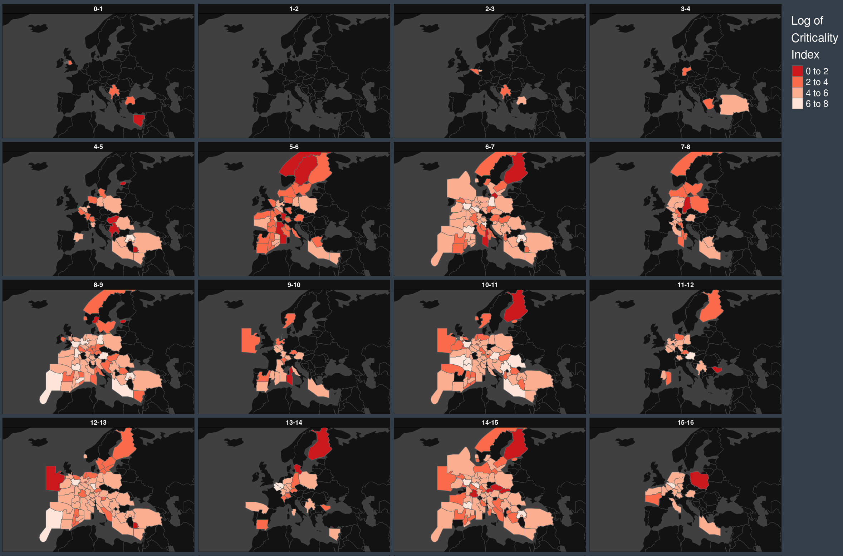

Slide 13
Thank you for your attention!
ADAPT project website:
  https://adapt-h2020.eu/
ADAPT Data Visualisation Tool:
  https://visualization.adapt-h2020.eu/
Tatjana Bolic – tbolic@units.it

